Slide 2
Notes:
We all know a bunch of words. (random notes)
Some people are really easy to follow when they speak (slow scale) You know exactly where they are going and you don’t have to work to understand.
Others….not only doesn’t it make sense (random) but it can be painful (minor chords)
When it comes to putting together an important message, how can we thoughtfully compose it so that it’s effective and easy for the listener to understand their melody.

Slide 3
www.DistinguishedComm.com

Slide 4
3 Keys to
Effective Presenting
1. Credibility
2. Connection
3. Construction

Slide 5
1. Credibility
Appearance
Body Language
Voice

Slide 6
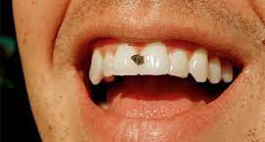

Slide 7
1. Credibility
Appearance
Body Language
Voice

Slide 9
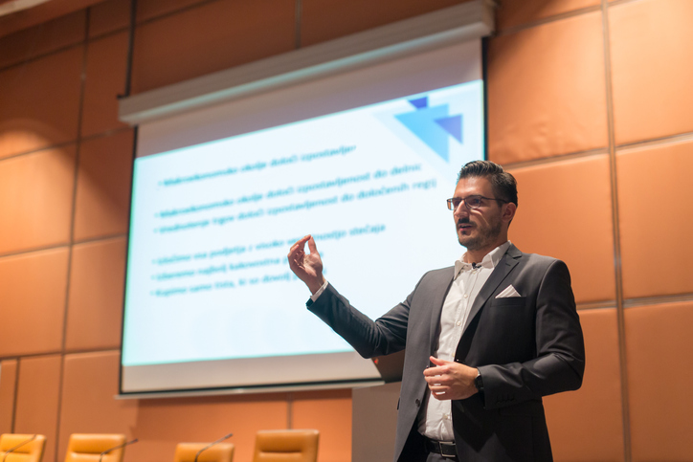

Slide 10
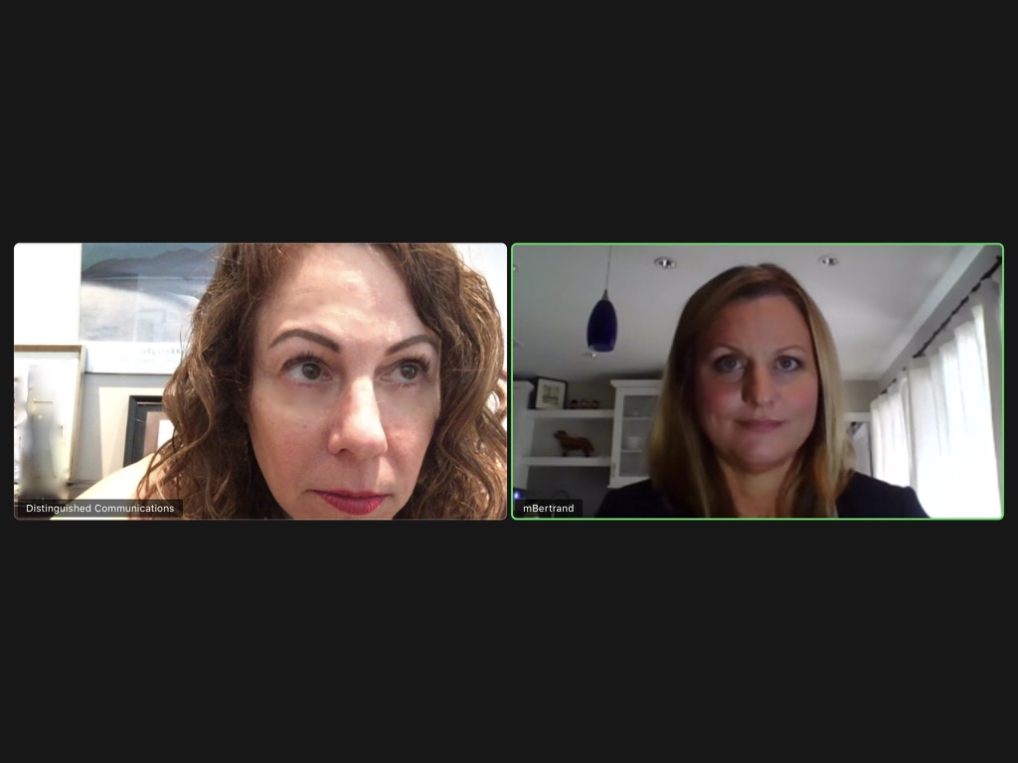

Slide 11
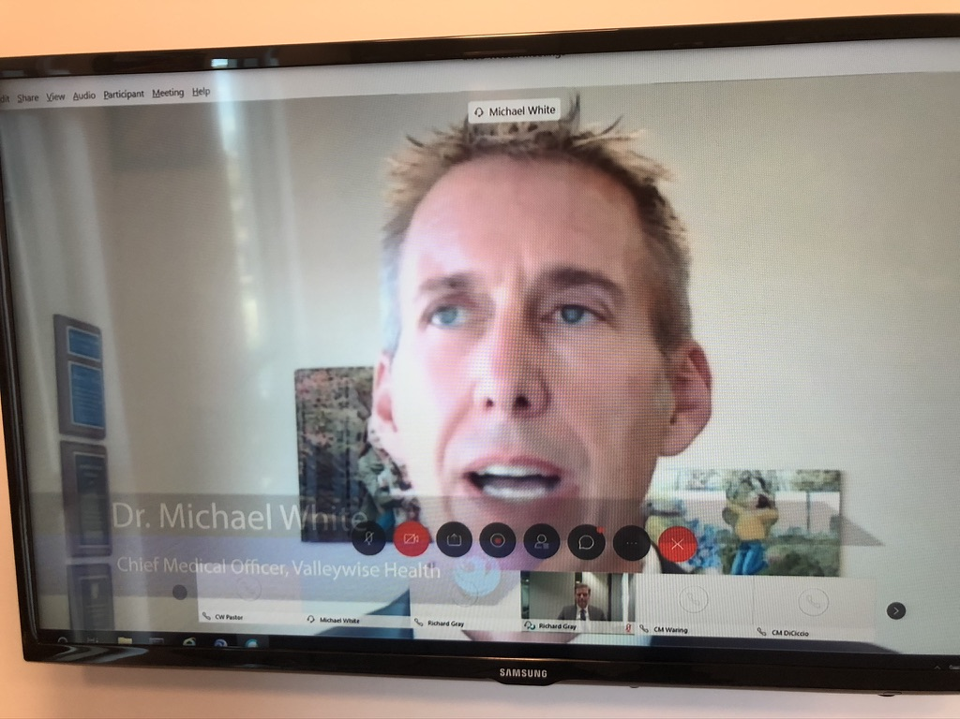

Slide 12
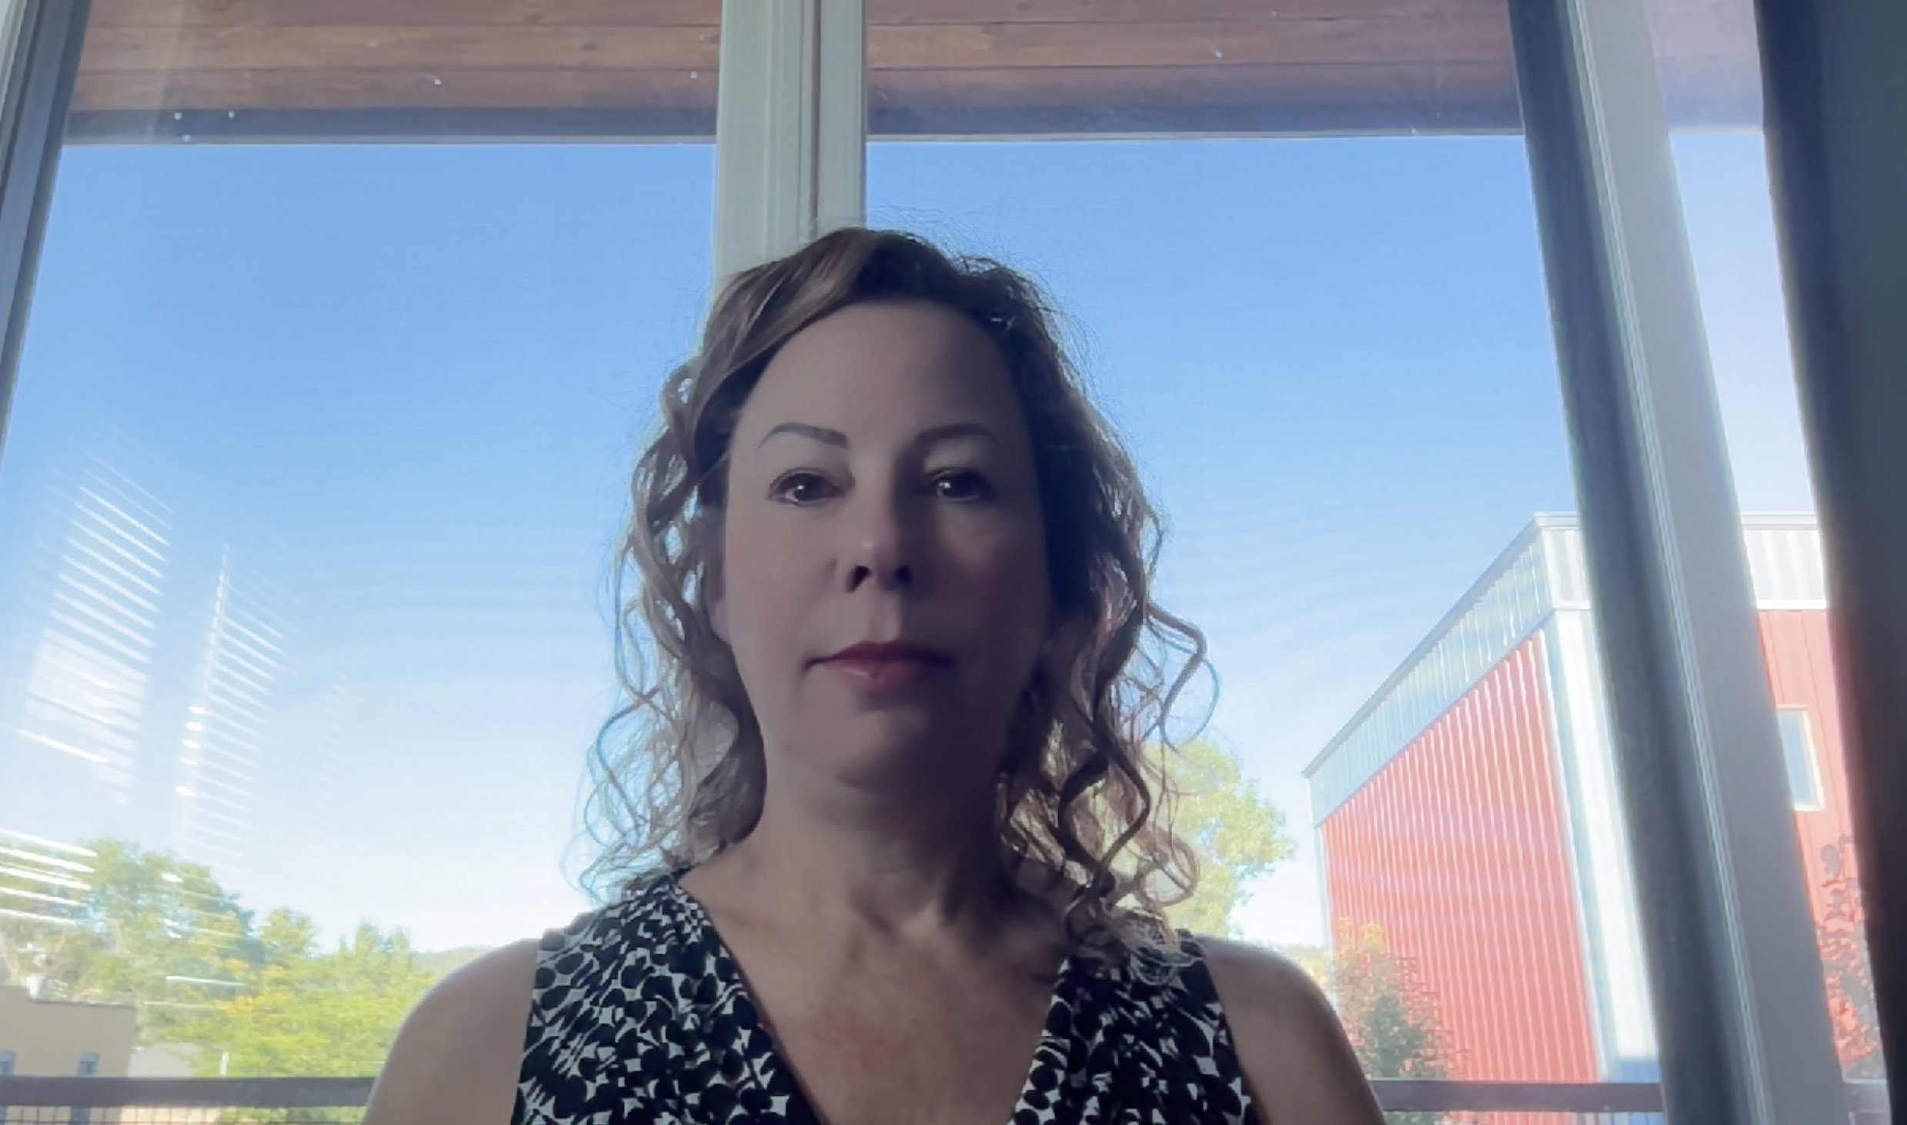
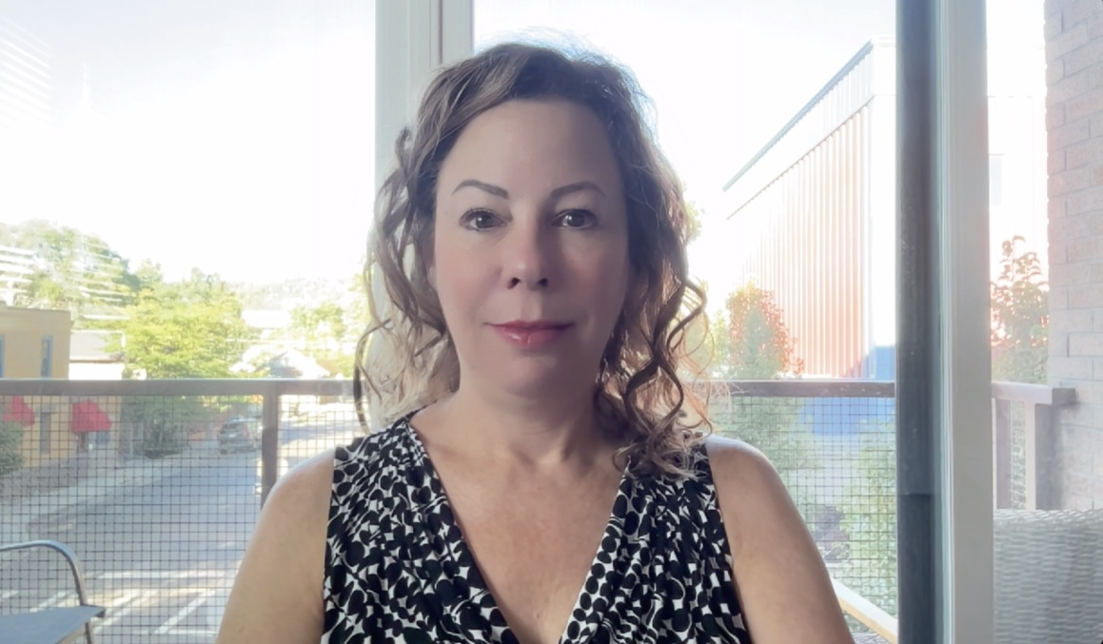

Slide 13
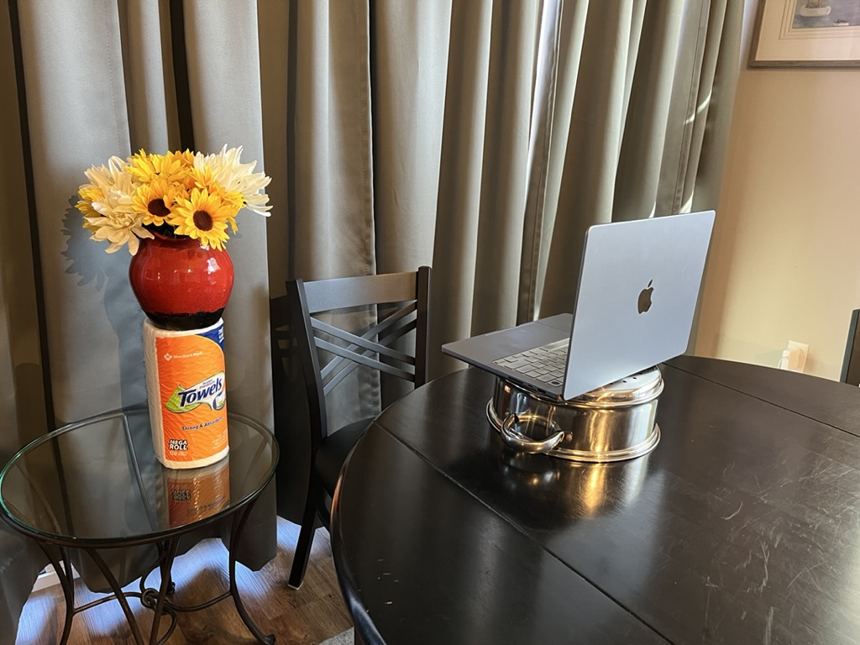
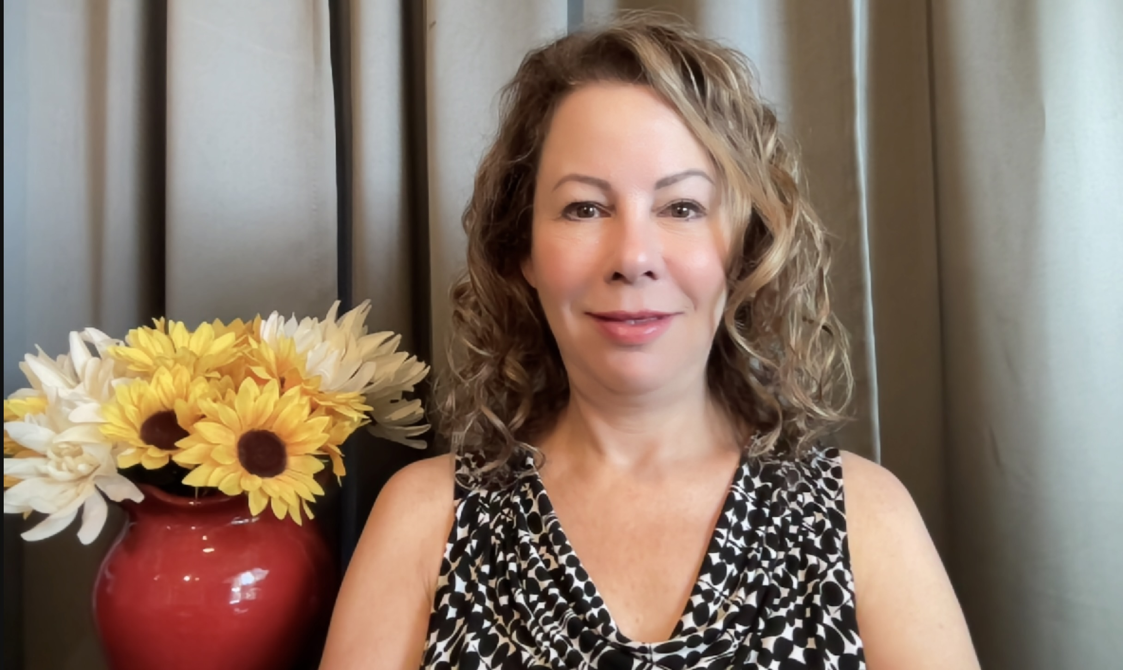

Slide 15
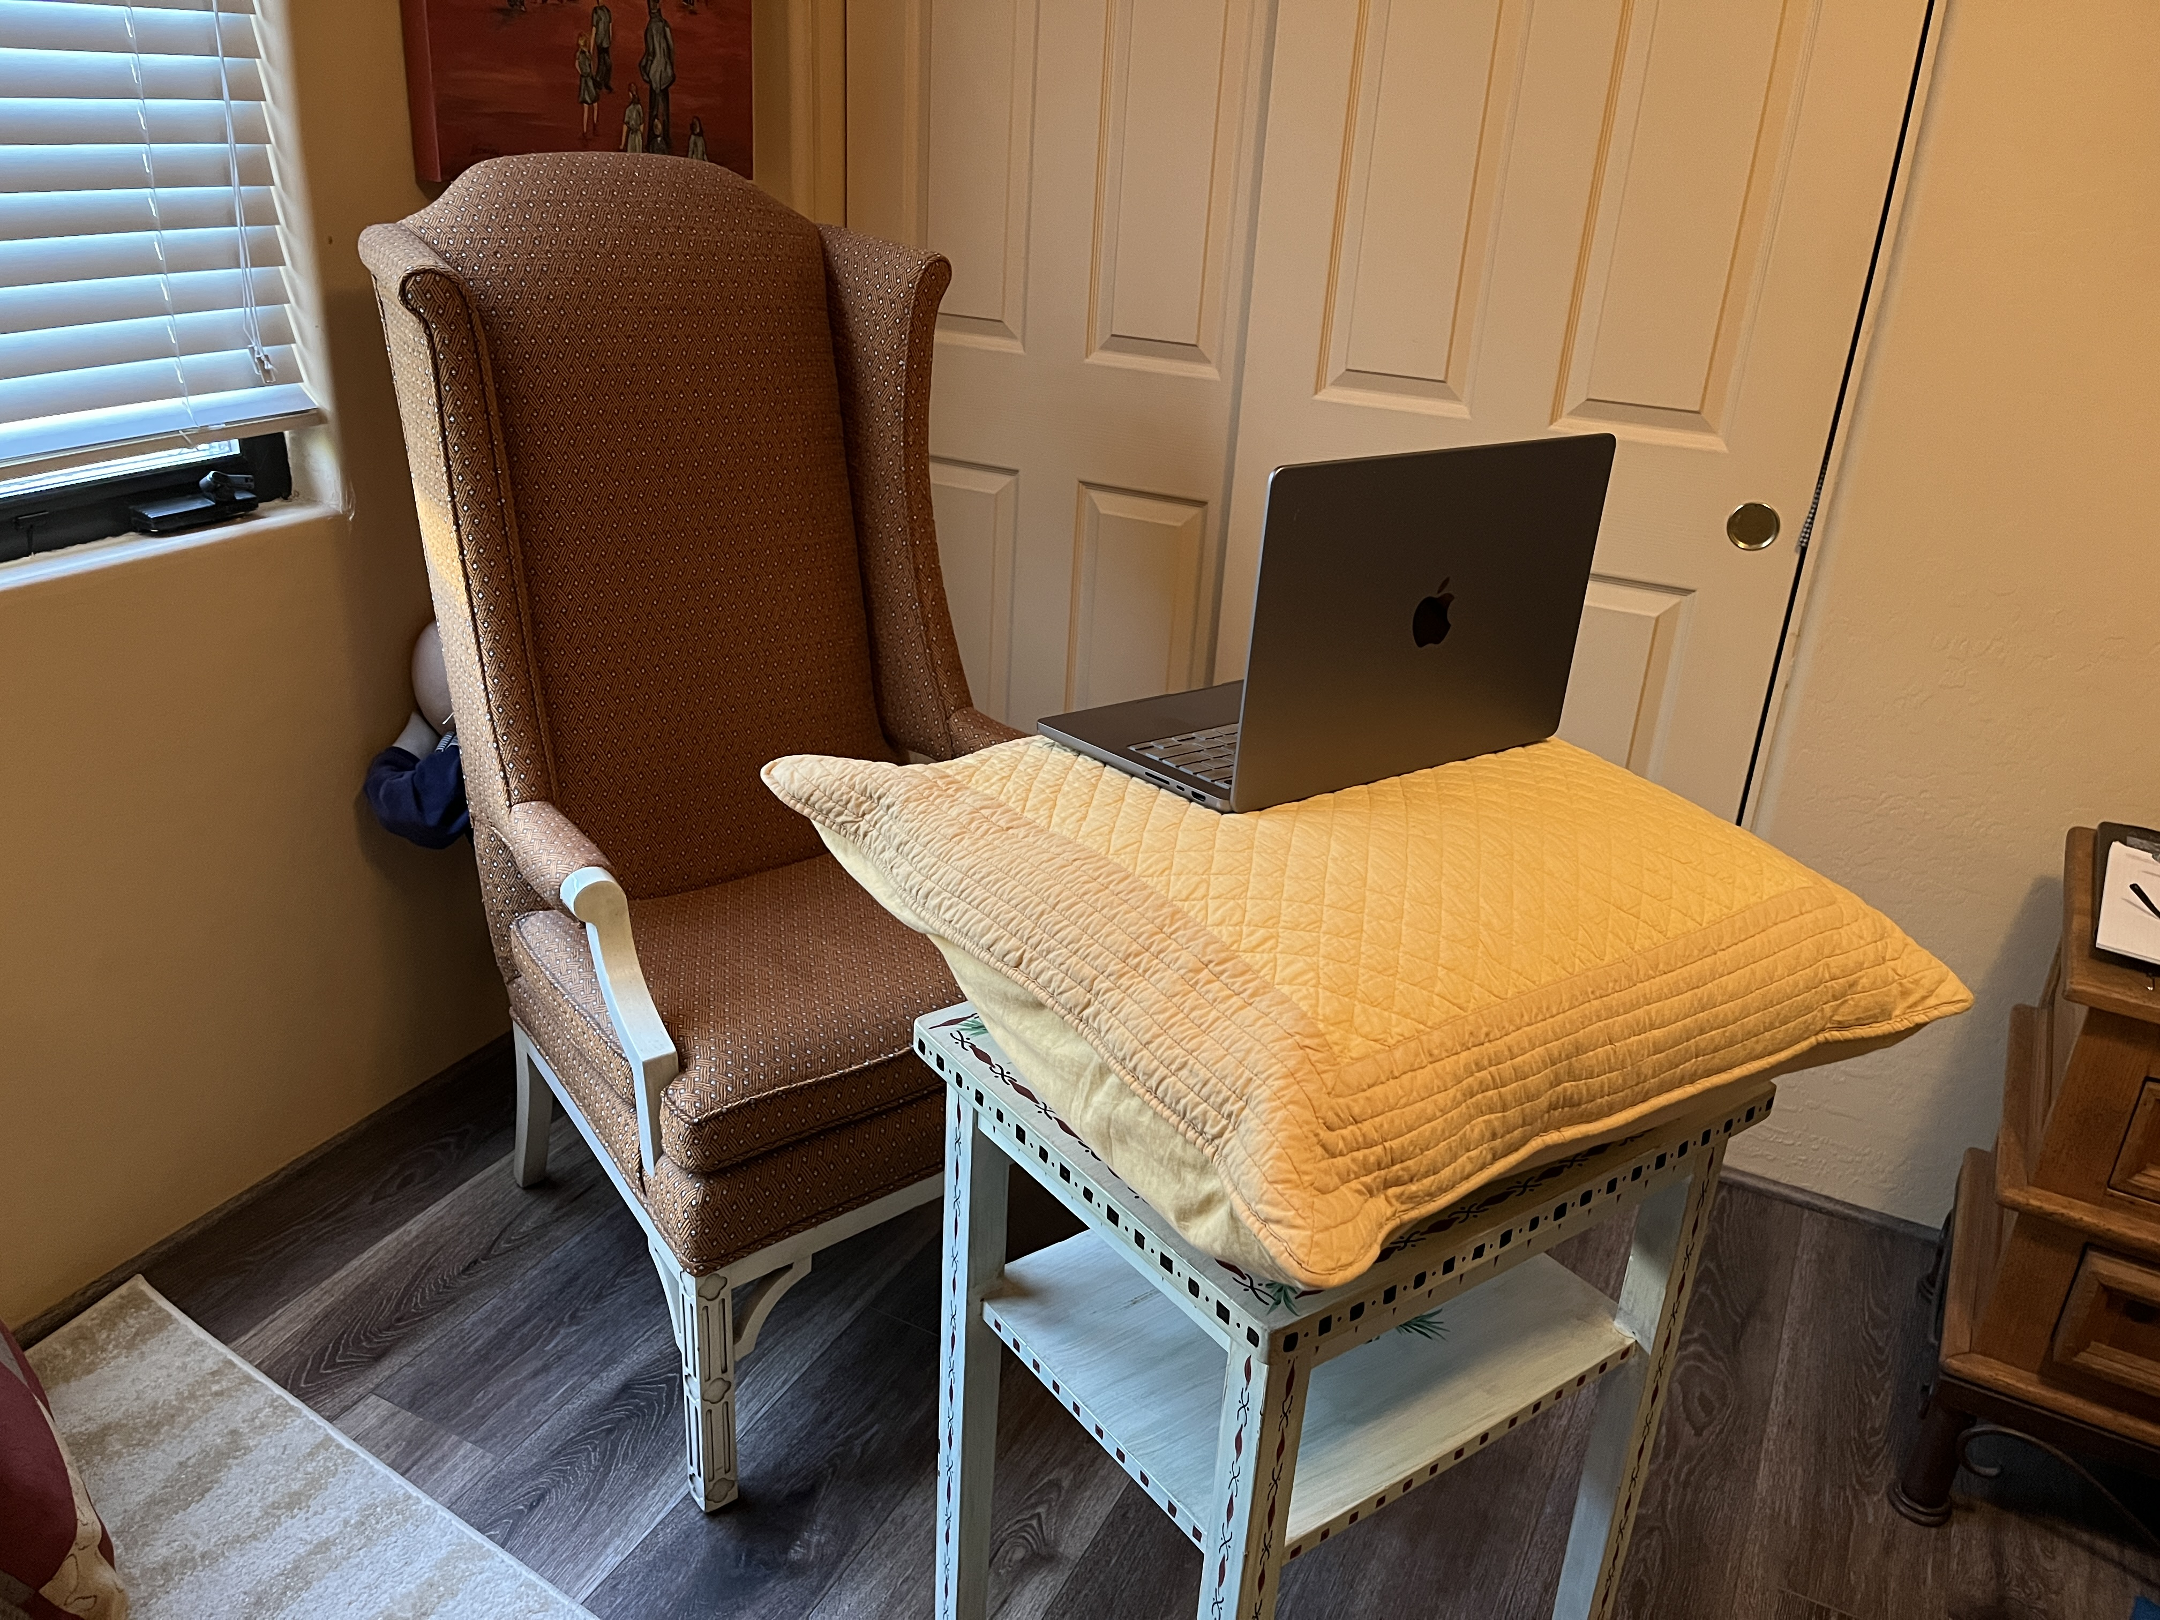

Slide 16
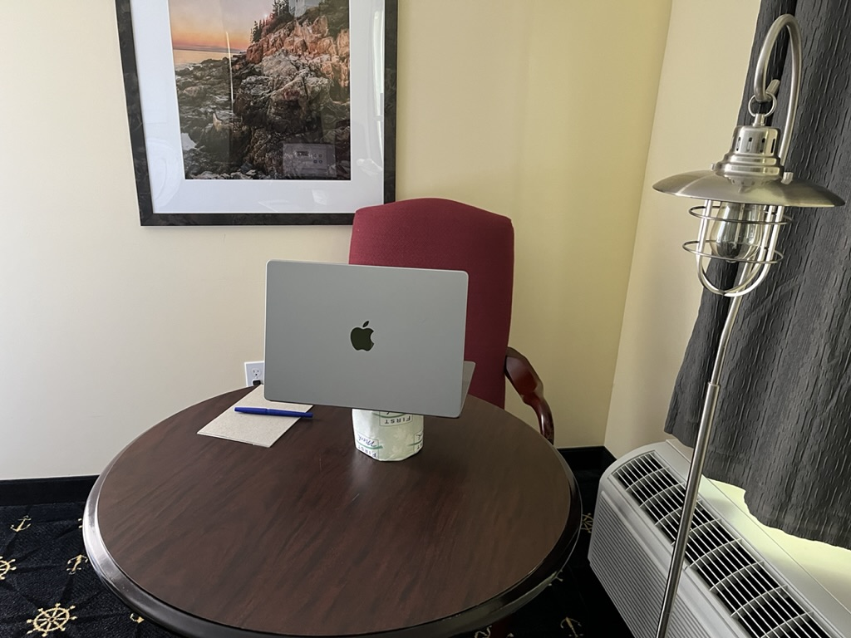

Slide 17
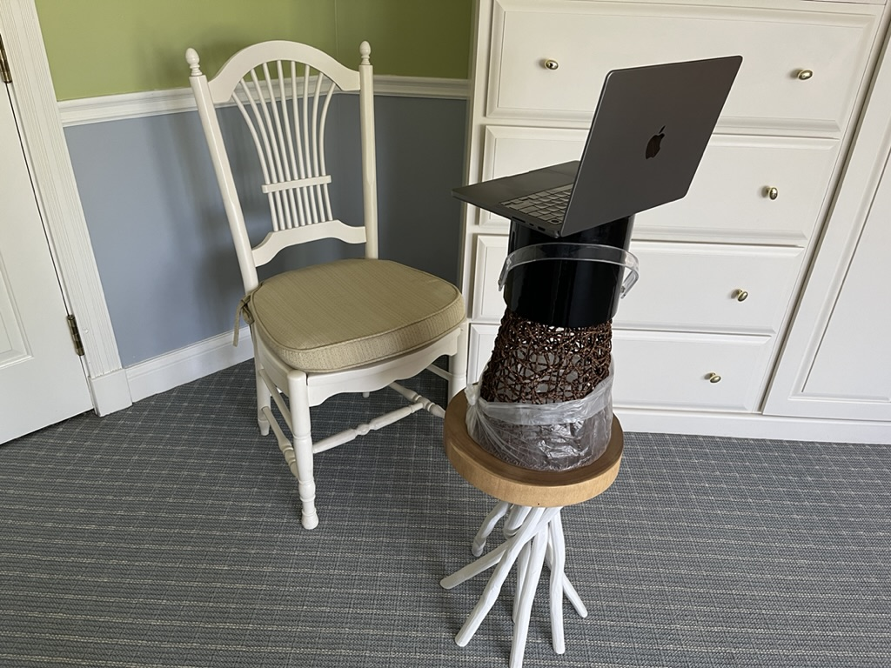

Slide 18
1. Credibility
Appearance
Body Language
Voice

Slide 20
2. Connection
Power Point

Slide 23
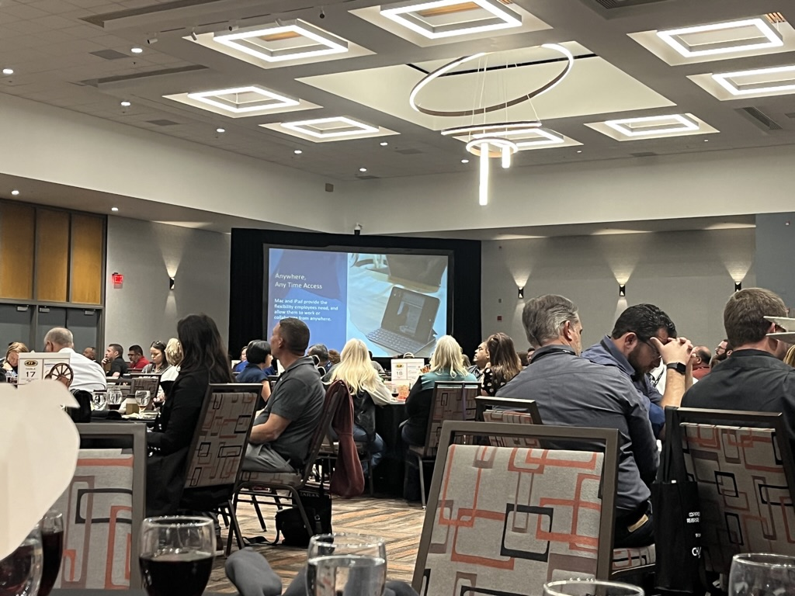

Slide 24
1. Credibility
Appearance
Body Language
Voice

Slide 25
1. Credibility
Credibility is based on many more factors than just background and education. It comes through in other ways that are important to think about such as those listed below:
Appearance
Presenters are judged on their appearance such as hair, clothing, etc. which can impact the outcome of an interaction.
Body Language
How one stands or appears on camera when communicating can send a message to the audience about the presenter’s level of confidence and investment in the subject matter.
Voice
It’s nearly impossible to fake passion or enthusiasm; the client can almost always tell. So, it’s important to find the information that resonates with you as a presenter in order to convey it to the audience in the most authentic way.

Slide 26
What’s in a Message?
Voice
Body Langauge
Words

Slide 27
What’s in a Message?
Voice
Body Language
Words

Slide 28
3 Keys to
Effective Presenting
1. Credibility
2. Connection
3. Construction

Slide 29
3. Construction
How do you “Enter” the Communication?
Distinguished Communications®

Slide 30
How to Make a Winning Presentation
Presented by:
Deborah Ostreicher
Distinguished Communications
August 24, 2023
www.DistinguishedComm.com

Slide 31
Notes:
We all know a bunch of words. (random notes)
Some people are really easy to follow when they speak (slow scale) You know exactly where they are going and you don’t have to work to understand.
Others….not only doesn’t it make sense (random) but it can be painful (minor chords)
Just like musical notes

Slide 32
3. Construction
Use the rule of 3
Enter
Enlighten
Distinguished Communications®

Slide 33
Eligible Activity
Assisting persons who are experiencing or At risk of homelessness, including, but not limited to:
–Rapid rehousing or rental assistance
–Supportive services and case management services that allow people to obtain and retain housing
–Operating costs for navigation centers
–Development of navigation centers
–Construction, rehabilitation, or preservation of permanent or transitional rental housing
Note:
At least 10% of the units in the project have to be restricted to tenants who are homeless or at risk of homelessness
homeless providers are not required to be a co-applicant, but they are permitted to be
Housing Department
Notes:
Please note that homeless providers are not required to be a co-applicant, but they are permitted to be. If the local government is not developing the navigation centers themselves and they apply without the owner of the property, then the required supporting documentation will not be in the name of the local government and will not be acceptable.

Slide 34
Eligible Activity
Assisting persons who are experiencing or At risk of homelessness, including, but not limited to:
–Rapid rehousing or rental assistance
–Supportive services and case management services that allow people to obtain and retain housing
–Operating costs for navigation centers
–Development of navigation centers
–Construction, rehabilitation, or preservation of permanent or transitional rental housing
Note:
At least 10% of the units in the project have to be restricted to tenants who are homeless or at risk of homelessness
Homeless providers are not required to be a co-applicant, but they are permitted to be
Housing Department
Notes:
Please note that homeless providers are not required to be a co-applicant, but they are permitted to be. If the local government is not developing the navigation centers themselves and they apply without the owner of the property, then the required supporting documentation will not be in the name of the local government and will not be acceptable.

Slide 35
Eligible Activity
For people currently or at risk of homelessness:
Rapid rehousing or rental assistance
Services to obtain and retain housing
Ops and devel. costs for nav centers
Construction, rehab., preservation of permanent or transitional rental housing
10% homeless or at risk of homelessness
Providers not required to be co-applicant
Housing Department
Notes:
Please note that homeless providers are not required to be a co-applicant, but they are permitted to be. If the local government is not developing the navigation centers themselves and they apply without the owner of the property, then the required supporting documentation will not be in the name of the local government and will not be acceptable.

Slide 36
Eligible Activity
Housing Department
Rehousing
Rental
Nav. Ops.
& Devel.
Const. Rehab.
Preserve
Services:
Obtain/Retain
Notes:
At risk of homelessness:
Rapid rehousing or rental assistance
Services to obtain and retain housing
Ops and devel. costs for nav centers
Construction, rehab., preservation of permanent or transitional rental housing
10% homeless or at risk of homelessness
Providers not required to be co-applicant

Slide 37
Eligible Activity
Assisting persons who are experiencing or At risk of homelessness, including, but not limited to:
–Rapid rehousing or rental assistance
–Supportive services and case management services that allow people to obtain and retain housing
–Operating costs for navigation centers
–Development of navigation centers
–Construction, rehabilitation, or preservation of permanent or transitional rental housing
Note:
At least 10% of the units in the project have to be restricted to tenants who are homeless or at risk of homelessness
homeless providers are not required to be a co-applicant, but they are permitted to be
Housing Department
Notes:
Please note that homeless providers are not required to be a co-applicant, but they are permitted to be. If the local government is not developing the navigation centers themselves and they apply without the owner of the property, then the required supporting documentation will not be in the name of the local government and will not be acceptable.

Slide 38
3. Construction
Enter
Enlighten
Exit
Distinguished Communications®

Slide 39
Questions?

Slide 42
www.DistinguishedComm.com

Slide 43
$30 in stores
$15 here today!
Venmo: @DistinguishedComm

Slide 44
Notes:
We all know a bunch of words. (random notes)
Some people are really easy to follow when they speak (slow scale) You know exactly where they are going and you don’t have to work to understand.
Others….not only doesn’t it make sense (random) but it can be painful (minor chords)
When it comes to putting together an important message, how can we thoughtfully compose it so that it’s effective and easy for the listener to understand their melody.

Slide 45
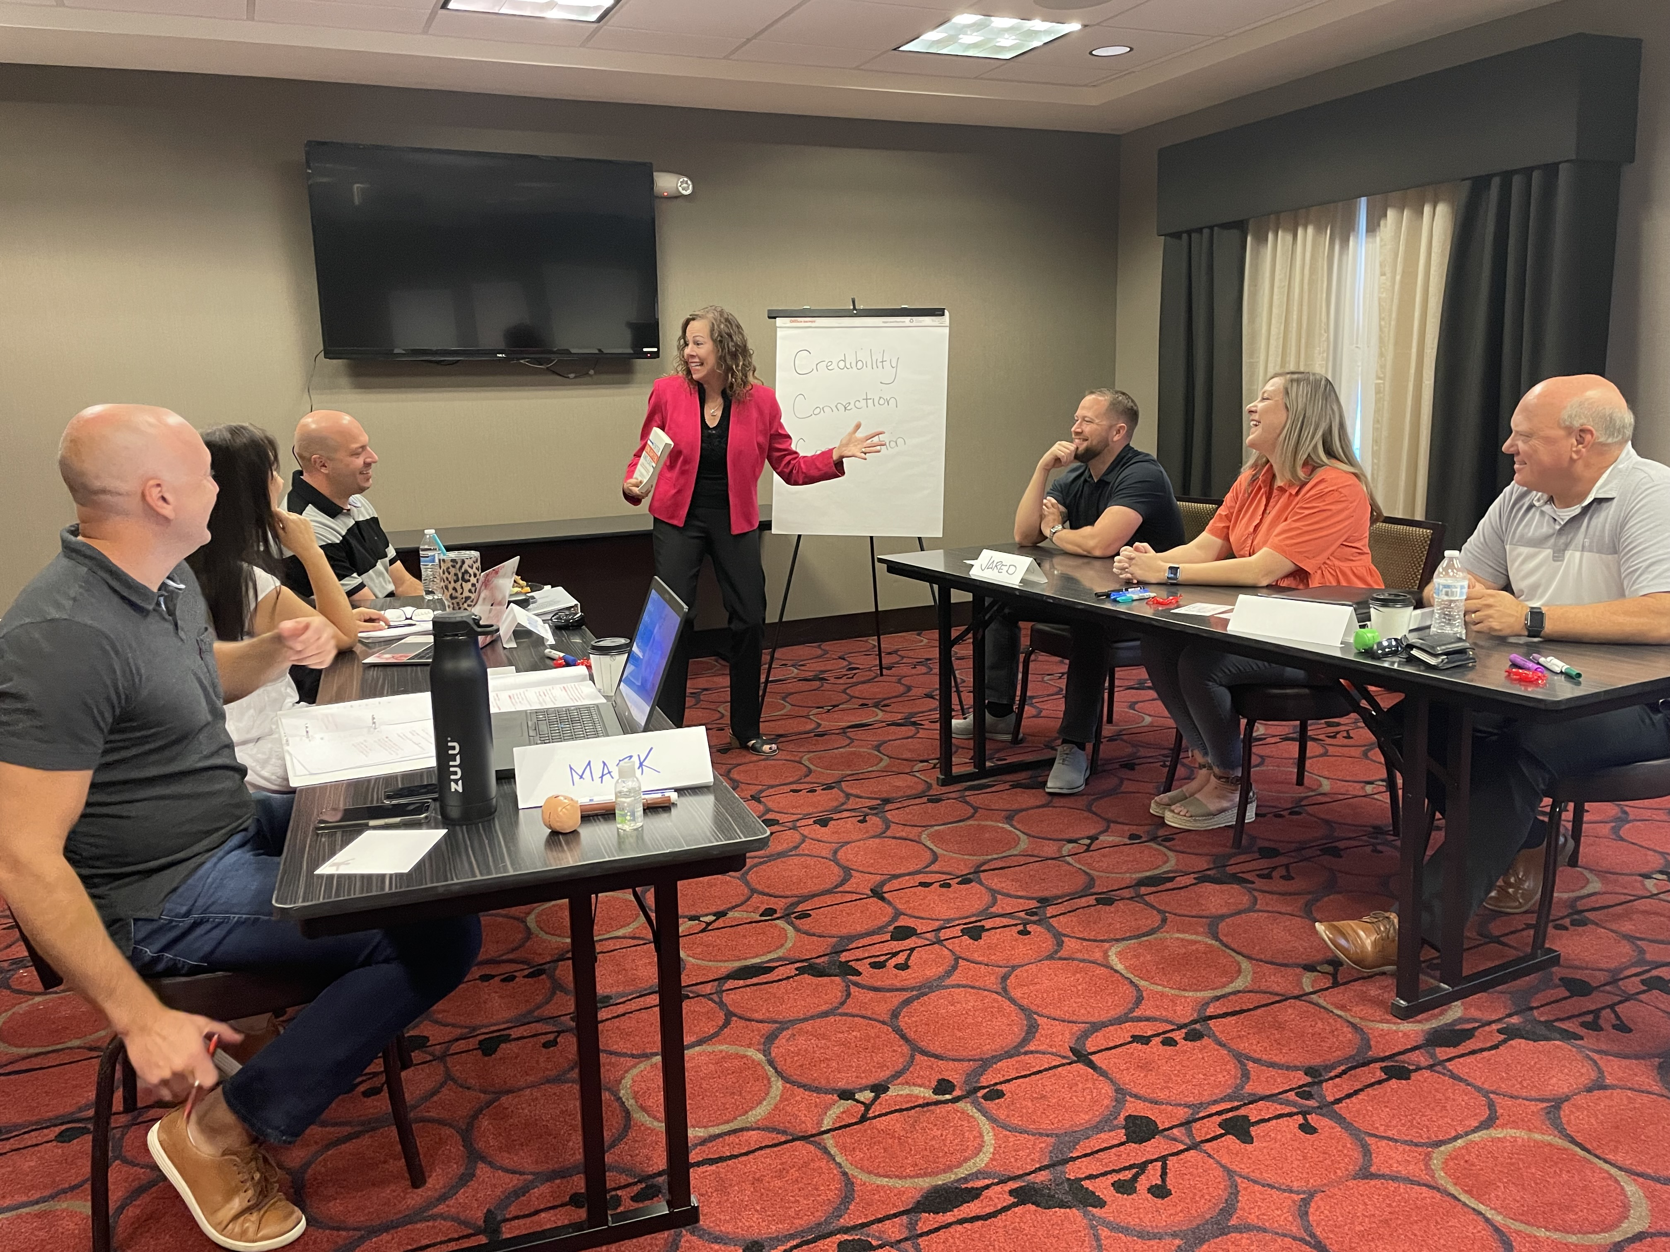
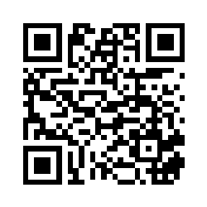
Presentation Boot Camp ~ Phoenix
Sept. 14-15, 2023
Or in your office,
at your convenience!

Slide 46
www.DistinguishedComm.com

