Slide 1
Street to Home: Lessons and Outcomes from a Five Year Interdisciplinary Homeless Outreach Project
Nicole Janich, MSW, PhD
Deirdra Goeth
Will Nieves

Slide 2
Background
5-year SAMHSA grant to house individuals experiencing homelessness
Goals:
enroll 300 participants across five years
move 150 participants into permanent housing
Interdisciplinary Outreach Team:
Navigator
Peer Support Specialist
Peer Guide
Behavioral Health Consultant
Medical Assistant
Nurse Practitioner
Case Manager
Student(s)
Notes:
The Street to Home Project (SHP) was a 5-year grant funded effort to house individuals experiencing homelessness in Tucson Arizona. The project used an interdisciplinary outreach team comprised of a Family Nurse Practitioner, Navigator, Peer Recovery Support Specialist, and Peer Guide.
The population of focus were individuals with the highest levels of vulnerability experiencing chronic homelessness, health conditions, and mental illness.

Slide 3
Working Together since 2018
Old Pueblo Community Services
El Rio Health
Supports 2,000 households per year
Offers outpatient services
11 locations in Tucson
Federally Qualified Health Center
125,000+ patients per year
13 locations in Tucson

Slide 4
Notes:
Will to explain this video and how it is relevant to our presentation
https://www.youtube.com/watch?v=F-n408XAXRk

Slide 5
Street to Home Program
Outreach
VI-SPDAT
Enroll in SHP
Services
Move into Permanent Housing
Benefit enrollment
Case management
Housing navigation
Peer Support
Employment
Eligibility: score of 14 or higher
Notes:
Dee speaking

Slide 6
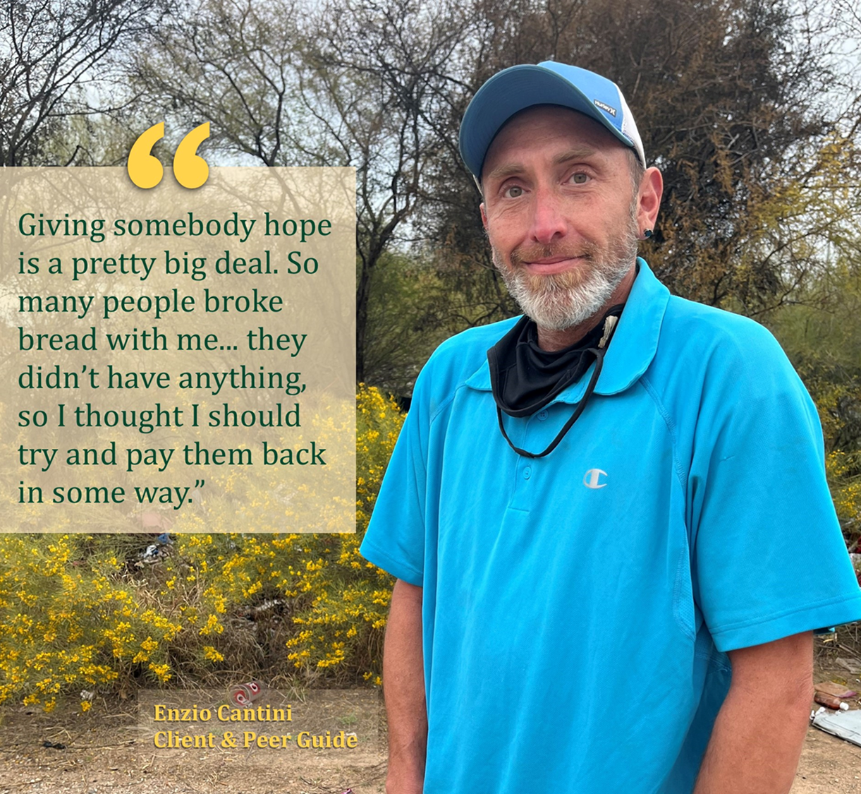
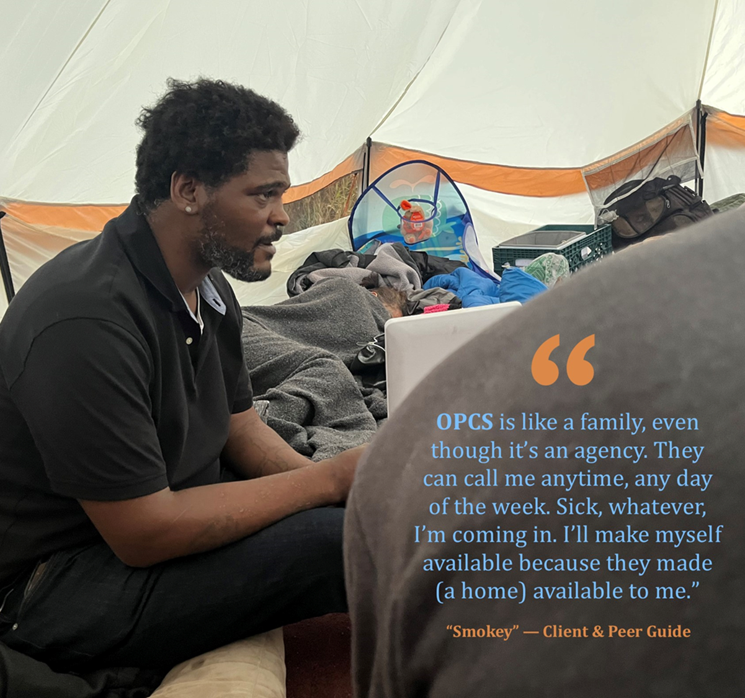
Peer Guides
Notes:
Dee to briefly explain the importance of Peer Guides in our outreach efforts.

Slide 7
Demographics (N=327)
 | n | %
Gender
Female | 169 | 51.7%
Male | 148 | 45.3%
Transgender | 8 | 2.4%
Hispanic | 120 | 36.7%
Race
Black/AA | 28 | 8.6%
White (non-Hispanic) | 170 | 52.0%
Asian | 1 | <1%
American Indian | 19 | 5.8%
NH/PI | 2 | <1%
48%
Screened + for SUD
4
Average years homeless
13%
Identified as LGBTQIA+
Notes:
Nicole speaking
Just over half the participants were female and white. About a third were Hispanic.
42 (13%) of participants identified as LGBTQIA+, 8 of whom identified as Transgender.
34 Lesbian/Gay/Bisexual/Pansexual/Asexual
8 Transgender
About half screened positive for substance use disorders. And the average number of years homeless was 4 years.

Slide 8
Successes
2,272 contacted by Interdisciplinary Outreach Team
327 enrolled in the program
260 permanently housed
Notes:
Nicole speaking
Over 5 years the team reached 2,272 individuals, enrolled 326 in the program, and permanently housed 260.

Slide 9
Successes Cont.
66%
24%
89%
61%
Abstinence from Substances
Employment/ Education
Social Connectedness
Income from all Sources
Notes:
Nicole speaking
Follow-up measures indicated participant abstinence from substances increased to 66% (from 58%)
Employment/education (currently employed or attending school) increased to 24% (from 9.4%)
89% of participants felt socially connected at follow-up (80% at intake)
Of the individuals housed, 61% had an increase in income which sources included wages, public assistance, retirement, and disability.

Slide 10
Successes Cont.
25%
72%
Mental Health Symptoms
Drug and Alcohol Use
Notes:
Nicole speaking
*Common mental health symptoms decreased from intake to follow-up (average decrease across all of 24.88%).
Depression -18.6
Anxiety -16.7
Hallucinations -61.8
Trouble understanding/concentrating -10.6
Controlling violent bx -16.7
*Drug and alcohol use decreased for all substance types (average decrease across all substances was 71.9%).
Alcohol -35.2%
Cocaine/crack -100%
Marijuana -43.3%
Opiates -68.4%
Meth -56.4%
Benzodiazepines -100%
Other tranq or sedatives -100%

Slide 11
Challenges
Participant related:
Participant complex health conditions (MH, SMI, SUD) created barriers for housing and service options
Participant readiness for services and independent housing
Program related:
Shortage of housing vouchers
Obtaining identity documentation, quashing warrants
Working with landlords
Additional funding for critical items such as transportation, phones, food, client fees, start up kits for newly housed
Notes:
Will speaking
Although the use of an interdisciplinary outreach team resulted in many successes, there were several challenges that should be addressed to house more individuals going forward. Participant health conditions, mental health, and substance use created barriers for housing and services, in addition to participants readiness for services and independent housing which increased the need for support and resources. For program staff, challenges included shortages of section 8 vouchers, working with government agencies to obtain identity documentation or quash warrants, and challenges working with landlords. Additional funds to help participants with transportation, cell phones, food, insurance, fees for clients, and start up kits for those newly housed (e.g. kitchenware, furniture, bed and bath supplies) were also critical needs.

Slide 12
Lessons
Trustworthiness
A key to building trusting relationships in the community is follow up. Those who are unsheltered have had many promises made to them which never come to fruition.
Client-centered approach
The outreach team uses a client-centered approach, coupled with deep empathy and willingness to go above and beyond the call of duty to support clients.
Strong Communication & Coordination
A function of trauma informed and client centered approaches is strong team communication and care coordination. The outreach team used multiple mechanisms to communicate in a timely and effective manner.
Notes:
Dee speaking

Slide 13
Lessons Cont.
Long term engagement:
team still contacted by past SHP participants
Need a plan for engaging with past participants who fall back into homelessness or need help and want to work with trusted staff
Landlords:
Pre-Negotiations with transparency to obtain a pool of Landlords that could potentially house our populations and maintain those relationships. Best possible outcome to get our unsheltered populations into PSH as quickly as possible and assist with maintaining that housing
Resources, Resources, Resources
Notes:
Dee speaking

Slide 14
Call to Action
Advocate for increased funding specifically, individuals with increased vulnerability due to experiencing mental illness and substance use.
Increase low barrier housing and services.
Engage in collaboration with other providers and stakeholders to improve resources.
Notes:
Nicole speaking

Slide 15
Questions?
Contact info:
Nicole Janich: njanich@helptucson.org
Deirdra Goeth: dgoeth@helptucson.org
Will Nieves: wnieves@helptucson.org

