Slide 1


Slide 2

Record Clearing: MJ Expungement, Set Asides & Other Petitions
Presented by
Danielle Morales

Slide 3


Initiative passed in 2020, application acceptance began July 2021.
Allowed the legalization, taxation, and recreational use of cannabis for adults 21 and over. Allows for the expungement of limited marijuana related criminal records; meaning eligible criminal records will be sealed from public view.

Slide 4
Arizona’s MJ Expungement
If you have a previous marijuana-related criminal record, either as a juvenile or an adult, in Arizona, you might be eligible to have that incident expunged from your
criminal record.
There are no court fees related to filing the petition, and there are many possible benefits related to having your criminal record expunged.

Slide 5
What Can be Expunged?
Types of actions that can be expunged:
Possessing, consuming, or transporting
2.5 ounces or less of marijuana
Not more than 12.5 grams can be in
the form of marijuana concentrate
  Ex: Shatter, Wax, Oil, Hash,
  etc.
  Does not include the weight of
  any other ingredients combined
  with the concentrate to prepare
  topical or oral administrations
  (food, drink, or other products)

Slide 6
What can be expunged cont.
Possessing, transporting, or cultivating
  Six marijuana plants or less
  Must be at the individuals primary residence for personal use (not for sale)
Possessing, using, or transporting
  Paraphernalia relating to the cultivation, manufacture, process, or consumption of marijuana

Slide 7
What happens after
charge is expunged?
When your case is expunged, several steps will occur.
First, the case file and law enforcement records will be sealed and not available to the public. Your conviction will no longer show up on a criminal history search.
Second, your conviction and sentence will be vacated along with any outstanding court debt imposed in connection with the expunged charge.
Third, your civil rights, related to the expunged charge, will be restored. You can state that you have never been arrested, charged with, adjudicated, or convicted of the expunged
offense. This charge also cannot also be used in any subsequent prosecution.
“Non-MJ” related records will still be subject to public records requests, but marijuana-related information will be redacted or sealed, as required by law.

Slide 8
What cannot be expunged?
Not all marijuana related charges can be expunged...
Federal marijuana charges are not expungable
Tribal marijuana charges are not expungable, as well.
If you have over the legal limit (2.5 ounces of marijuana or 12.5 grams of marijuana concentrate
or six plants, which is not combinable)
  A.R.S. § 36-2862(A)(1)-(2)
    If less than 2.5 ounces (70 grams) of marijuana, if more than 12.5 grams is in the form of marijuana concentrate
    Driving under the influence of marijuana
    Selling marijuana
      Including: marijuana, marijuana plants, marijuana-related products

Slide 9
What is Needed to File A Prop 207 Petition
What You Will Need to File a Petition
    Your name, address, date of birth, and email address, if you have an email address;
    A description of the offense for which you are seeking expungement as stated on the petition form;
    The name of the law enforcement agency that arrested you for the marijuana-related offense; and
    The court’s case number if your arrest resulted in a criminal complaint being filed with the court.
    This website may help individuals access the information they need:
      https://apps.supremecourt.az.gov/publicaccess/caselookup.aspx

Slide 10

Arizona’s Set Aside
In Arizona, a criminal conviction can and often remains a part of public record for life. (Juvenile records/marijuana convictions – possible exceptions)
A person who has been convicted of a crime in Arizona may apply to have their conviction “set aside.”
If granted, does NOT seal, erase, or expunge your criminal record. Your conviction can be used against you if you are prosecuted again at a later date, and the charges against you may still appear on background checks.
The original conviction will not be reversed or overturned with a granted set aside.
Judicial acknowledgment.

Slide 11
Arizona – Set Asides
All other convictions
  You may qualify to have your judgement set aside.
  Set aside is not the same as an expungement the charge will still remain on your criminal record.
  Charge can still be used in subsequent criminal cases against you by state.
  Must report crime on job application, even if set aside.

Slide 12
Arizona – Set Asides
Not eligible:
1. A dangerous offense (something prosecutor must prove, not as commonly understood)
2. An offense for which the person is required or ordered by the court to register pursuant to § 13-3821. (sex offender registration)
3. An offense for which there has been a finding of sexual motivation pursuant to § 13-118.
4. A felony offense in which the victim is a minor under fifteen years of age.
Set aside cases are reviewed by judges. No hearing or appearance is required. There is no fee to apply for a set aside.

Slide 13

A.R.S. §13-905
A.R.S. §13-905 states that a judge must consider the following factors when considering an application to set aside a conviction:
  The nature and circumstances of the offense the conviction is based on;
  The applicant’s compliance with the conditions of probation and/or the sentence imposed
  Any prior or subsequent convictions
  The victim’s input and the status of victim restitution, if any
  The length of time that has elapsed since the completion of the applicant’s sentence
  The applicant’s age at the time of conviction
  Any other relevant factor.

Slide 14
Arizona – Set Aside
How do I apply?
File an application in the county court in which you were convicted. (If Felony – in Superior Court *typically* and if misdemeanor in municipal court)
There is no fee to file an application to set aside.
You must submit a certificate of absolute discharge from the director of the Department of Corrections with your application (if imprisoned).
Process can take a year as it allows State opportunity to respond & courts are backlogged.

Slide 15
Arizona – Certificate of Second Chance
If the court grants the application to set aside the judgment of guilt, the court's order must include a certificate of second chance if the person has not previously received a certificate of second chance and the person was convicted of a misdemeanor, if the person was convicted of a class 4, 5 or 6 felony and at least two years have elapsed since the person fulfilled the conditions of probation or sentence or if the person was convicted of a class 2 or 3 felony and at least five years have elapsed since the person fulfilled the conditions of probation or sentence.

Slide 16
Arizona – Certificate of Second Chance
•The certificate of second chance:
Releases the person from all barriers and disabilities in obtaining an occupational license issued under Title 32 that resulted from the conviction if the person is otherwise qualified.
What’s Title 32? Wide range of occupations that require licensure from attorneys, dentist, contractors, cosmetologist, etc.
2. Protects prospective employers: “An employer is not liable for hiring an employee…who has previously been convicted of a criminal offense.”
3. Protects prospective housing provider by limiting evidence of tenant criminal background in cases brought against housing provider
4. Is not a recommendation or sponsorship for a promotion when applying for an occupational license, employment or housing.

Slide 17



Restoration of Civil Rights
What rights are lost when a person is convicted of a felony?
A felony conviction suspends a person’s civil rights.
The person loses:
  The right to vote;
  The right to hold public office of trust or profit;
  The right to serve as a juror; and
  The right to possess a firearm.
A felony conviction may also prevent a person from obtaining business and professional licenses, government secured loans and housing.

Slide 18

Arizona – Restoration of Civil Rights
How can I restore my civil rights?
If you have only one felony conviction:
  Civil rights are restored automatically once the person has completed probation or has received an absolute discharge from the Department of Corrections AND has finished paying any victim restitution.
  The automatic restoration of civil rights does not occur if you still owe victim restitution. If you have not completed paying victim restitution, you may apply upon after you do.
If you have more than one felony conviction:
  Although your rights may have been restored after your first felony case, any subsequent felony conviction would remove them again.
  You may still apply for restoration of civil rights: 1) after you have completed probation (final discharge) or 2)after you received an absolute discharge from the Department of Corrections.

Slide 19
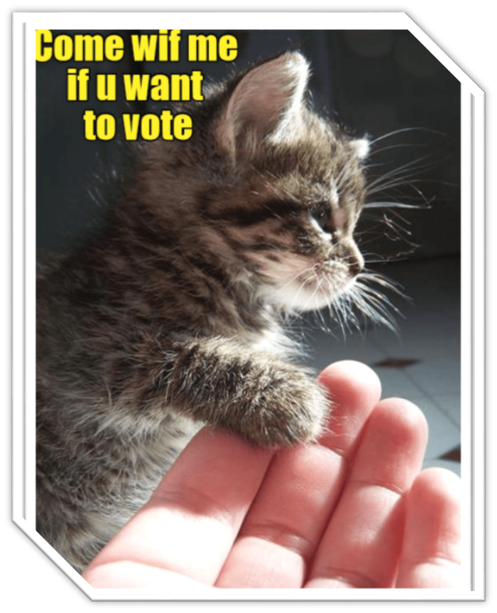
Arizona – Restoration of Civil Rights
How do I apply?
Arizona: File an application in the county court in which you were convicted.
Outside AZ: County where you live
There is no fee to file an application to restore civil rights.
Include a certificate of absolute discharge from the Department of Corrections (if imprisoned).
The process to restore civil rights does not restore the right to possess a firearm.
  The process to apply for restoration of the right to possess a firearm varies by county and may require a separate application.

Slide 20

Arizona – Restoration of Civil Rights
How can I get a copy of my absolute discharge?
State Prison: Email, write to, or visit the Arizona Department of Corrections and request the records
  1601 W Jefferson, M/C 112, Phoenix, AZ 85007
  Request form available online
  The information will be mailed in three to six weeks.
Federal Prison: Visit the Clerk’s Office at the United States District Court
  401 W Washington, Phoenix;
  123 N. San Francisco St, Flagstaff;
  405 W Congress St, Tucson;
  325 W 19th St, Suite A, Yuma;
  3001 N Main St, Prescott Valley

Slide 21

Arizona – Fingerprint Clearance Cards
Arizona law requires that employees or volunteers with certain state agencies, licensees, and contractors, engaged in certain types of work, have a fingerprint clearance card.
Generally, this means that jobs involving vulnerable adults or children, persons with developmental disabilities, or the handling of sensitive information will require a fingerprint clearance card.
There are two levels of fingerprint clearance card: “Level One” and “Standard.”
Name Here
Name Here
Name Here
r

Slide 22

Fingerprint Clearance Cards
Continued
There is a long list of convictions that, if shown on an applicant’s background, will disqualify the applicant from obtaining the fingerprint clearance card.
Not all hope is lost – an applicant can apply for a “good cause exception” with the Arizona Board of Fingerprinting
Applicants have one year from the date of their rejection to apply for a “good cause exception.”

Slide 23

Good Cause Exception
Not all offenses are eligible for a good cause exception. Some examples of ineligible offenses include:
  A conviction for child abuse
  Sex related crimes
The Fingerprint Board shall consider:
  The extent of a person’s criminal record;
  The length of time that that has elapsed since the offense was committed;
  The nature of the offense;
  Any applicable mitigating circumstances;
  The degree to which the person participated in the offense;
  The extent of the person’s rehabilitation, including completion of probation, payment of restitution, evidence of positive action to change criminal behavior, and personal references attesting to the person’s rehabilitation.
You must have a copy of your fingerprint clearance denial letter for your application, so keep your denial letter in a safe place.

Slide 24
Arizona – Sealing
New in 2023; still learning how it’s being applied
Applicable to arrests, dismissed charges, and convictions.
There is no fee to file an application.
File in court of conviction, dismissal, or initial appearance.
Mandatory waiting periods to apply, from completion of sentence & discharge:
  Class 2 or 3 felony; 10 years
  Class 4, 5, or 6 felony; 5 years
  Class 1 Misdemeanor; 3 years.
  Class 2 or 3 Misdemeanor; 2 years.

Slide 25
Arizona – Sealing Cont.
Some offenses are ineligible:
1. Sentenced as a dangerous offender pursuant to § 13-704.
2. Convicted of a dangerous crime against children as defined in § 13-705.
3. Convicted of a serious offense or violent or aggravated felony as defined in § 13-706.
4. Convicted of any offense that has either of the following as an element of the offense:
(a) The discharge, use or threatening exhibition of a deadly weapon or dangerous instrument.
(b) The knowing infliction of serious physical injury on another person.
5. Convicted of sex trafficking pursuant to § 13-1307.
6. Convicted of a class 2, 3, 4 or 5 felony offense that is included in chapter 14 or 35.1 of this title. (sexual offense/sexual exploitation of children

Slide 26
Arizona – Sealing Cont.
Mandatory waiting period to apply again if rejected; 3 years.
Process can take several months allows State Attorney/Prosecutor opportunity to respond.
Many exceptions to when you still have to share past conviction (it’s a long list).
Does not have any impact on information maintained by private entities (Background-check companies).

Slide 27




Thank you
Follow us
on Social
Media

