Slide 1

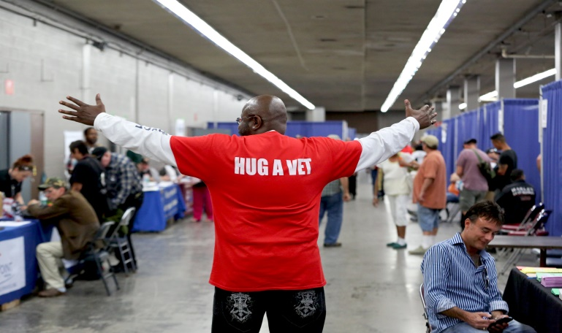




2016 Maricopa County StandDown Annual Report
Founding Partner Agencies

Slide 2

Maricopa County StandDown
The Maricopa County StandDown is Arizona’s largest outreach event targeting veterans experiencing or at-risk of homelessness. Through a partnership with the Arizona State Fairgrounds, the Maricopa County StandDown is held each year in the spring at the Veterans’ Memorial Coliseum and spans 3 days and 2 nights. Over the course of these days, homeless and at-risk veterans are offered shelter beds and other basic needs items such as meals, clothing, shoes, hygiene products, shower and restroom facilities among other care items needed to recuperate from the conditions of life on the streets.
When their basic needs addressed, homeless veterans are better able to access the services available to assist them in ending the experience of homelessness. Thus, over 70 service providers come together to deliver on-site support during the event; all committed to “cutting the red tape” to deliver their services quickly, efficiently and in a veteran-centered framework. Major service providers include the Arizona Department of Transportation’s Motor Vehicle Division, City of Phoenix Municipal and other Court systems, Social Security Administration, the Department of Economic Security, and the Phoenix VA Health Care System.
The end of homelessness among veterans begins with housing and thus over 20 housing provider agencies convene on-site and with beds/units available to bring as many veterans off the streets as possible. Arizona StandDown also intervenes, where possible, to prevent homelessness among at-risk veterans and uses excess funds to end homelessness among veterans throughout the year with its partner agencies.
The Maricopa County StandDown would not be possible without its generous donors, partner agencies and hundreds of dedicated volunteers. We hope you enjoy this report and find it useful in your efforts to end homelessness among veterans throughout the year. We look forward to seeing you at next year’s Maricopa County StandDown.
For More Information: www.arizonastanddown.org

Slide 3

2016 Maricopa County StandDown Demographics: 1,850 Veterans

Slide 4
2016 Maricopa County StandDown Demographics: 1,850 Veterans

Slide 5
2016 Maricopa County StandDown Demographics: 1,850 Veterans

Slide 6
2016 Maricopa County StandDown Demographics: 1,850 Veterans

Slide 7
2016 Maricopa County StandDown Demographics: 1,850 Veterans

Slide 8
2016 Maricopa County StandDown Demographics: 1,850 Veterans

Slide 9
2016 Maricopa County StandDown Demographics: 1,850 Veterans

Slide 10
2016 Maricopa County StandDown Demographics: 1,850 Veterans

Slide 11
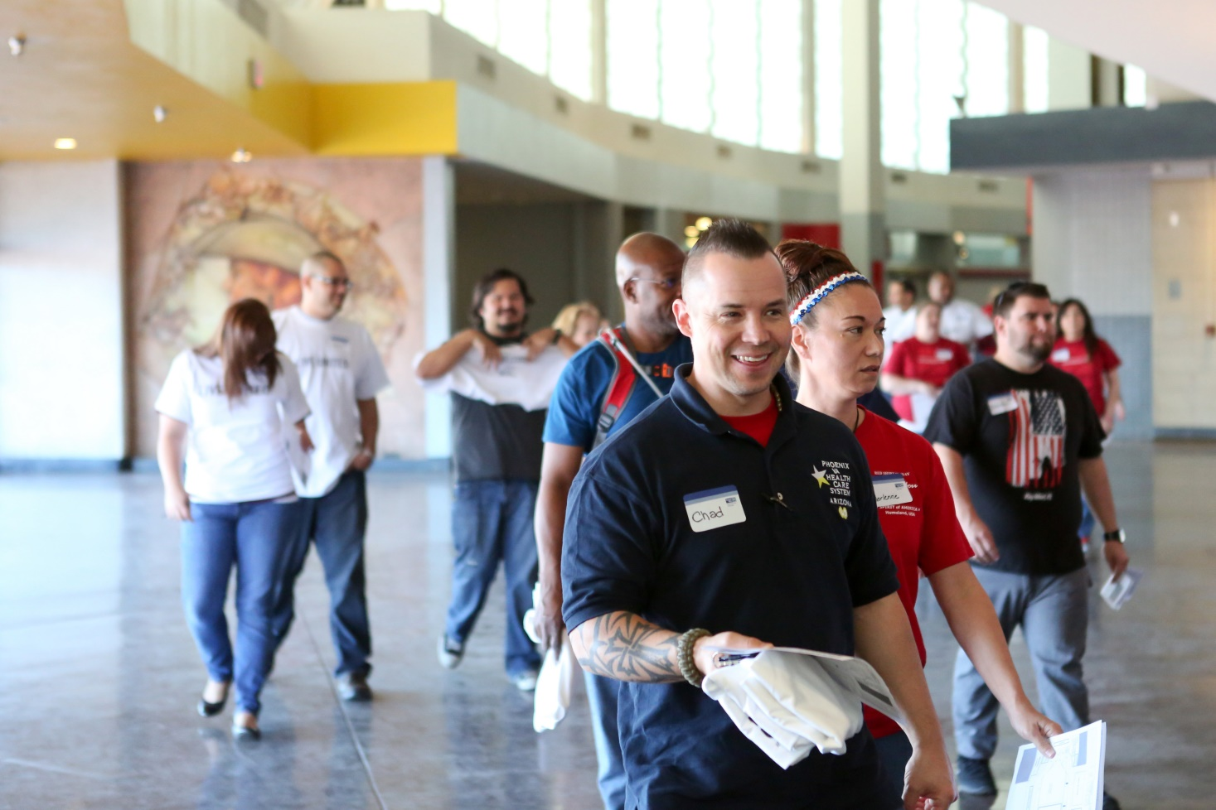
VSUW Guest Guide Volunteers: 900+

Slide 12
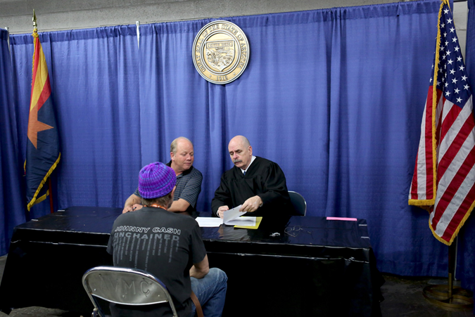
Court & Legal System:
985 Veterans registered for legal services
14 Municipal Courts represented, 131 cases
278 cases were reviewed by Adult Probation
109 cases in Justice Courts, 689 hours of community service
35 DUI screenings
305 Superior Court, 18 warrants quashed
350 Phoenix Court
86 letters to courts not represented
(45 in Maricopa county, 41 out of county)
43 Restoration of Rights
18 Wills
240 Out-of-county and/or out-of-state matters
State Bar 258 veterans, 298 consultations
9 Ignition Interlock
47 Superior Court Family Law Assistance
463 veterans completed community service hours
225 Legal Volunteers including Private Attorneys, County Public Defenders, Phoenix Prosecutors, County Attorneys, Phoenix Public Defenders, Civil Attorneys, Judges, and other legal professionals

Slide 13
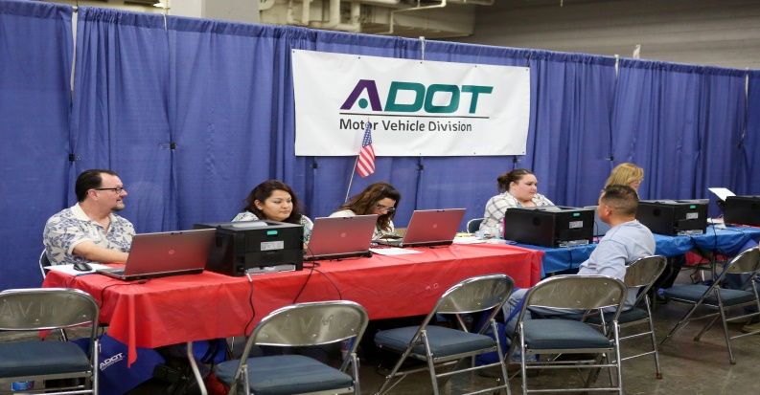
ADOT Motor Vehicle Division:
Total Customers Served 885
Transactions Processed 779
The Motor Vehicle Division experienced a 16% decrease in total services from the previous year. A big part of the decrease was due to a better process being put in place at the courts. In previous years the customer would come to MVD first to obtain their record and then visit the court. Once the court satisfied their citations, the customer would then return back to MVD to finally reinstate their driving privileges. This resulted in customer being counted twice and slowed the issuance process down. This year MVD had three staff member work with in the courts section and provide driving records to attorney’s and court representatives. By having the record pulled immediately the court was able to better coordinate where each customer needed to go to clear up their citations. Once everything was cleared with the court the customer was then sent to MVD to reinstate their driving privilege. This reduced the double visit and eliminated a lot of confusion customers faced in previous years.

Slide 14
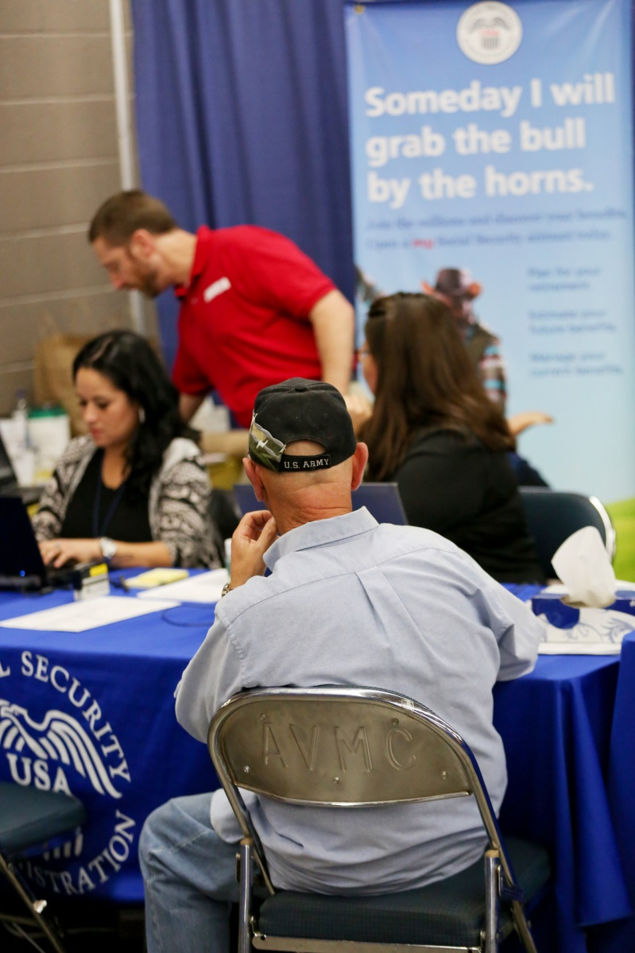
Social Security Administration:
Total Services: 342
25 employees from the Phoenix Downtown and Phoenix North offices participated in the 2016 Maricopa County StandDown.
148 SSN Card applications
82 new benefit claims
112 other status changes and inquiries.
Success stories included several cases where suspended benefit payments were reinstated as well as one veteran was not aware he was eligible for Retirement Benefits, was able to file and, after he was told he would be receiving his first payment shortly, was so elated he started to dance.

Slide 15
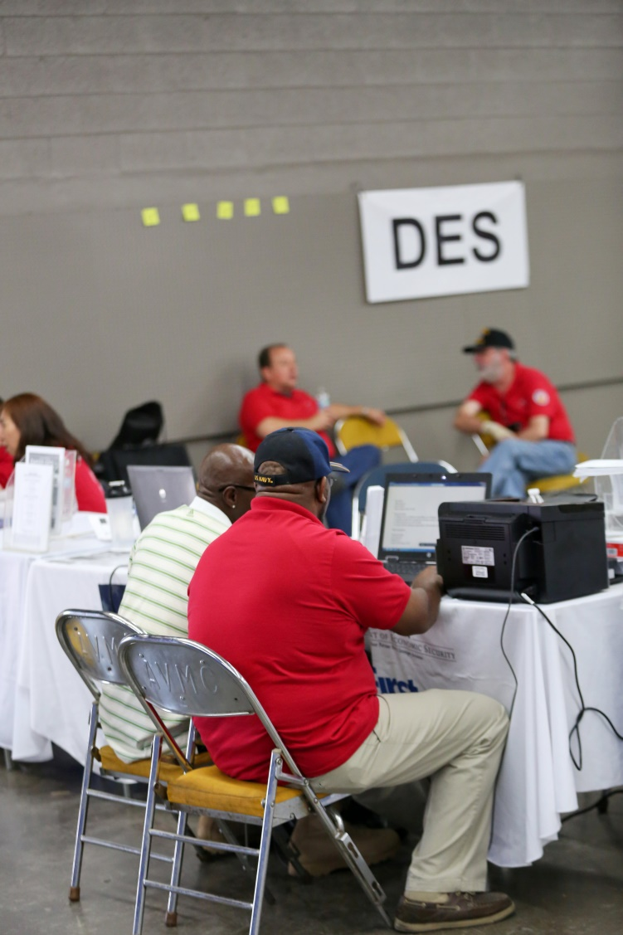
DES:
Family Assistance Administration
# Veterans applicants
Food Stamps- 102
Food stamps and medical- 19
Food stamps and cash assistance -11
Medical insurance only -5
Cash assistance, food stamps and medical -5
Veterans applied for 142 services
Veteran Employment Administration
50 veteran job seekers assisted
LIHEAP
11 veterans referred to CAP agencies
Division of Child Support Services
Assisted 30 veterans
Telephone Discount program
Assisted 8 veterans with information

Slide 16
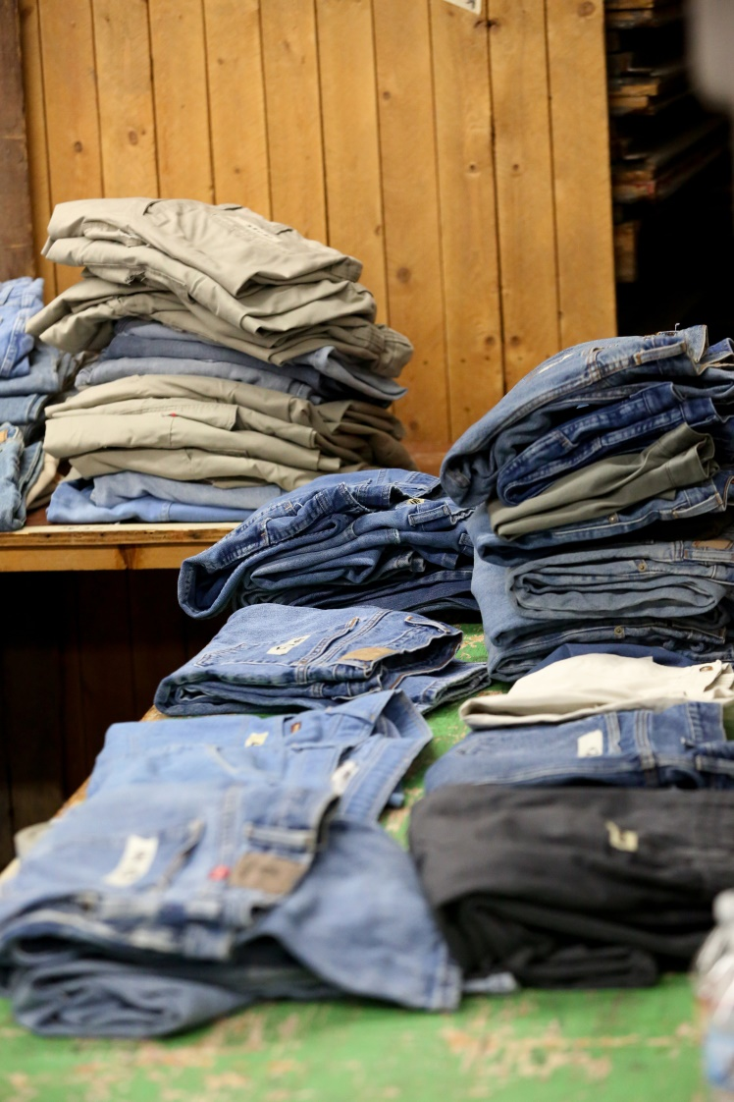
Clothing :
Veterans that received services your Organization provided: 1400
Veterans received referrals or follow -up for services : 100
The Trilogy Veterans Club provided 41 volunteers who helped unload personal clothing items provided by the DOD and various volunteer organizations. On Thursday, approximately 1,100 veterans were processed through the boot, underwear and blue jean areas. On Friday, we greeted about 300 veterans and were completely out of clothing and boots by 11:00.

Slide 17
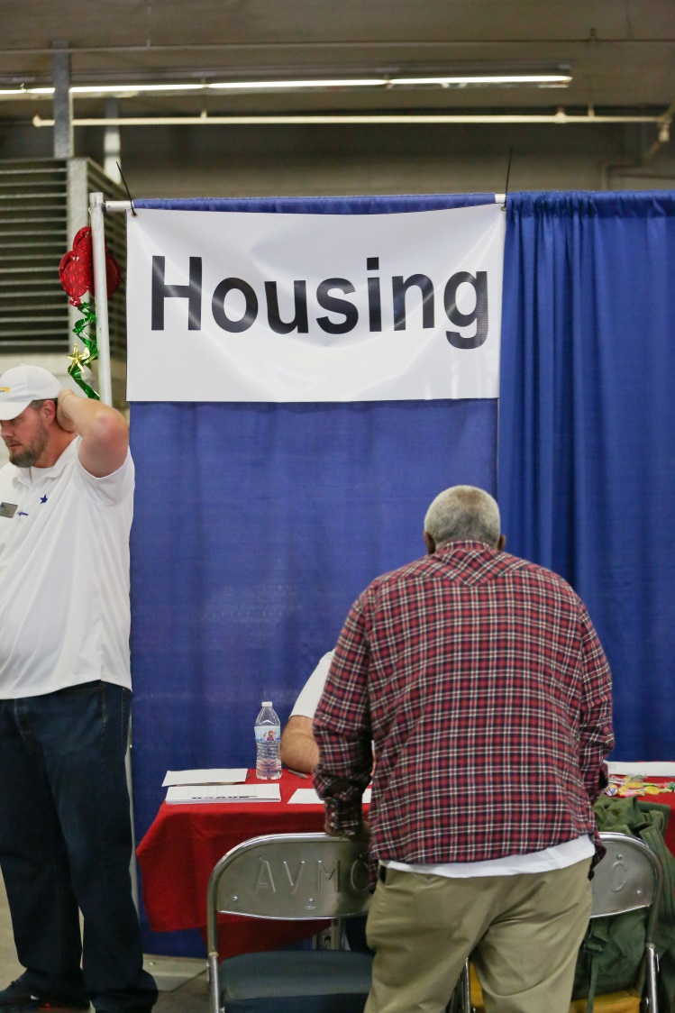
Housing:
14 Housing Providers
299 veterans came through the Housing station
SSVF interviewed 148 Veterans -96 were deemed eligible
47 have since been enrolled, 28 have been housed, others working with case manager
U.S. VETS also housed 14 veterans into our TIP/VIP Transitional Housing Programs

Slide 18
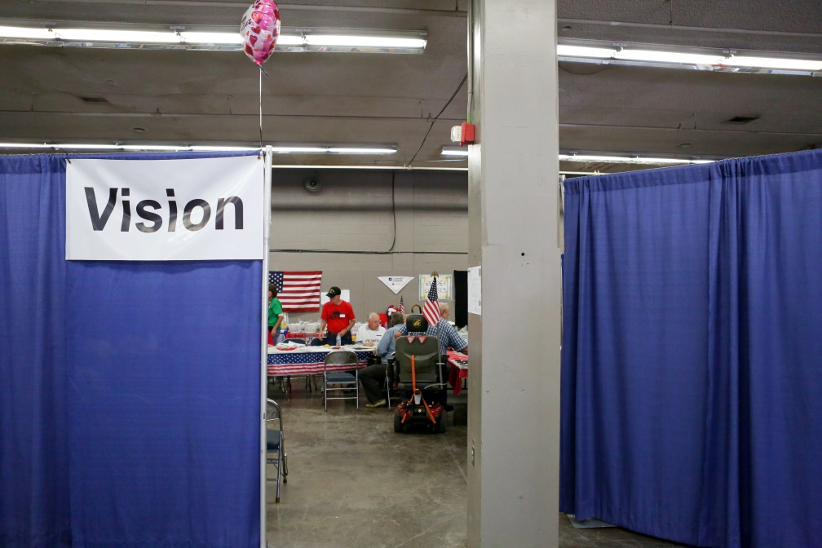
Readers given out: 468
Consults to be made through the VAMC Eye Clinic – Low Vision Area Tom Hicks: 266 (largest number for consults to be seen)
Total seen in the Eye Clinic Area: 734 Largest number ever seen in our Eye Area.

Slide 19
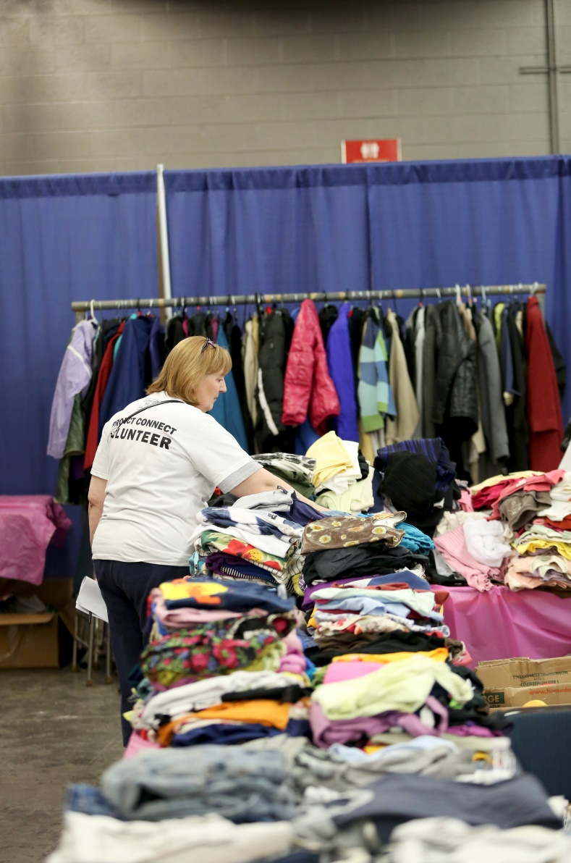
Women’s clothing:
• Women veterans seen the first day = 120 and 56 on the second day. Total = 176
• Volunteers staffing the Women Vet area: 64 on day one and 34 on the second day Total 98
• Children left in childcare area to be watched: 17 on first day and 13 on the second day. Total 30 received childcare, toys and other gifts.
• Mary Kay Pampering sessions on Friday (3 parties) 48 women and 6 men. Total 54
• Haircuts - 2 stylists both days, 25 haircuts the first day & 16 the second day for a total of 41.

Slide 20
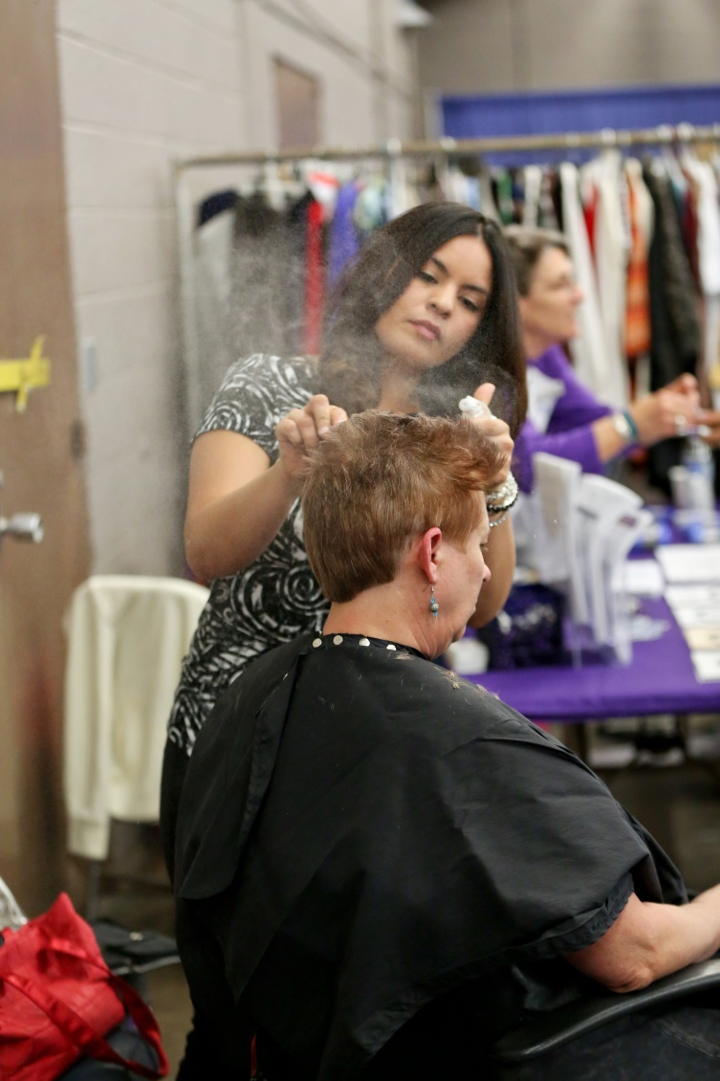
Women’s clothing continued:
• Families visiting the Childcare area for toys and clothes: 75 + 60 = 135
• Volunteers who are veterans:
6 were Army
4 were Air Force
7 were Navy
• The guests' branches of service:
o Army = 101
o Air Force = 35
o Marine = 9
o Navy = 34
• On the guest log, there were 8 women who indicated they owned their own homes

Slide 21
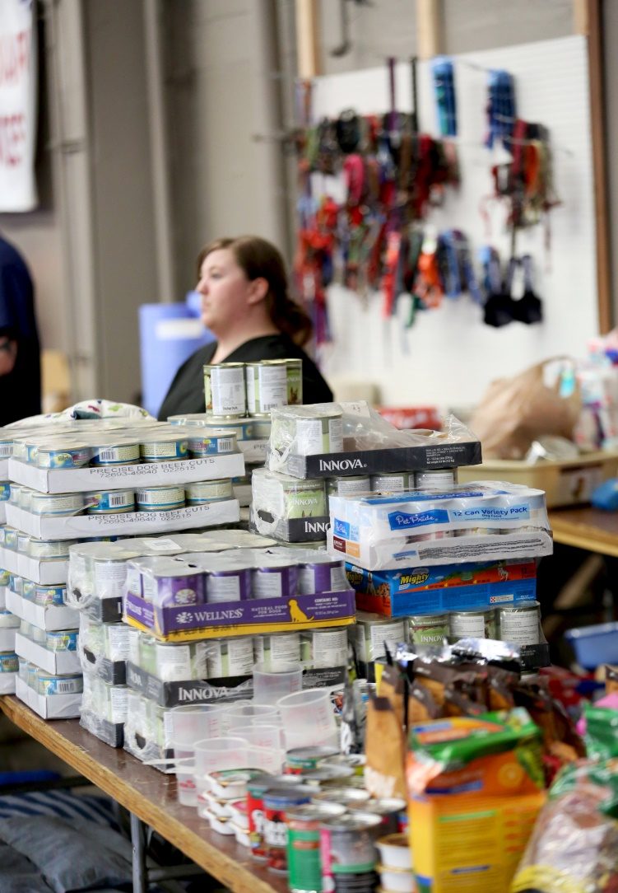
Veterinary Services:
Vets for Vets' Pets served 594 veterans
with 606 pets.
The breakdown
478 dogs served
125 cats served
2 birds served
1 guinea pig served
We distributed:
73 harnesses
285 collars
233 leashes
308 pet beds
731 toys

Slide 22
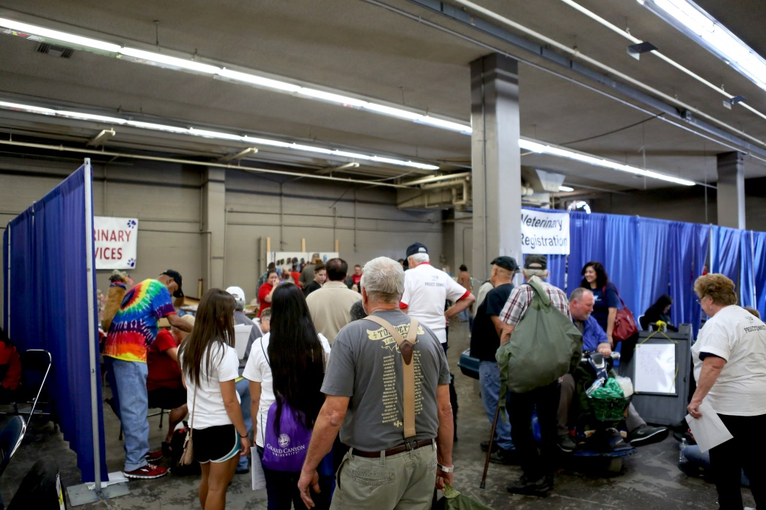
Veterinary Services (continued):
Our veterinarians performed exams and administered vaccines to:
185 dogs
12 cats
42 spayed and neutered pets.
70 pets groomed .
129 pets boarded.
1,850 veterans attended the StandDown,
which means that 1/3 of them registered for service in our area.

Slide 23
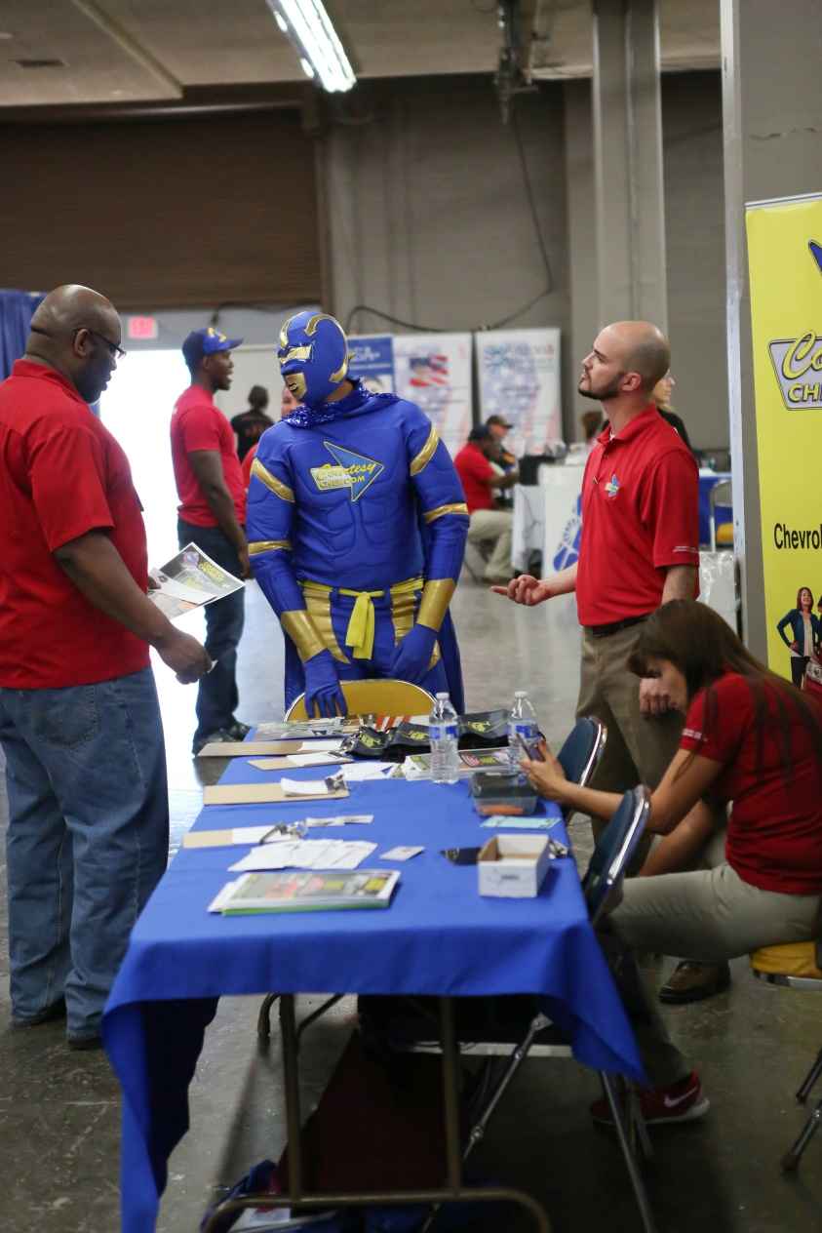
Hygiene Kits –2000 hygiene kits were distributed
Ultrasounds -637 veterans, up to 5 screenings each, 100 doctor referrals
Haircuts -622 were given
VBA -463 veterans seen, 235 claims processed
VA patients seen -19
Acupuncture -262 veterans. Many reports of better sleep, calmer, more able to relax.
White Apple Institute: 100 veterans . Education, Media, and Self-Help Support and Resources. 33 referrals

Slide 24
Feedback:
Very pleased that this year our room was cleaned in advance and that chairs and tables were available for our setup on Thursday. We will come earlier next year, since we were surprised by early birds this time. The organization of the overall event was much smoother this year with less lines for essential services, which freed up more time for services like ours in the mornings. Thank you for this opportunity every year.
Changing schedule to include Thursday, ending on Saturday was helpful to process more cases. Saturday afternoon was quieter than expected.
Our folks appreciated the opportunity to provide this service to all the Veterans we met at StandDown. The Trilogy Veterans Club will provide the same service at the next Phoenix StandDown, if we are needed. If we do participate, we would like to also assist in the procurement and ordering process for the boots, equipment and clothing.

Slide 25
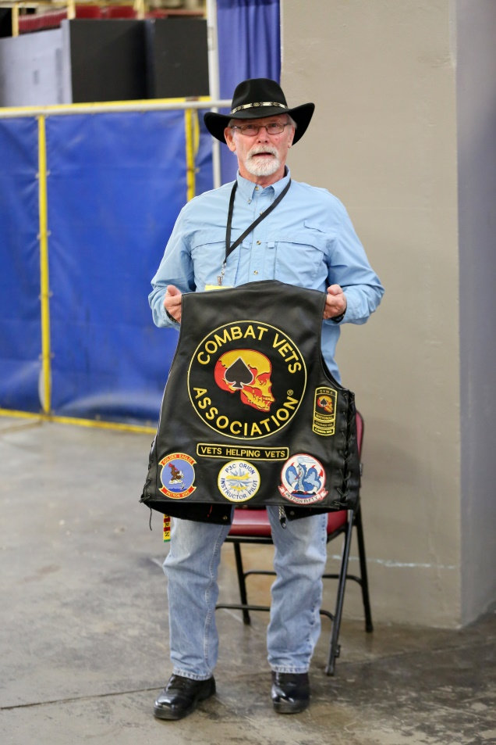
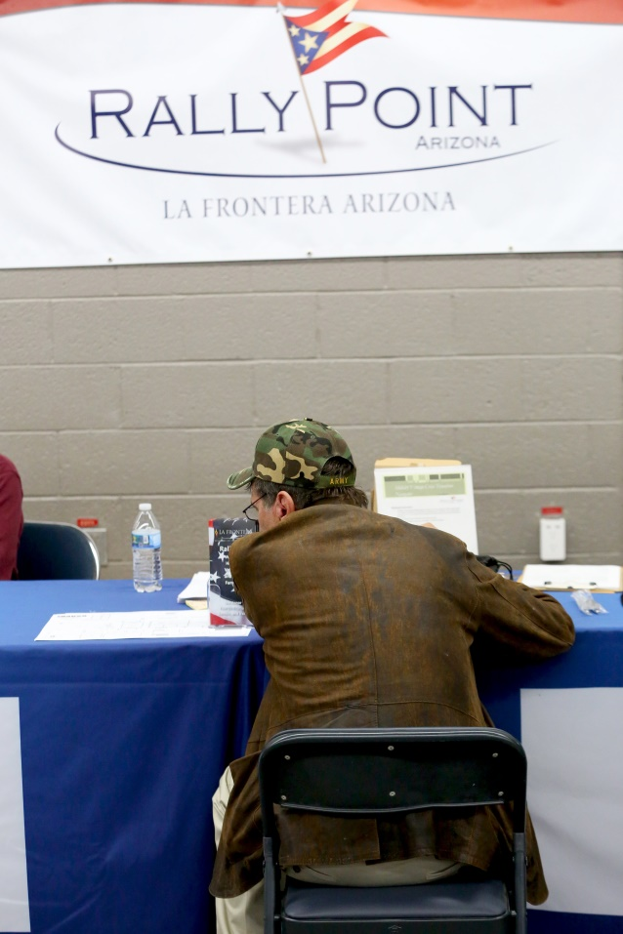
For their "behind the scenes" efforts in offering a safe, secure, and efficient event we want to thank
Rally Point
Combat Vets

Slide 26
Thank You to Our Organizational Donors:
Arizona Department of Veteran Services, Intel Involved Volunteer Program, Jewish War Veterans Copper State Post 619, John Dixon, MCS Charitable Foundation, Melissa Faulkner, Micheline Jo Conty, Military Order of the Purple Heart, AZ Dept., Military Order of the Purple Heart Chapter 691, Military Order of the Purple Heart Chapter 472, American Legion Department of Arizona, VMLC Charities, Arizona Veterans Hall of Fame Society, Vietnam Veterans of America, Chapter 1011, Sun Lakes Rotary Club, Caroline Champlin, Jewish War Veterans Scottsdale Post 210, Korean War Veterans Countryman Chapter, Marge Guilfoil, Mental Health Guild, Paralyzed Veterans of America, Sun Lakes Lions Foundation. Sun Lakes Breakfast Lions Foundation, U.S Department of Labor, Others First, Swift Transportation, Phoenix VA Nutrition Services, Subway, Pepsico, Javo Beverage Company, Orbital ATK, Sodexo, USAA, Starbucks, Arizona State Fair.

Slide 27
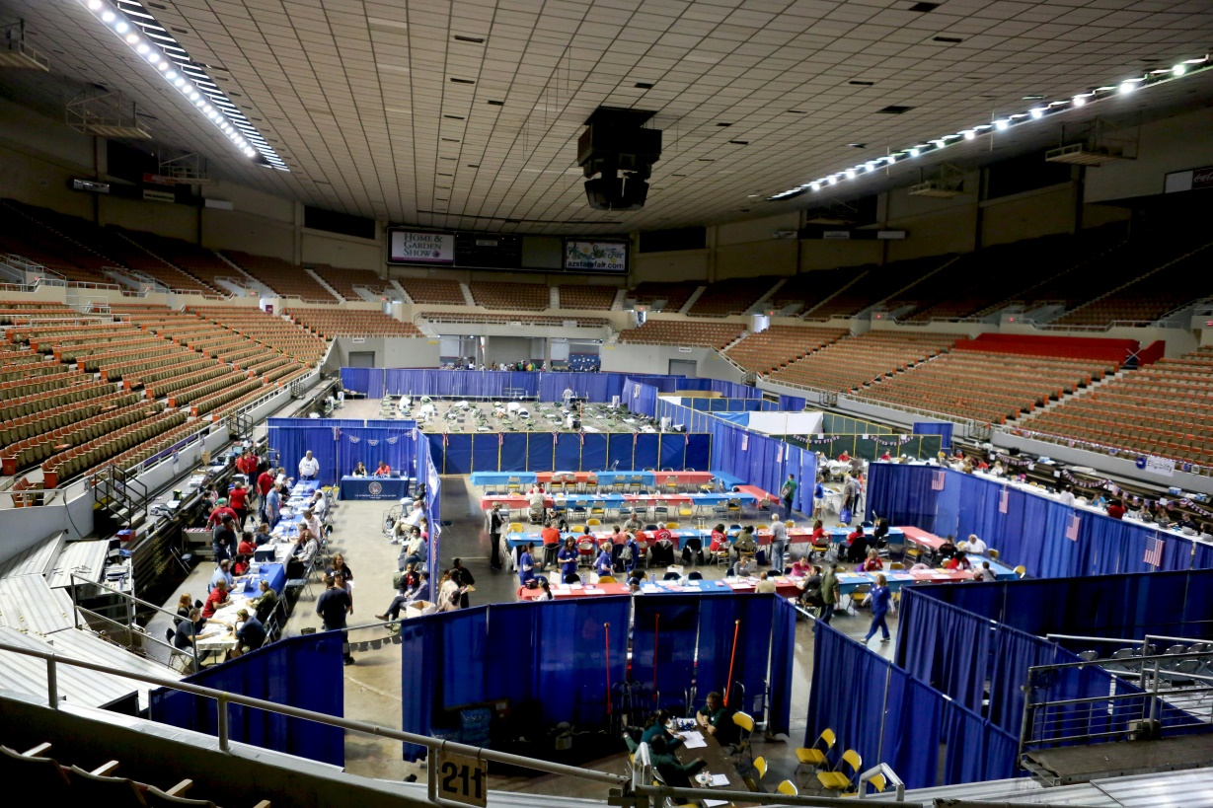
….and the reason we’re all here! Thank you to our service providers and volunteers!

