Slide 1
Advancing equitable solutions to addressing evictions in Arizona, through data, collaboration and tenant protections
Maxine Becker
WildFire
Lora Phillips
ASU KER
Joanna Carr
Arizona Housing Coalition

Slide 2
Eviction in Arizona: An Overview
In January 2023, 7031 evictions filings were received in the Maricopa County Justice Courts.
Evictions are surpassing pre-pandemic levels and are the highest since September 2008
COVID-19 and evictions
Housing is healthcare
Gaps in data - The eviction “Tsunami”
Inequity in the process
Influx of ERA funding
The funding cliff
Building the ERA infrastructure
Moving to tenant protections
Notes:
Also speak to the lack of upstream efforts historically

Slide 3
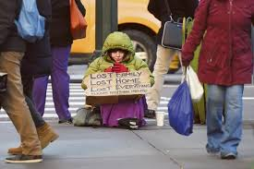
A Lack of Affordable Housing
The lack of affordable housing sits at the root of a host of social problems:
Poverty
Homelessness
Educational Disparities
Health Care Disparities
Evictions are a critical aspect of the Affordability crisis!
Notes:
Inflation and the lack of affordable homes have directly impacted the number of people facing eviction.

Slide 4
Eviction Impacts
Homelessness
Loss of possessions
Housing Discrimination
Disruption to education
Eviction
Financial Instability
Job Loss
Poverty
Mental and Emotional instability
Notes:
Eviction causes a family to lose their home. They often are also expelled from their community and their children have to switch schools. Families regularly lose their possessions, too, which are piled on the sidewalk or placed in storage, only to be reclaimed after paying a fee. A legal eviction comes with a court record, which can prevent families from relocating to decent housing in a safe neighborhood, because many landlords screen for recent evictions. Studies also show that eviction causes job loss, as the stressful and drawn-out process of being forcibly expelled from a home causes people to make mistakes at work and lose their job. Eviction also has been shown to affect people's mental health: one study found that mothers who experienced eviction reported higher rates of depression two years after their move. The evidence strongly indicates that eviction is not just a condition of poverty, it is a cause of it.

Slide 5
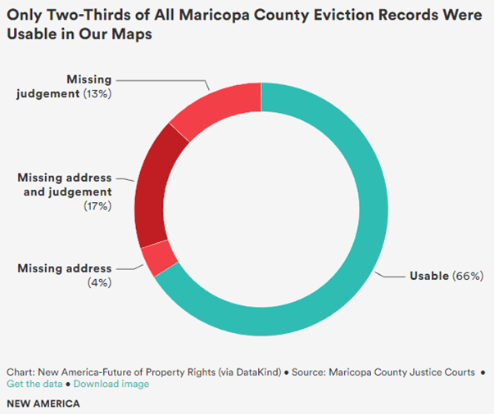
Eviction Data in Arizona: Gaps and Challenges
No statewide data repository
Certain data fields (e.g., race and ethnicity) that are important for developing eviction prevention programs are not collected
Missing data
Freely available data on number of renter-occupied units is often outdated
Unclear impact of recent eviction record sealing legislation
Notes:
**Not an exhaustive list
-Effective eviction prevention begins with the minimally viable data necessary for developing and implementing targeted interventions
-To this end, eviction data in Arizona can be improved in severals ways
Creates challenges for cross-county comparison because (a) counties may collect different information and (b) need to gather data from each individual county
According to the National League of Cities, necessary data includes: historical data to allow for comparison; real-time or frequently updated data to allow for timely eviction prevention interventions; geographic data to identify hot spots for intervention; and program metrics to analyze the efficacy of eviction prevention programs. // Would add: data on individuals being evicted, landlords themselves // According to Scott Davis of the Maricopa County Justice Courts, the courts collect what is legally mandated by the legislature
According to a report by national think tank New America, in Maricopa County specifically, between 2014 and 2018, 1 in 3 eviction filing records lack judgment information and, of those that have judgment information, nearly ¼ were missing address data
Creates distinct challenges for calculating eviction rates in fast-growing parts of the state, where number of rental units is growing faster than data can keep up (i.e., may create over-estimates of evictions, especially at smaller geographies like census tracts)
Legislation an extremely necessary first step, though MAXINE will discuss how this is only one prong in suite of necessary policies. However, the courts are still determining how to implement the legislation and, for instance, may not release identifying information like address or may omit a proportion of eviction filings altogether. Again, legislative action may be needed to circumvent this.

Slide 6
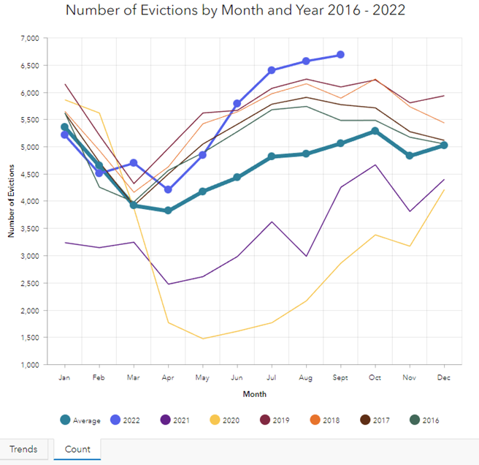
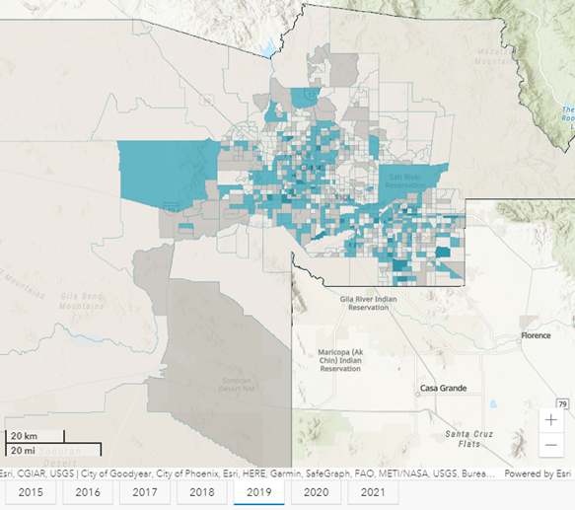
Eviction Data in Arizona: Opportunities
Source: https://resilience.asu.edu/evictions-dashboard
Notes:
-Despite gaps and challenges in Arizona’s eviction data landscape, existing data has several strengths that allow for analyses to help guide eviction prevention efforts
-At least prior to new eviction sealing law, data in Maricopa County has been: historically available, updated frequently (i.e., monthly), and includes addresses as geographic identifiers // i.e., three of the four dimensions recommended by the National League of Cities – even if we know that these data aren’t perfect due to, for instance, missing data
-We at the Knowledge Exchange for Resilience at Arizona State University have used these data to develop our Maricopa County Evictions Dashboard, which: tracks eviction trends over time and maps evictions at the census tract level
-However, (1) the process of geocoding address data is time-consuming and, for some organizations, prohibitively costly and (2) this still doesn’t tell us much about WHO is being evicted (just where eviction is occurring) since the courts don’t collect this data

Slide 7
Eviction Data in Arizona: Opportunities
https://www.newamerica.org/future-land-housing/reports/foreclosure-and-eviction-analysis-tool/

Slide 8
Eviction Data in Arizona: Opportunities
Data Requirements
Individual records for each eviction or eviction filing
A date
A geographic identifier (address, census tract, zip code, etc.)
Data in .csv format (can be easily converted from Excel)

Slide 9
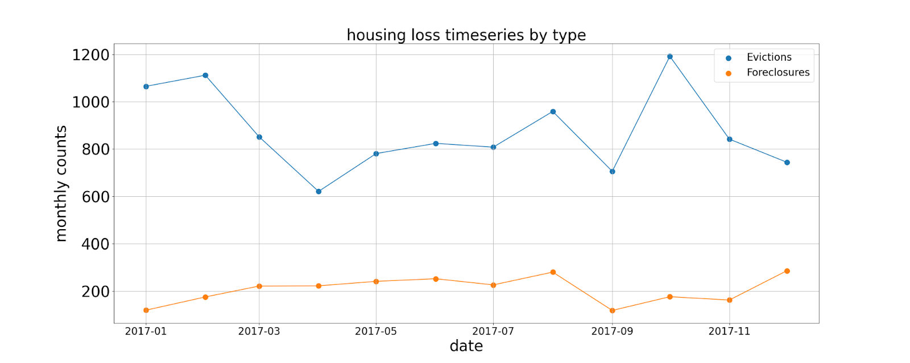
Eviction Data in Arizona: Opportunities
Using free, open-source software and following detailed, step-by-step instructions, FEAT automatically:
Geocodes eviction data
Appends eviction data to 5-year 2019 American Community Survey (ACS) data
Creates files that can be used for mapping in QGIS (free) or ArcGIS
Produces time-series plots
Produces correlation analyses

Slide 10
Eviction Data in Arizona: Opportunities

Slide 11
Eviction Data and Race
Courts do not collect demographic data on eviction cases.
Fair Housing Act and Equal Credit Opportunity Act, which banned discrimination by race, gender, and marital status, property owners disproportionately evict Black and Latinx renters—particularly women.
Eviction Lab Study
Black individuals made up 19.9% of all adult renters in the counties for which there was data, but 32.7% of all eviction filing defendants.
One in every five adult renters in the sample was Black, yet one in every three eviction filings were served to a Black renter.
By contrast, whites made up over half the population of adult renters (51.5%) but received only 42.7% of eviction filings.
Notes:
Eviction Lab - Sociological Science
Used a set of statistical techniques to impute—to predict based on available information—the gender and race/ethnicity of individuals facing eviction on the basis of names and addresses.
Given Census and Social Security data about the distribution of names by gender and race/ethnicity, every defendant in the data assigned a probability of being a member of a given gender-by-race/ethnicity category.
Used these probabilities to produce annual estimates of the number of individuals filed against and evicted in each group within each included county.

Slide 12
Turning Data into Information that Spurs Action
Issue: Reduce Evictions in Phoenix BIPOC Communities
Data:
Using a Data Tool determined highest eviction rates per zip code
Census Data - zip code with large BIPOC Communities
Eviction Lab Data - Matched “Super Evictors” with zip codes
Grant Application in Process to Surge Education and Prevention Resources to High Impact Area

Slide 13
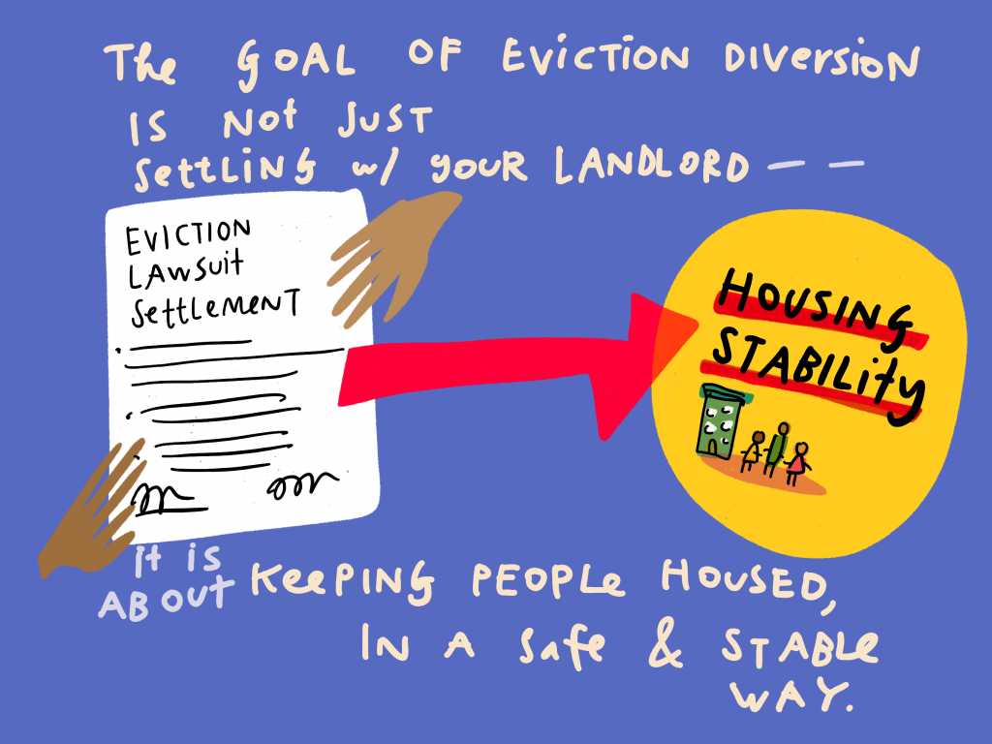

Slide 14
Eviction Diversion
Developing Eviction Alternatives
Court Based
Law and Policy
Legal Service Innovations
Tech and Data
Eviction Diversion

Slide 15
Court Based
90% of landlords have counsel - Less than 5% of tenants have counsel
Access to Counsel
City of Phoenix/Maricopa County Tenant Eviction Assistance Program
Pima County EELS Program
Summons, Complaint, Eviction Information Sheets -materials that lay out clear, visual descriptions of rights, responsibilities, and services
Rules that slow the court process. Allow tenants to raise claims, access information, work out a fair settlement.
Rules that acknowledge issues of digital equity and inclusion.
Court Navigators, Self-Help Centers to help a person navigate the court system
Eviction Courts should be Trauma-Informed Courts

Slide 16
Law and Policy
Government agencies, legislators, and courts can develop eviction protection policies in 4 key areas. These correspond with the points in a tenant’s justice journey through informal or formal eviction.
Area 1: Upstream Policies that allow for better relationships and problem-solving between tenants and landlords.
Area 2: Lawsuit Limits that stop or slow landlords from filing
Area 3: Court Reforms for more options, time, support, and advice to defend rights.
Area 4: After Judgment to mitigate harmful consequences.
Notes:
Changing the landlord’s calculus about when to pursue eviction vs. working it out with the landlord.

Slide 17
Housing Stability Legal Advocate Program
Recently Approved by the Arizona Supreme Court
Initiated by Innovation for Justice (i4J) within the University of Arizona College of Law
HSLAs would:
1. Provide limited-scope legal advice in the course and scope of their social service work.
2. Not charge for their services–HSLA legal advice would be provided in the course and scope of free social services, not as a free-standing legal service; and
3. Be limited to providing HSLA services while employed by or volunteering with a non-profit social service organization - HSLAs would not be authorized to set up free-standing, for-profit legal service organizations.
Notes:
For example, a caseworker at a community action agency or a human services campus who assists tenants in securing food and/or applying for utility and rent assistance would also be able to identify tenants that are at risk of eviction and provide legal advice to reduce housing instability risk;

Slide 18
Upstream Eviction Policies
General Civil Legal Aid
Clear Process to Raise Habitability Concerns
Early notice to tenant if landlord is considering eviction with clear information about how to stop the eviction.
Notice to a Government Agency if landlord is considering eviction so they can connect tenant with resources.
Increased and Enforced Penalties for illegal lockouts, shut-offs
Cash for Keys policies
Notes:
General Civil Legal Aid - 1 of 3 states with no state appropriation for legal aid.
Consumer Finance
Education
Employment
Family Law
Health
Housing
Income Maintenance
Individual Rights (restoration of civil rights, disability rights, criminal expungement)
Juvenile
Current policies:
TEAP EELS
HLSA
Phoenix Landlord Tenant Program
Maricopa County Landlord Liaison
Scottsdale LL Liasion (section 8 focus)

Slide 19
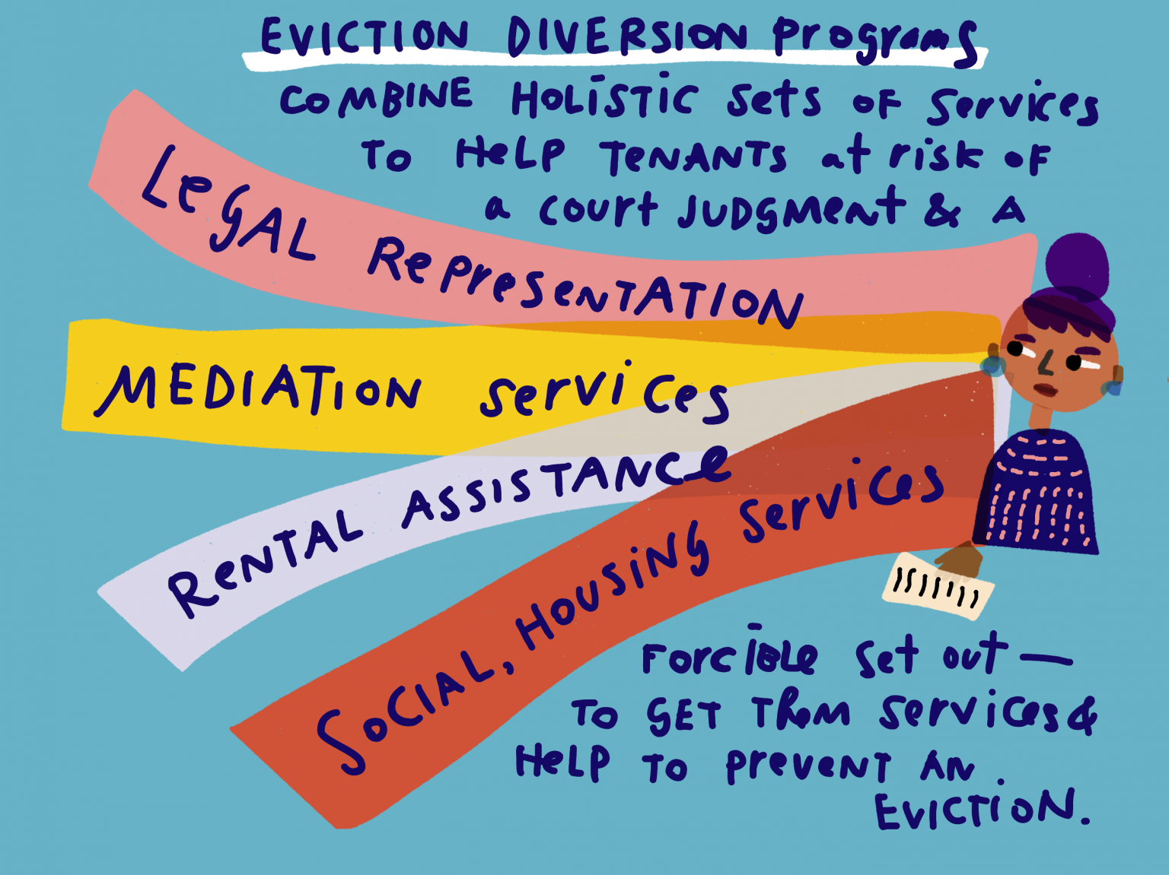

Slide 20
Eviction Diversion
An Eviction Diversion Program is a holistic combination of services that divert a landlord-tenant dispute away from a court judgment.
Rental Assistance
Legal Representation
Mediation Services
Other Financial and Social Services
Notes:
36 states and 180 jurisdictions have instituted eviction diversion programs. Other than Pima County’s EELS program, Arizona has not.
Many of the programs are tailored to the community - Voluntary or mandatory mediation; 1st appearance is “pre-trial conference” that ensures that the tenant understands the process and has time and referrals to seek assistance; Lawyer for the Day - lawyers in the courtroom; housing navigators in the courtroom to assist before or after the hearing to provide information and assistance.

Slide 21
Audience Participation
Where do we go from here?
Are there efforts in your community that can be replicated?
What support does your community need to address evictions?

