Slide 1
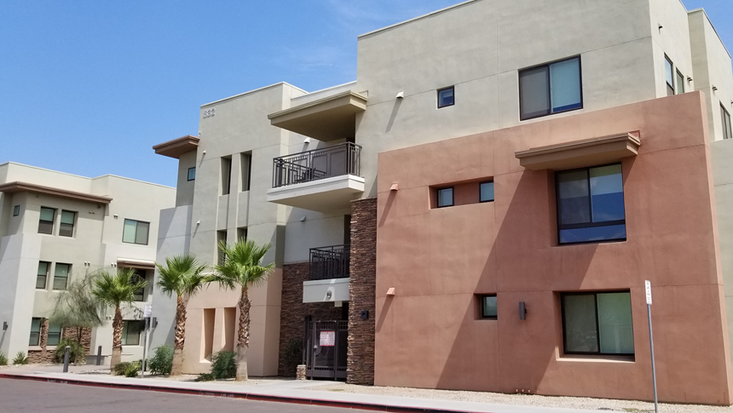
2023 Strategic Direction

Slide 2
Arizona Housing Shortage
Estimated Need – 270,000 units
Annual Production
17,000 MF
45,000 SF
Annual In-migration 100,000
Notes:
●Phoenix alone is 163,000 – put together with HUD numbers and extrapolated statewide to estimate 270,000
●National Low Income Housing Coalition 2021 identified a gap of 160,488 housing units needed for HH at or below 50% of AMI. Report also identified a 7% shortage for HH at or below 80%. Using census data we extrapolated 7% of this population to be approximately 110,000 HHs – totaling 270,000
●Annual MF units from AZ Multi-Housing Association website
●Annual SF units , ave 3,586/month for last 6 months 43,000 annually

Slide 3
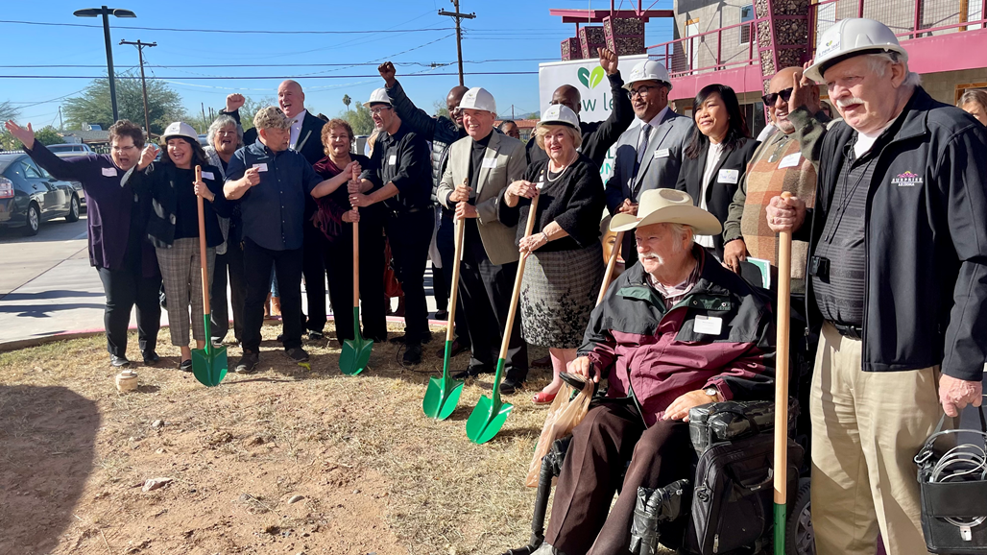
Building an Arizona for Everyone
Maximize Efficiencies
Marshall Resources
Collaborate
Explore Flexibilities
Couple Innovation w/tried & true

Slide 4
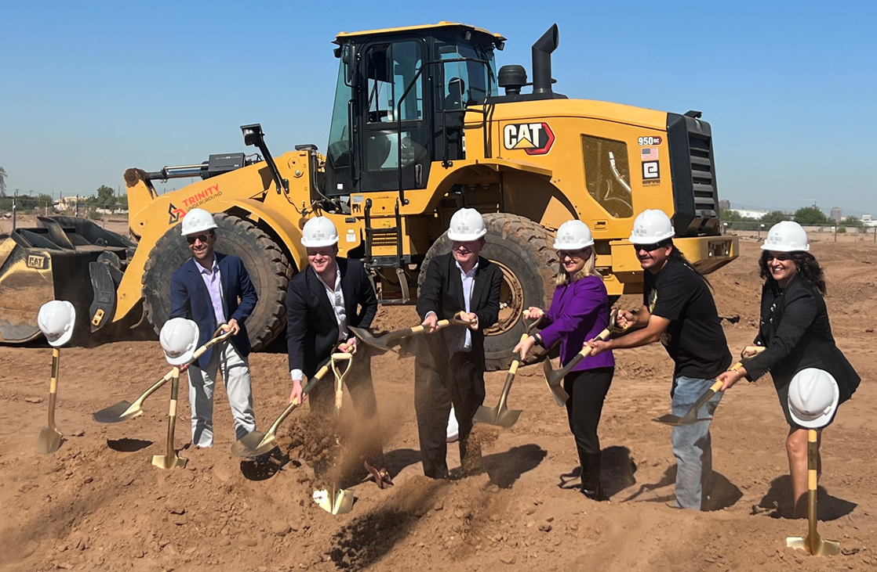
Maximize Efficiencies
Encourage zoning reform w/lens of affordability
Streamline QAP
Reduce size & complexity
Separate 4%
Build upon an already highly efficient Housing Department
Notes:
Encourage zoning reform w/lens of affordability
Streamline QAP
Reduce size & complexity
Separate 4%
Build upon an already highly efficient Housing Department

Slide 5
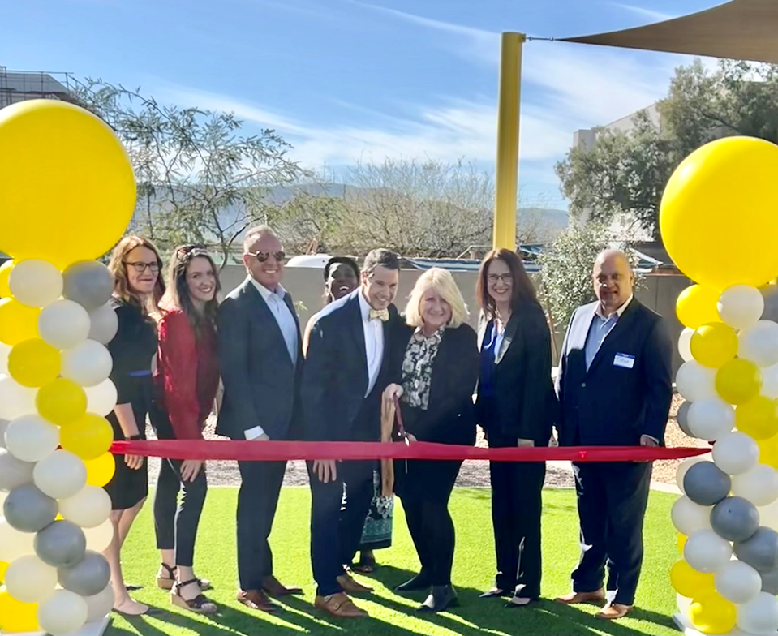
Marshall Resources
Bolster State LIHTC
Make permanent
Increase funding
Invest in State Housing Trust Fund
Leverage public-private partnership
Bolster rent & utility assistance programs
Keep people stably housed
Notes:
Bolster State LIHTC
Make permanent
Increase funding
Invest in the State Housing Trust Fund
Leverage public-private partnership to bring shovel-ready projects to occupancy
Bolster rent & utility assistance programs
Keep people stably housed

Slide 6
Collaborate
Governor’s Interagency & Community Council on Homelessness & Housing
Roundtables
Listening Sessions
Notes:
Reinstate Governor’s Interagency & Community Council on Homelessness & Housing
Original Commission formed under Gov. Napolitano; Blueprint in use across the US
Continues the leadership of former Dir. Simplot
Co-chairs ADOH and DES Directors
Continue Roundtables & Listening Sessions
Housing Developer Stakeholder sessions
Homelessness to Housing Bi-weekly Roundtables

Slide 7
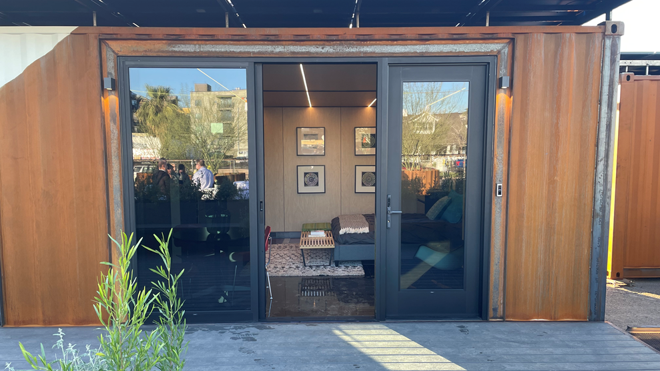
Couple Innovation with Tried & True
Innovations & Advances
Quick Occupancy Solutions
What’s Old is New again
Accessory Dwelling Units
Single Room Occupancy
Missing Middle
Transitional Housing
Notes:
Manufactured Housing Innovations
Explore advancements in housing manufacturing
Shipping containers, Sparkbox, 3D printed Homes, Sprung shelters
Quick occupancy solutions
Dust off what is tried & true
Accessory Dwelling Units
Single Room Occupancy
Missing Middle = Duplexes, Triplexes
Transitional Housing

Slide 8
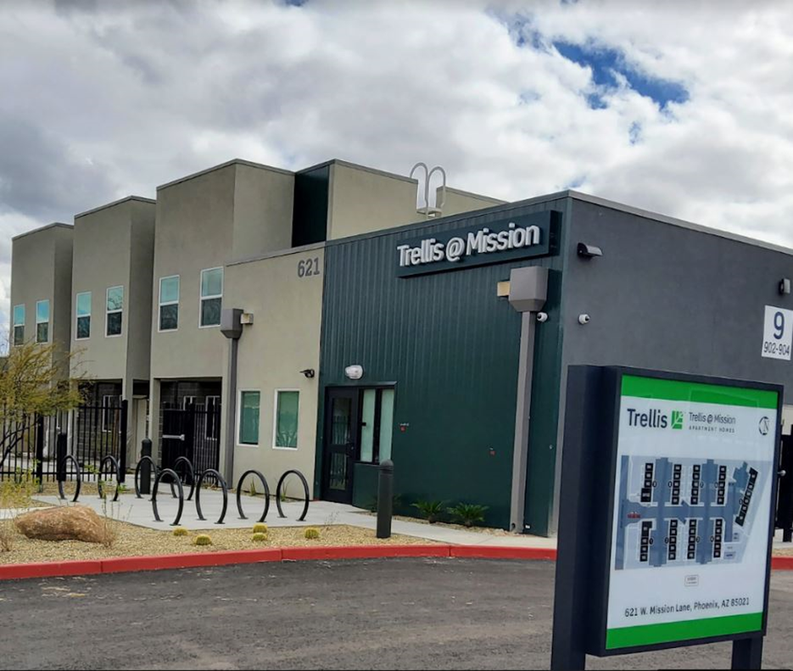
Explore Flexibilities
ARPA & LIHTC
Homeowner Assistance Fund
Underutilized
Strengthen What Works
Remaining COVID-19 Funds
Regulate & De-Regulate
Notes:
ARPA Funding for LIHTC Projects
Homeowner Assistance Fund
Underutilized
Strengthen what works (AHCIA, NHIA, NHTF, HOME, etc.)
Optimize any remaining COVID-19 funds
Regulate & de-regulate

Slide 9
Building an Arizona for Everyone

