Slide 1
Direct Cash - A Radically Effective Housing Intervention
Presented by Michael Simm
Executive Director,
The Logical oundation

Slide 2
What is OUR Purpose?
Money
Helping People
$
$
Funder

Slide 3
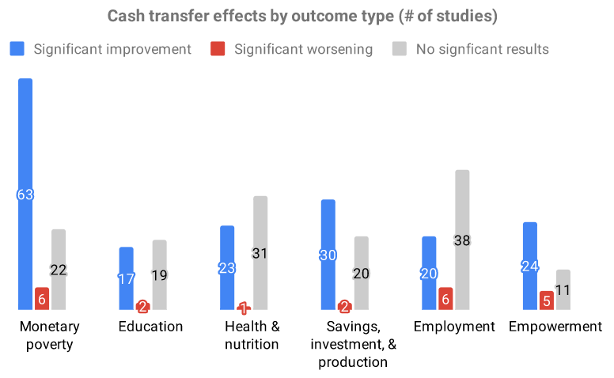
Cash Assistance
Effective Efficient Scalable Safe

Slide 4
Homelessness: Key Questions & Concerns
Do people purchase drugs and alcohol?
Do people impulsively spend all of the money?
Who doesn’t benefit?
What are the impacts & do they Last?

Slide 5
Foundations For Social Change
115 Unhoused Participants in Vancouver
Randomized Controlled Trial Study
$6,000 Upfront

Slide 6
$4,000
Participants retained $4,000 after the first month.
This challenges assumptions about impulsive spending.

Slide 7
39%
Reduction in Spending on Alcohol, Drugs, & Cigarettes

Slide 8
75%
Regained Stable Housing Within 6 Months

Slide 9
Miracle Messages - Miracle Money
9 Unhoused Participants
$500/Month for 6 months
San Francisco
Average Studio Apartment Rent = $2,395/Month

Slide 10
“We did not expect much in terms of outcomes beyond a temporary relief of material hardship”
-Kevin Adler, Executive Director of Miracle Messages

Slide 11
66%
Regained Stable Housing Within 6 Months

Slide 12
100%
“Two years later, to the best of my knowledge, 100% of these newly housed participants are still in stable housing.” - Kevin Feb. 2023

Slide 13
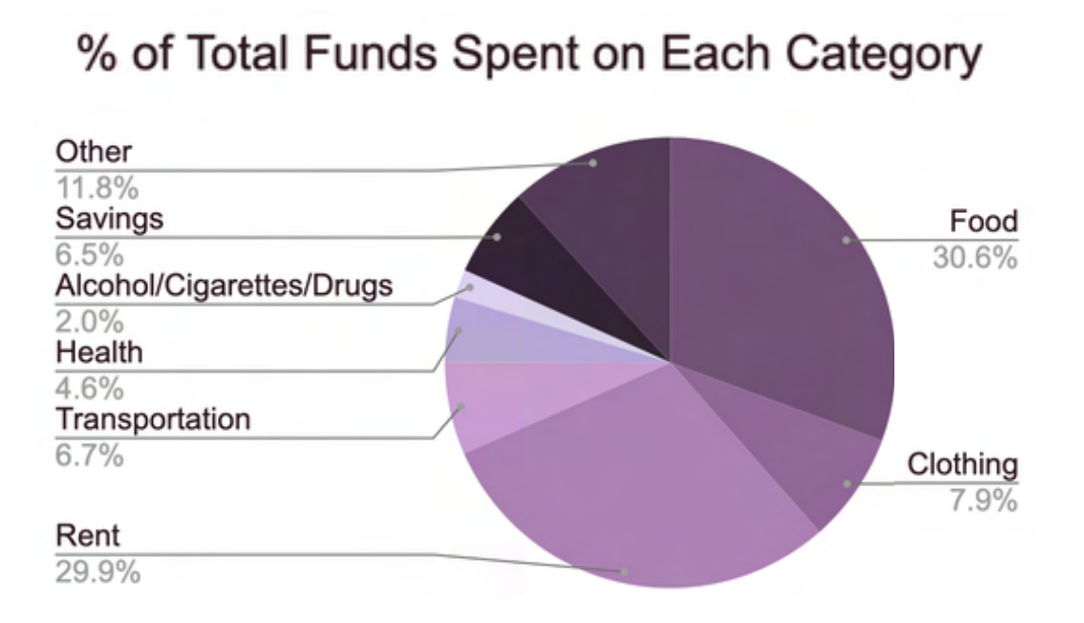
Notes:
Story about wine bottle

Slide 14
Who can’t guaranteed income help?
Families, Youth, Seniors
Recently Homeless
About to be Homeless
Chronically Homeless Individuals
Children w/o Parents
Severely Disabled
People suffering from
Addiction &/or
Mental Illness
✅

Slide 15
London’s Rough Sleeper Experiment
13 People
4-45 Years Homeless
One year of a “personalized budget”
69% Moved into Housing <1 Year

Slide 16
“For the first time in my life, everything just clicked, it feels like now I can do something.” - Simon

Slide 17
Who can’t guaranteed income help?
Families, Youth, Seniors
Recently Homeless
About to be Homeless
Chronically Situationally Homeless Individuals
Children w/o Parents
Severely Disabled
People suffering from extreme & debilitating
Addiction &/or
Mental Illness
✅

Slide 19
-13 IQ
The Stress Imposed by Poverty
=
The Effects of Alcoholism
=
Losing a Night of Sleep

Slide 20
Guaranteed Income is not a silver bullet.
But it is a (very) large part of the solution.

Slide 21
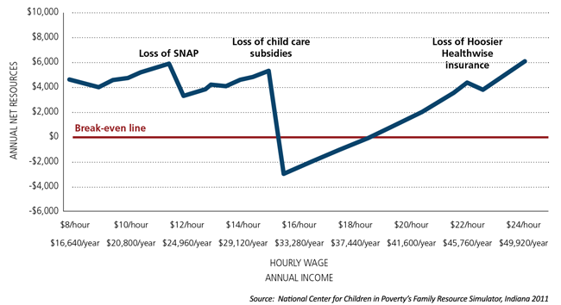
Why? Incentives!

Slide 22
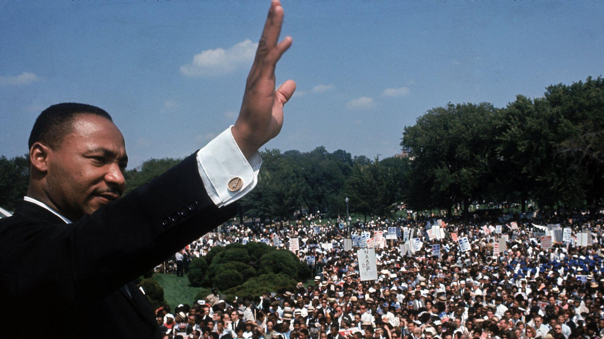
I am now convinced that the simplest approach will prove to be the most
effective -- The solution to poverty is to abolish it directly by a now widely discussed measure: the guaranteed income
-Martin Luther King Jr.

Slide 23
Universal Basic Income
Power to End Poverty
No Negative Incentives
No Paternalism
No Humiliation

Slide 24
The Logical oundation
Normalize Guaranteed Income for People in Need
Run Rigorous Cash Benchmarking Studies
Increase Resources for High Impact Interventions
Notes:
if we’re trying to help people in poverty, and we have money dedicated to that purpose, we must treat the money like it is their money, not ours. Giving it directly should be the default, and doing anything else should be subject to benchmarking research

Slide 25
Annual Costs of Homelessness in Arizona
13,556 People Experiencing Homelessness
Federal + Local + Charity + Police/Legal + Medical
>$1.25 Billion Arizona Annually

Slide 26
<5% - $50M
Provide 50% of the homeless population in Arizona $1,000 a month for 6 Months

Slide 27
Foundation’s Maximum Impact Pilot
$200,000 Minimum Budget
80% Directly to Unhoused People
24 Unhoused Participants
$1,000/Month for 6 Months
2-Step Addiction/Mental Illness Screening Process

Slide 28
The Logical oundation
We are paving a path towards cost-effectively ending homelessness and poverty
Contact Michael to get involved!
Michael@thelogicalfoundation.org
Learn More
thelogicalfoundation.org

