Slide 1
Making our Voices Heard: Tips and Tools for Affordable Housing Advocacy
Please enjoy some music by local band Cold Shott and the Hurricane Horns!
Lindsay Duvall (she/her)
National Low Income Housing Coalition

Slide 2
Workshop Outline
Introduction
Advocacy 101
Advocacy Tools
Federal Policy Update
Take Action!
Reflections, Next Steps
40 minutes
15 minutes
5 minutes

Slide 3
About NLIHC
The National Low Income Housing Coalition is dedicated to achieving racially and socially equitable public policy that ensures people with the lowest incomes have quality homes that are accessible and affordable in communities of their choice.

Slide 4
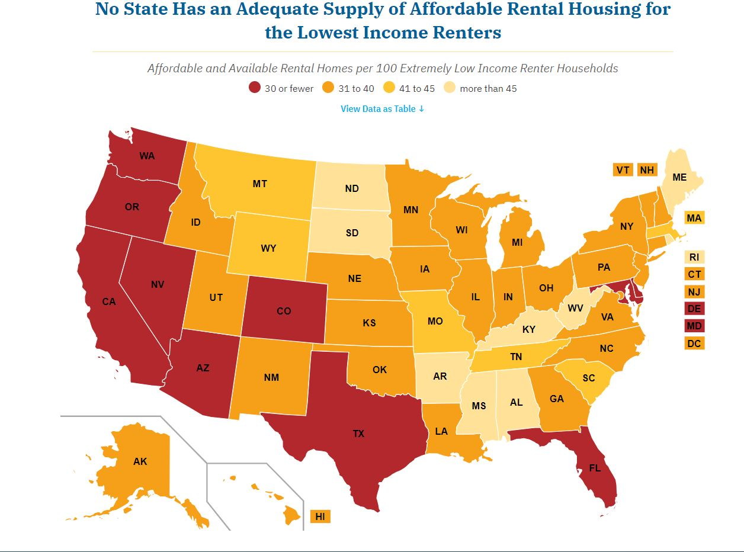
The Gap
No State Has an Adequate Supply of Affordable Rental Housing for the Lowest Income Renters

Slide 5
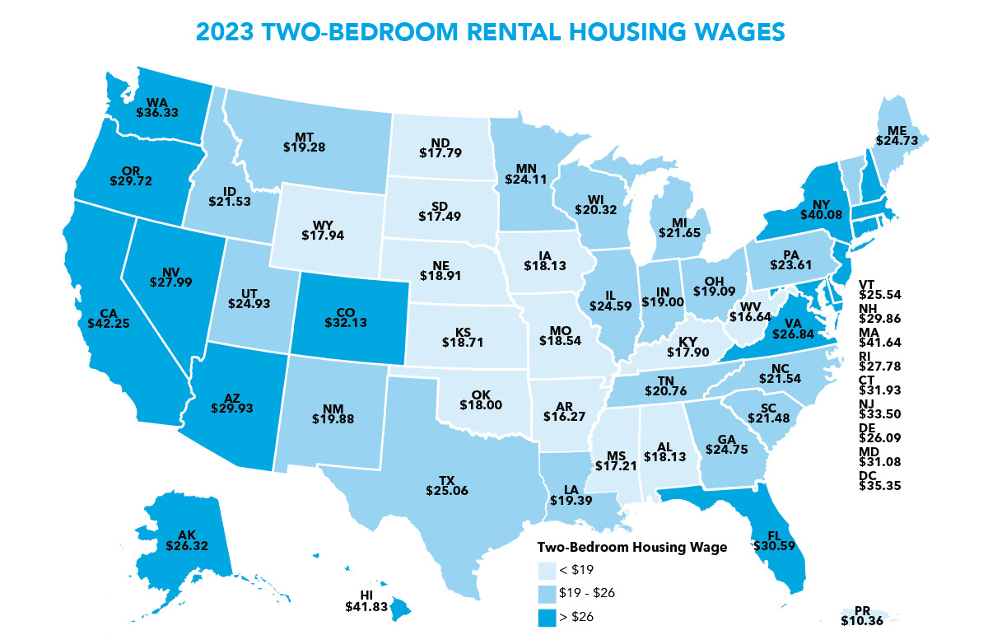
Out of Reach

Slide 6
Solutions
Bridge the gap between incomes and housing costs
Expand and preserve the supply of deeply affordable rental homes
Provide emergency rental assistance to stabilize families in crisis
Strengthen and enforce renter protections

Slide 7
Advocacy 101

Slide 8
Advocacy vs. Lobbying
Advocacy
Public education and organizing in support of your mission
Includes informing public officials about an issue or problem without specific legislation
Lobbying – must include all 3
Communicating with decision makers
Communicating about existing or potential legislation
Asking the decision-maker to vote a specific way on legislation
In general, should be less than 5% of overall staff time + resources
Resources
www.bolderadvocacy.org

Slide 9
Advocacy Campaign
Identify your goals
Identify your targets
Assess your strengths and limitations
Select your strategy/strategies
Create your message

Slide 10
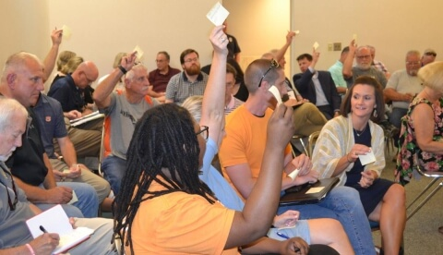
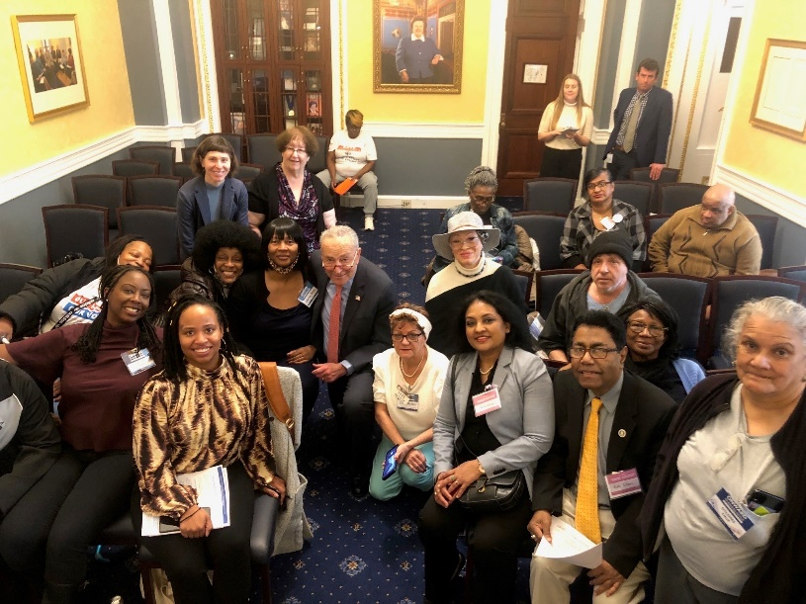
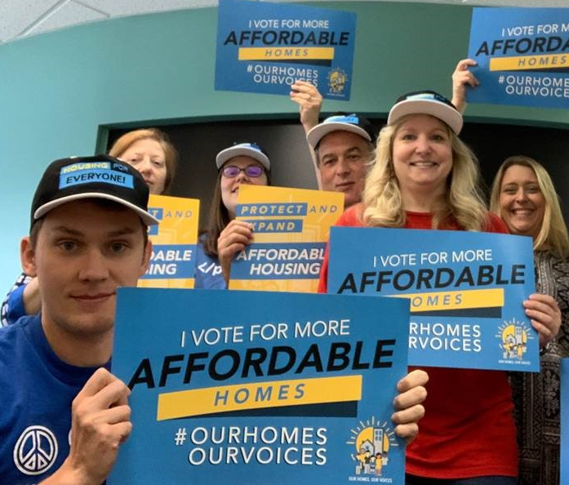
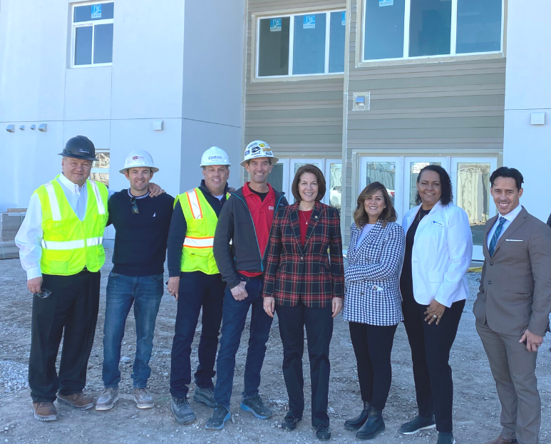
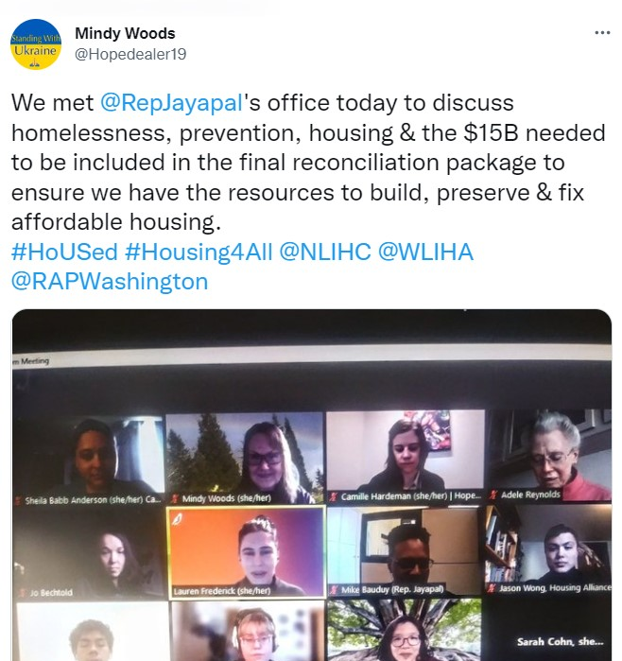
Advocacy Strategies

Slide 11
Advocacy Meetings
Just a conversation
You are the expert on the issue
Bring directly impacted people into the conversation
Research your legislator in advance
Prepare talking points and materials
Build a relationship, establish a tone of partnership
Share personal stories and your common values
Make a specific ask
Listen
Thank them and follow-up

Slide 12
Policy Advocacy Goal
Staunch Opponent
Opponent
Neutral
Supporter
Staunch Supporter

Slide 13
Advocacy Tools

Slide 14
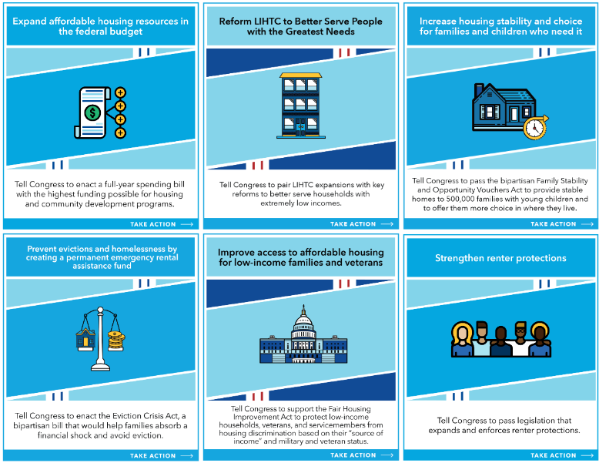
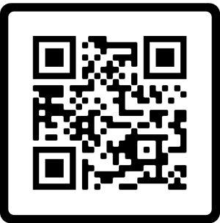
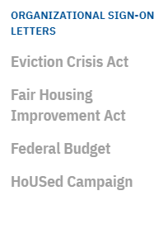
Legislative Action Center
nlihc.org/take-action

Slide 15
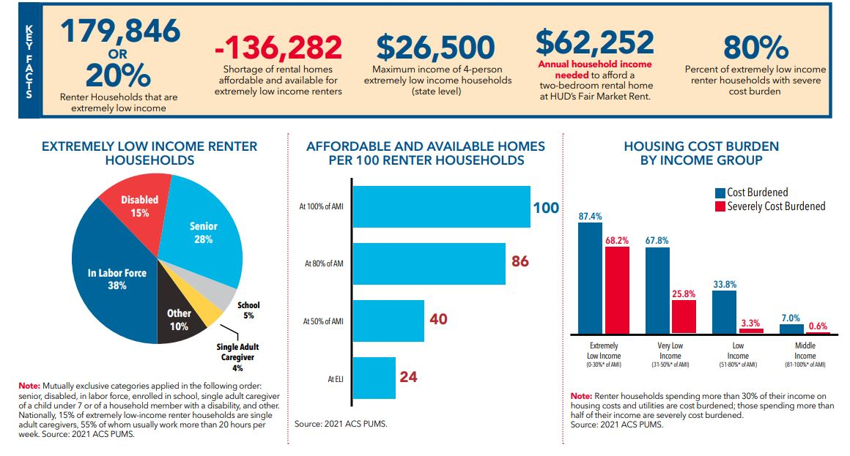
Arizona Housing Profile

Slide 16
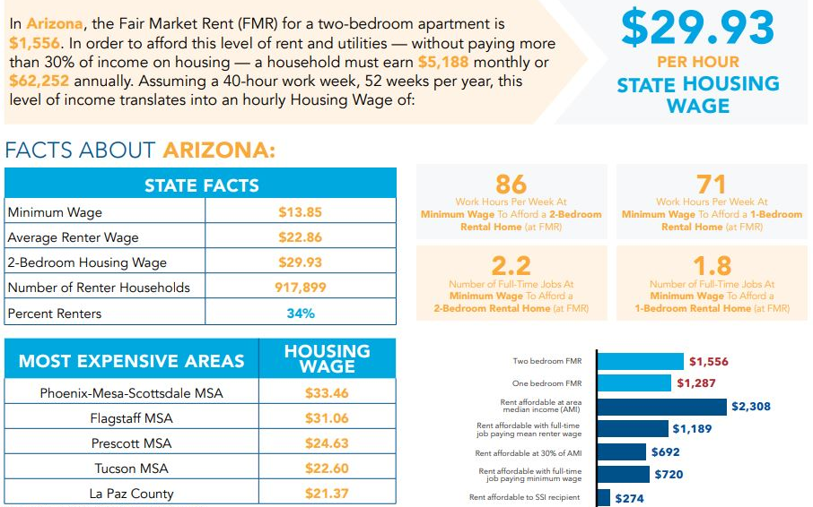
Arizona Housing Wages

Slide 17
Congressional District Data

Slide 18
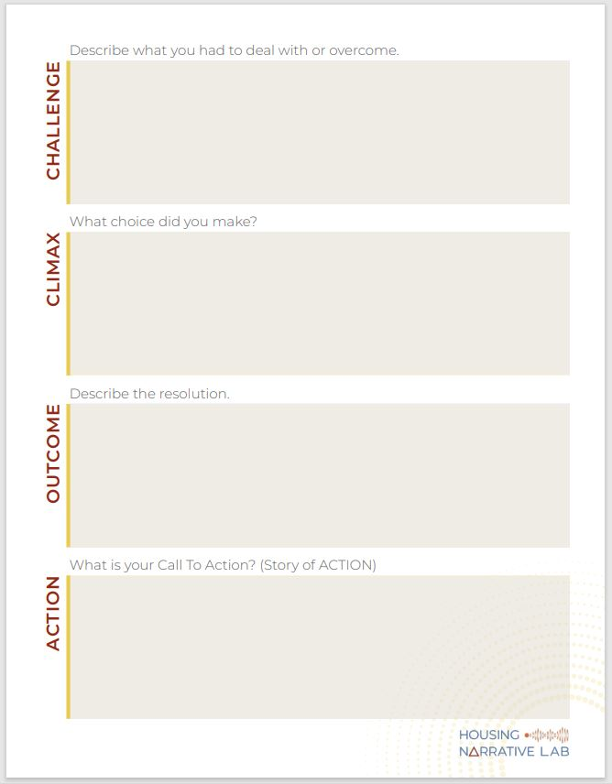
Storytelling

Slide 19
Messaging/ Framing
www.
housingnarrativelab.org
/resources

Slide 20
Federal Policy Update

Slide 21
Federal Budget
Funding runs out for some federal agencies on March 1st
Congress must either pass a final spending bill or enact another short-term continuing resolution
Reports indicate that appropriators have reached an agreement on funding HUD, but still finalizing agreements on policy provisions
Because of the debt ceiling negotiations earlier this year, there are tight spending caps in place
NLIHC is pushing for the highest possible funding for affordable housing in the FY 24 budget

Slide 22
NLIHC Policy Priorities
Bipartisan Eviction Crisis Act
Bipartisan Family Stability and Opportunities Vouchers Act
Fair Housing Improvement Act
Reform LIHTC Program
Expand Renter Protections
Oppose Efforts to Undermine Housing First or Criminalize Homelessness

Slide 23
Putting it all Together
Goal: Expand funding for Housing Choice Vouchers in the federal budget
Targets: Members of Congress
Strengths/ limitations: Data to show the need/ Limited time
Strategies: Phone calls, emails, virtual meetings
Create your message
Everybody wants a safe place to call home, but skyrocketing rents, lack of available units, and low-paying jobs are forcing some of our neighbors into homelessness.
Here in the 4th district, there are only 24 affordable and available rental homes for every 100 extremely low income households, which forces 80% of them to pay more than half their income on housing. This leaves very little money leftover for other basic needs, and puts them at great risk for falling behind on rent, facing an eviction, and in the worst cases, being pushed into homelessness.
The Housing Choice Voucher program is an essential tool that enables low-income families to stabilize and improve their lives, but currently only 1 out of every 4 eligible households receive a voucher due to limited funding.
Many of my clients are on the waiting list for a voucher for years. The work multiple jobs or double-up to afford rent.
By expanding – not cutting - funding for Housing Choice Vouchers in the budget, we can stabilize more households, prevent them from being pushed into homelessness, and enable them to be productive members of our community.

Slide 24
Take Action!

Slide 25
Suggestions
Use NLIHC’s Legislative Action Center
sign-on to letters
send emails, phone calls or Tweets
look up your legislators, identify their priorities
Complete ‘Building a Story of Self’ handout or identify someone with a personal story to share
View Housing Narrative Lab messaging resources at www.housingnarrativelab.org/resources
Review NLIHC housing needs data sheets
Review Arizona Housing Coalition’s priorities at www.azhousingcoalition.org/advocacy
nlihc.org/take-action

Slide 26
Reflections, Next Steps
Thank You!
Lindsay Duvall (she/her)
National Low Income Housing Coalition
lduvall@nlihc.org | 202-662-1530 x206

