Slide 1
Expanding Promising Practices to Co-Locate with Churches, FQHCs and Government Owned Land
Gabriel Jaramillo-Vitalyst Health Foundation
Darlene Newsome- Newsome Nonprofit Consulting- Consultant with Vitalsyt

Slide 4
Housing on School Property
Original Report came out in 2021
Highlighting Needs, Obstacles
Outlined Opportunities for Development
How School Districts Can Create Attainable Housing Opportunities (June 2021) - Vitalyst Health

Slide 5
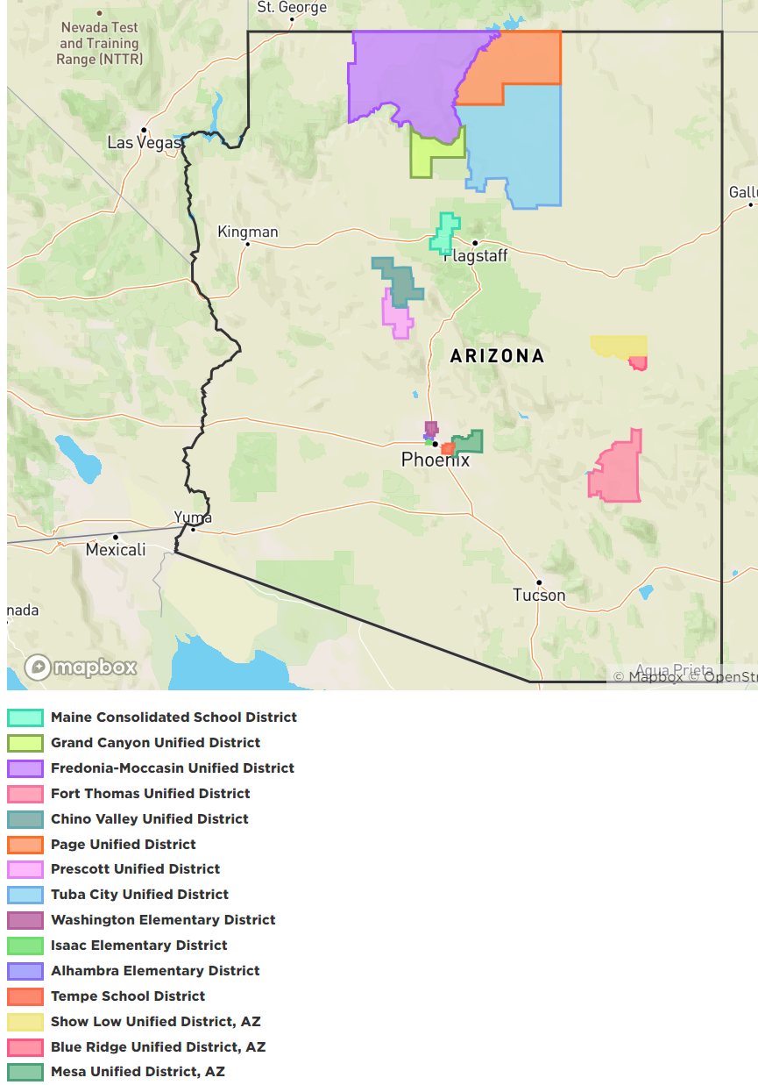
Housing on School Properties Tool Kit
How School Districts Can Create Attainable Housing: A Toolkit (January 2024) - Vitalyst Health
7 Cohorts
Plans with School Districts and Developers
Growing and Expanding Interest
Taking Advantage of Land Use and Zoning Policy
Addressing Community Needs

Slide 6
Colocation- Examples and Best Practices
What is Colocation?
Benefits
Joint use, shared use
Financial benefits. Spread Costs
One stop for communities
Examples:
Hellen Drake Center, Phoenix Az
Housing and Senior Center
Montgomery County, Maryland
Alexandria Virginia, Housing and Police Station
City of Surprise, Az
Multi-Generation Center, Resources
Colocation options with FQHC’s and other government owned property
Mountain Park Health Clinic and YMCA
School Districts and FQHCs
City of Chicago- Library and affordable housing
Colocation White Paper- Montgomery County Planning Department-Montgomery_County_Colocation_Study_Final_Report_20180830.pdf (montgomeryplanning.org)
Pinetop Lakeside and Blueridge School District- Housing and Childcare on School Property

Slide 7
Churches and Affordable Housing
Why were faith-based groups the next step?
Similarities to School Property
Mission Focused
Recognized as Local Resource Hubs
Enterprise- Faith Based Development
LISC- Alameda County, Faith and Housing Impact Report-Faith and Housing Program | LISC Bay Area
Examples:
Family Promise
Tanner CDC
Rehoboth Place
Seattle, Wa.

Slide 8
Next Steps:
Faith Based Academy
Continued Work With School Districts
Developing New Cohorts Around Colocation Projects
Presenting Reports: School Tool Kits and Promising Practices
Continue to Find National Best Practices
Support Land Use Policy at all Levels
Funding Resources- Workforce Fund, LIHTC, Bonds and Private Funds
Faith Based Academy-lp.constantcontactpages.com/ev/reg/hd3g3t6

Slide 9
Policy and Land Use for Colocation
State Policy- Current Session
HB2815-Church Property Affordable Housing, YIGBY
HB2576 and SB1689 Renewing State LIHTC
SB1506- Allows Residential Mixed Use Development on Land Zoned Commercial
SB1415- ADU’s
HB2721- Allowing for Middle Housing
Local Policy-
City of Tucson ADU and preapproved site plans
City of Phoenix- TA for ADU’s and Manufactured Housing, Parking minimums changed, General Plan Update
City of Mesa and Tempe- General Plan updates
Support policy that promotes solutions for housing.

Slide 10
Questions?
Gabriel Jaramillo- Gjaramillo@VitalsytHealth.org
Darlene Newsom- DarleneNewsomAZ@GMail.com

