Slide 1


A Reflective Look
at Affordable and Supportive Housing
Jennifer Jennings, Sr. Director of Housing and Asset Management
Jessica Cruz, Sr Director of Homeless Housing Services
Notes:
During our time today we will discuss the complexities of supportive housing development and property management. From a mission driven lens.

Slide 2

  Established in 1972, we began as a small grassroots organization operating on program for Native American men in recovery from substance use disorder.
  Today NAC owns and operates 25+ sites through the greater Phoenix. Our housing portfolio offers affordable family, affordable senior and permanent supportive housing.
  NAC’s also operates 2 inpatient treatment centers, an outpatient treatment center, a health office and two youth shelters (18 to 26).

Slide 3
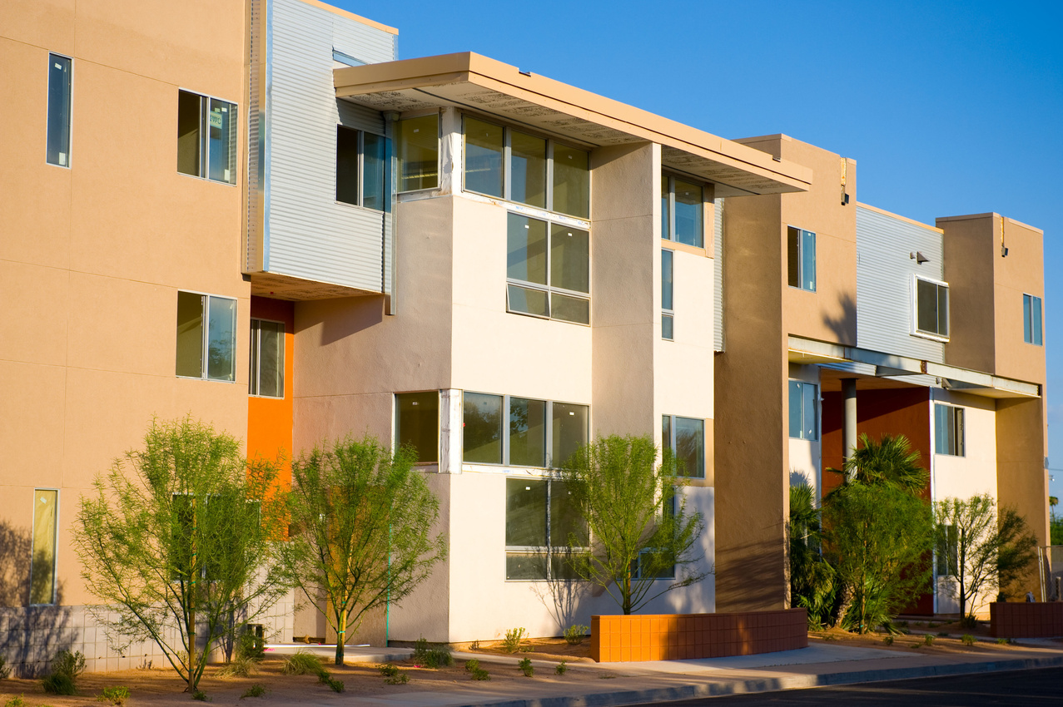
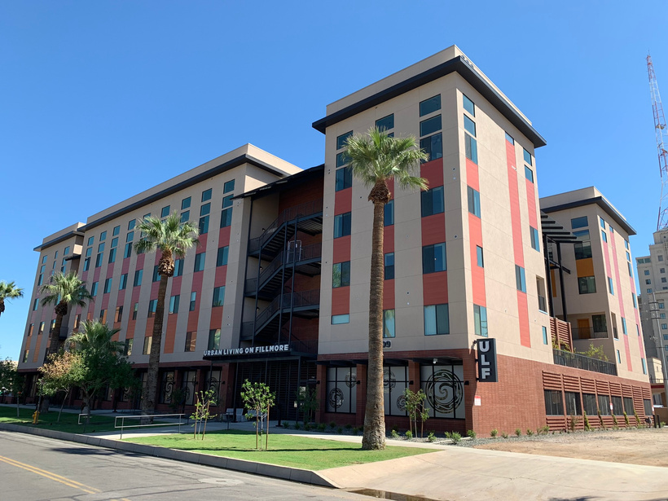
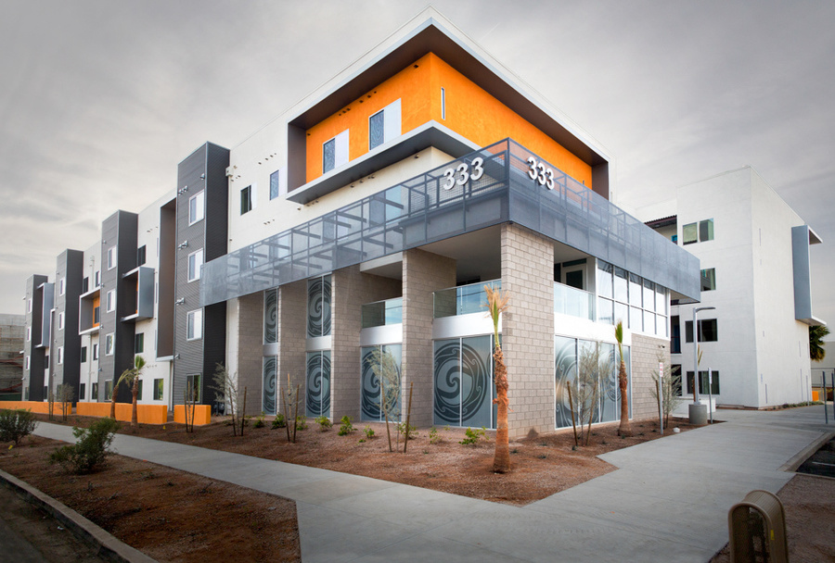
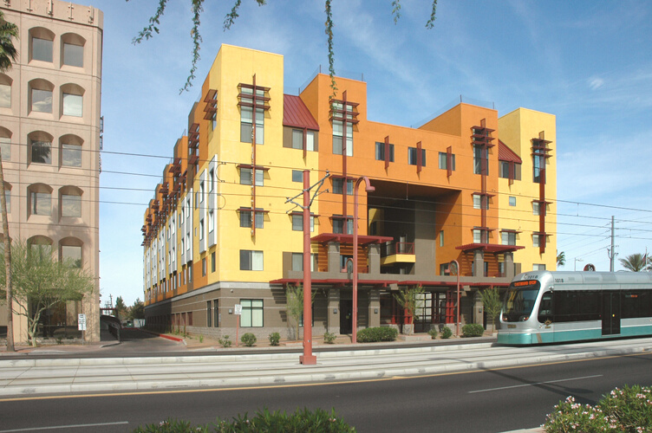
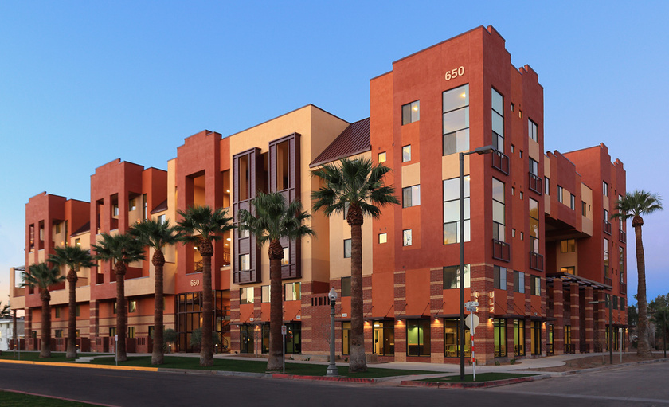
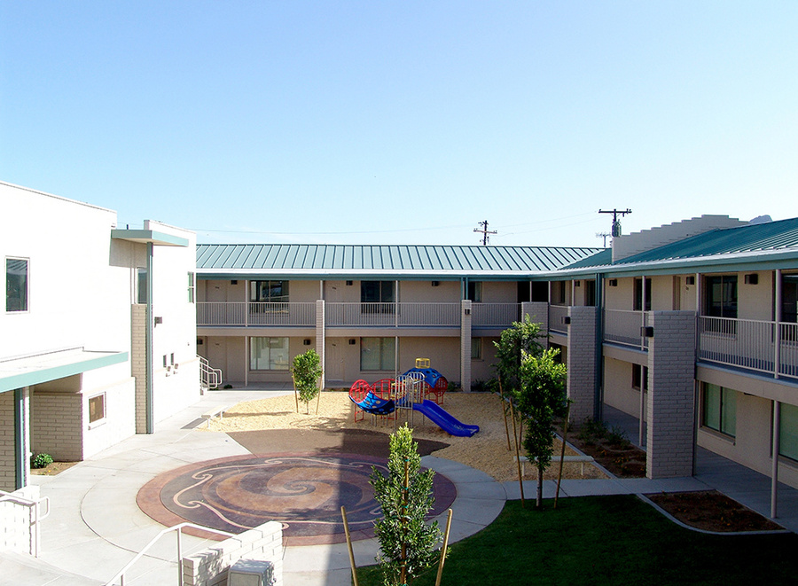
Affordable Housing
Resident Services Available at All Affordable Housing Communities

Slide 4
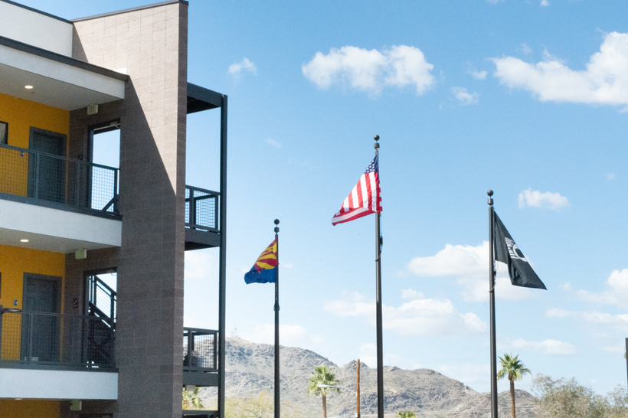
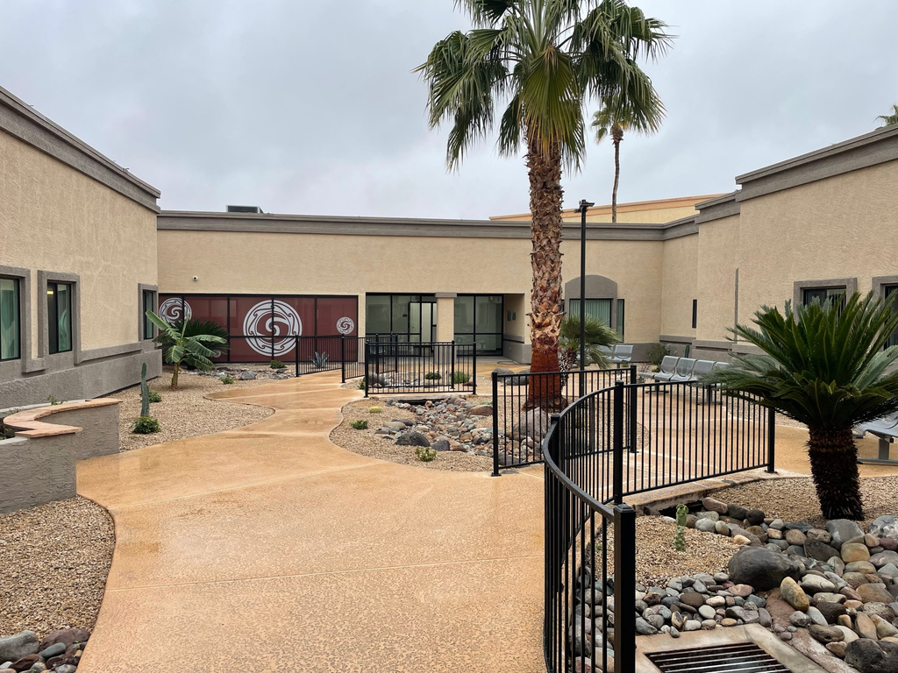
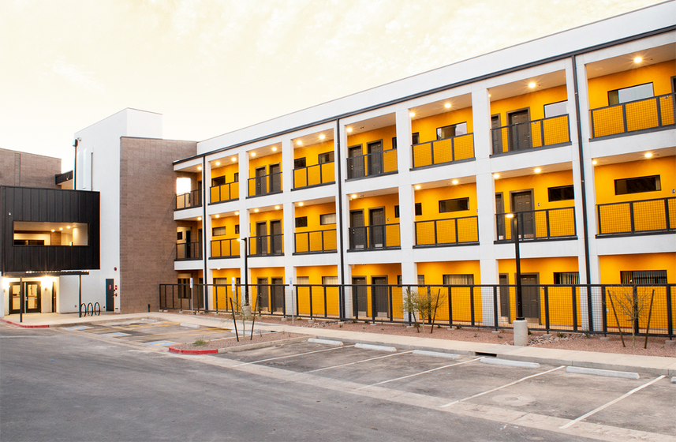
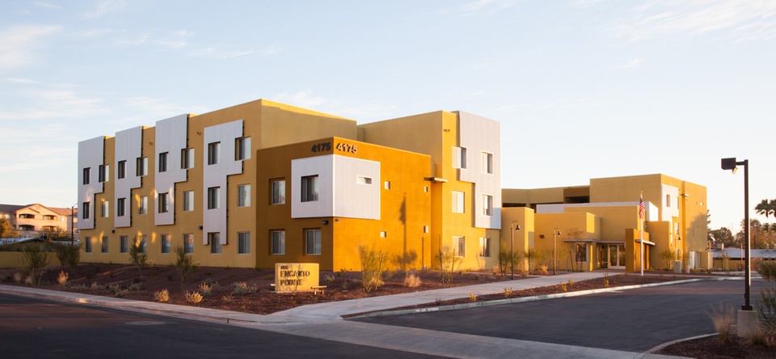
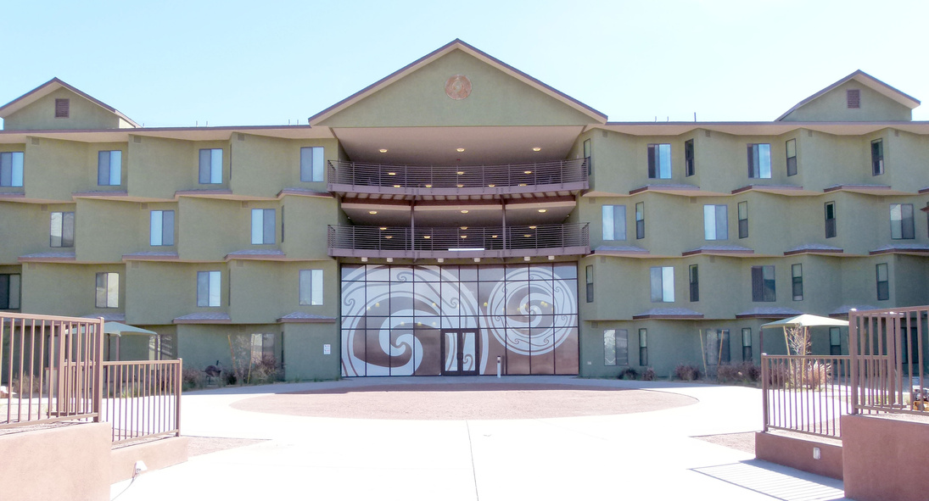
Permanent Supportive Housing
Case Management & Resident Services Available at All PSH Communities
Notes:
One point of entry, overnight limitations (single occupants), 72 hour checks – case management
Case Management- 24/7 case aid to ensure safety
Social determinants of Health – focuses on economic stability, health care access – through our integrated health facility, economic stability – connection to entitlements/SOAR certified specialists, social and community (superbowl party requested by the residents), Neighborhood, in the development stage, communicate with the PM side .
Monthly home visits, although CM is available onsite 24/7Community Meetings
What sets us apart from other PSH programs, we hold their units, coordinate transportation. When their housing is secure they are more likely to complete their treatment because they know they have somewhere to go.
During summer months we extend overnight stays as opportunity to serve our community for those unsheltered individuals. 15
We have PM staffing once a week with PM/CM and HUDVASH for our veteran properties
The site lead or supervisor meets with the PM at the beginning of the week to review notices to be issued for weekend occurrences, any outstanding recertifications, potential health and safety, or residents that have not been seen.

Slide 5
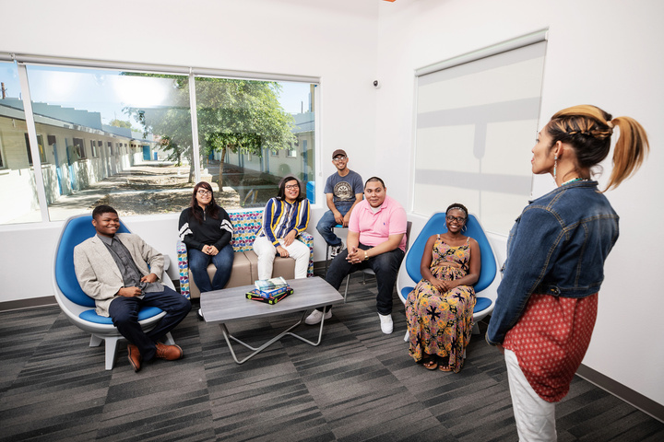
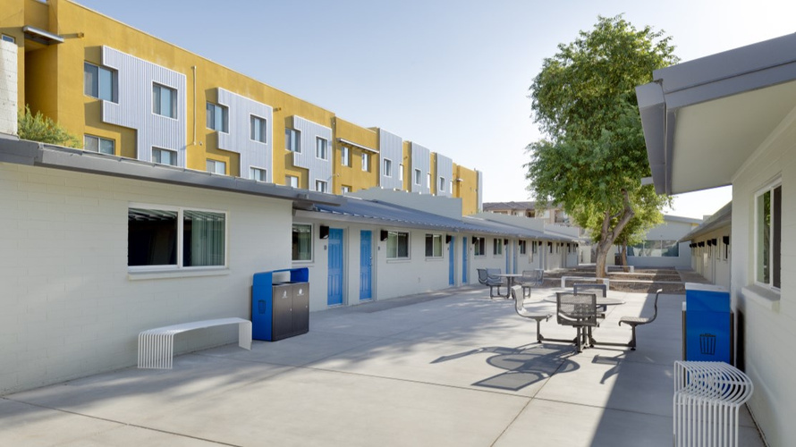
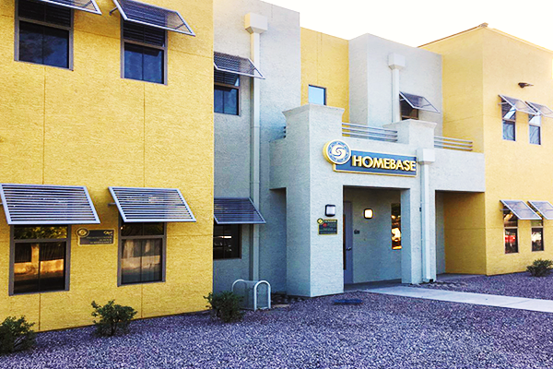
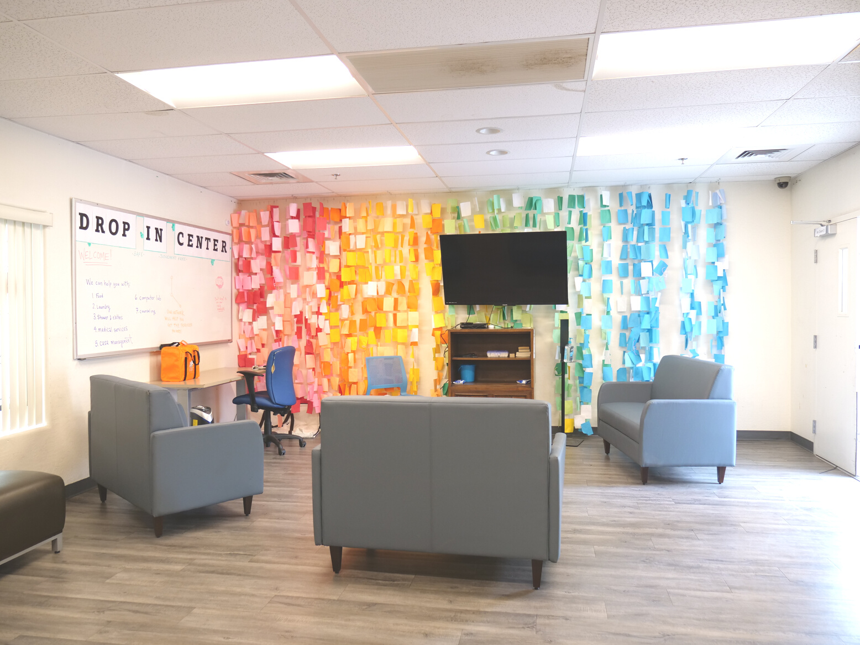
Transition Age Youth Housing & Shelter
Case Management & Resident Services Available at All Transition Age Youth Communities
Notes:
Homebase Phoenix was acquired in 2008 from Tumbleweed. 25 units, With ADA 18-26, SK 24 units, remodeled in
Homebase Surprise opened in Feb 2023 with 40 beds (2 ADA units), Teacher on site, youth are expected to attend 10 a week. Teacher has 4 classes a day. We promote education and employment. We are partnered with Maricopa County Arizona at work – Youth program. Averaging 80% of positive exits.
1618 people as of December 2024. Drop in centers and outreach teams.

Slide 6
Affordable Housing
Urban Living on Fillmore (ULF)
Supportive Housing
Stepping Stone III

Slide 7
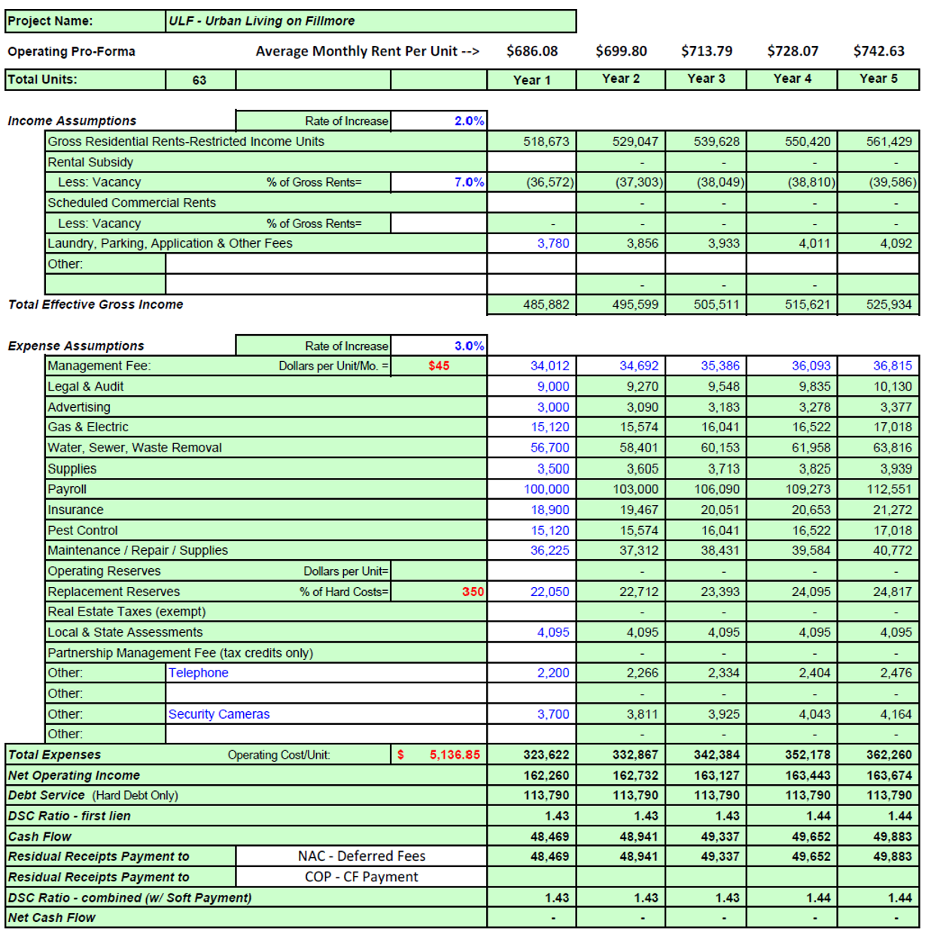
ULF
NAC leveraged 9% LIHTCs awarded by ADOH to anchor the capital stack for this affordable housing community serving families.
Since NAC’s basis in the land was minimal, NAC
was able to provide Seller Carryback financing to ensure financial viability.

Slide 8
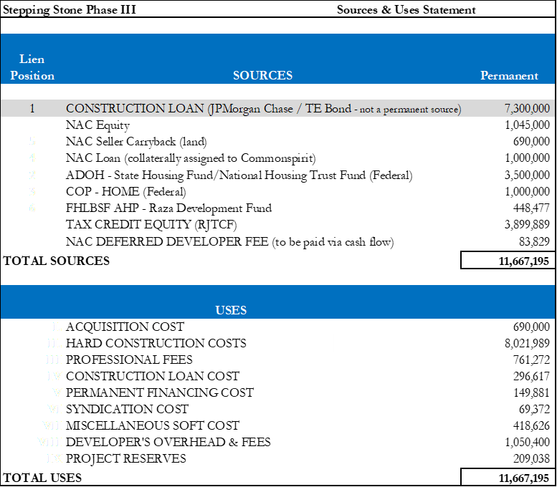
ULF
From construction loan sizing at construction start to stabilization, the maximum rents established by HUD increased to create “cushion” in the DSC Ratio.
Fortunately, NAC can allocate that surplus cash flow to pay the deferred developer fees.

Slide 9
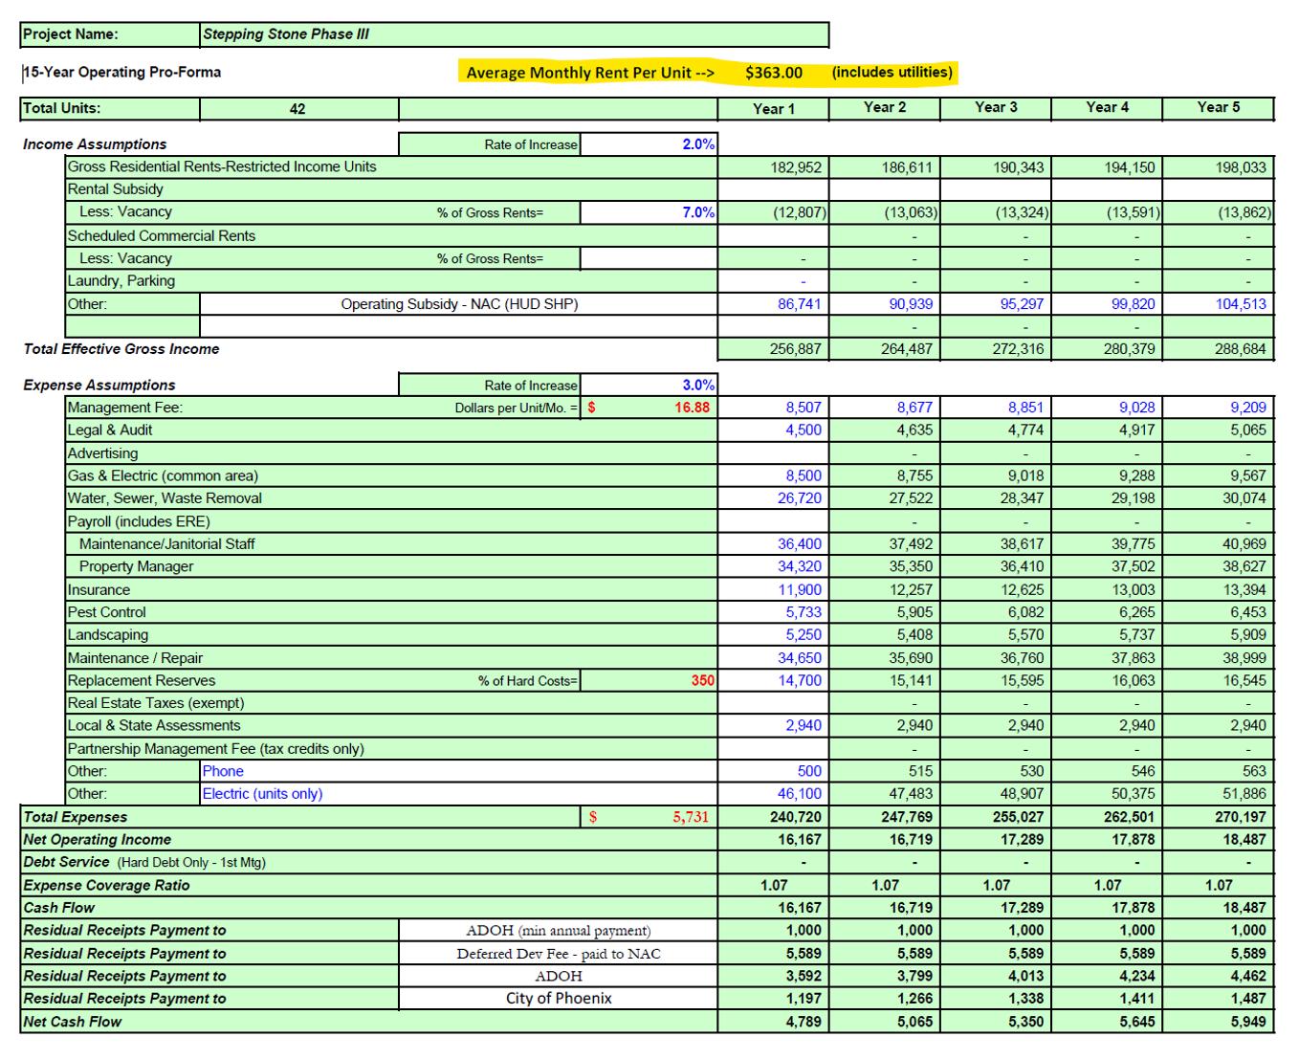
Stepping Stone III
NAC utilized 9 different capital sources to develop Stepping Stone III. Originally planned as a 9% LIHTC project, competitiveness in the Arizona 9% LIHTC program required NAC to switch to a 4% LIHTC Tax-Exempt Bond financing structure.
This property utilizes a combination of TBRA’s and HUD CoC for operational support to serve chronically homeless individuals.

Slide 10
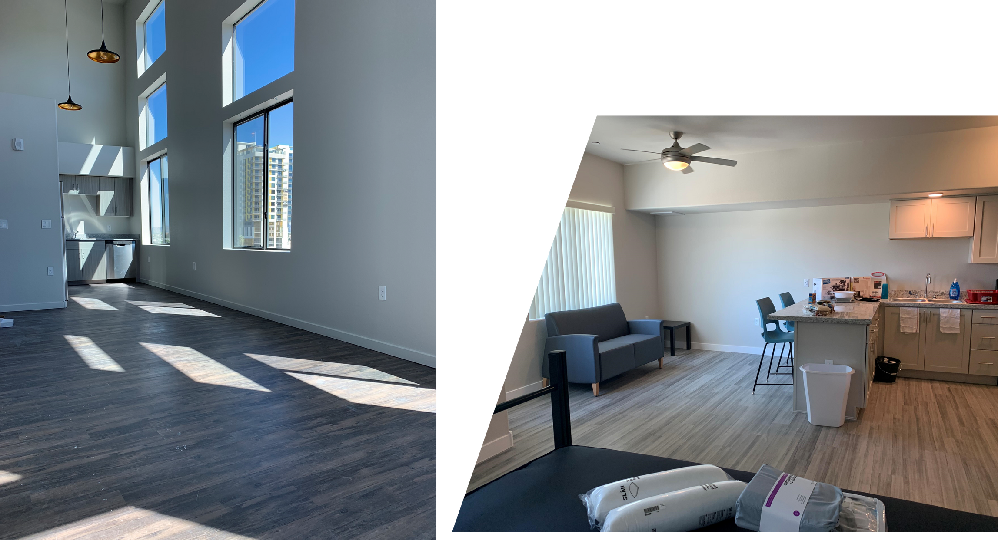
Stepping Stone III
Stepping Stone III participates in the Maricopa Association of Government’s Continuum of Care(“CoC”) program for all referrals into this Housing First Permanent Supportive Housing Community. Under the CoC program NAC is able to utilize HUD’s financial support for operations and services of the property ensuring deep rent skewing serving many households at $0 income up to 30% AMI.
In addition, NAC accepts all Section 8 and VASH Vouchers as well as private rental assistance source (e.g. Tribes).

Slide 11
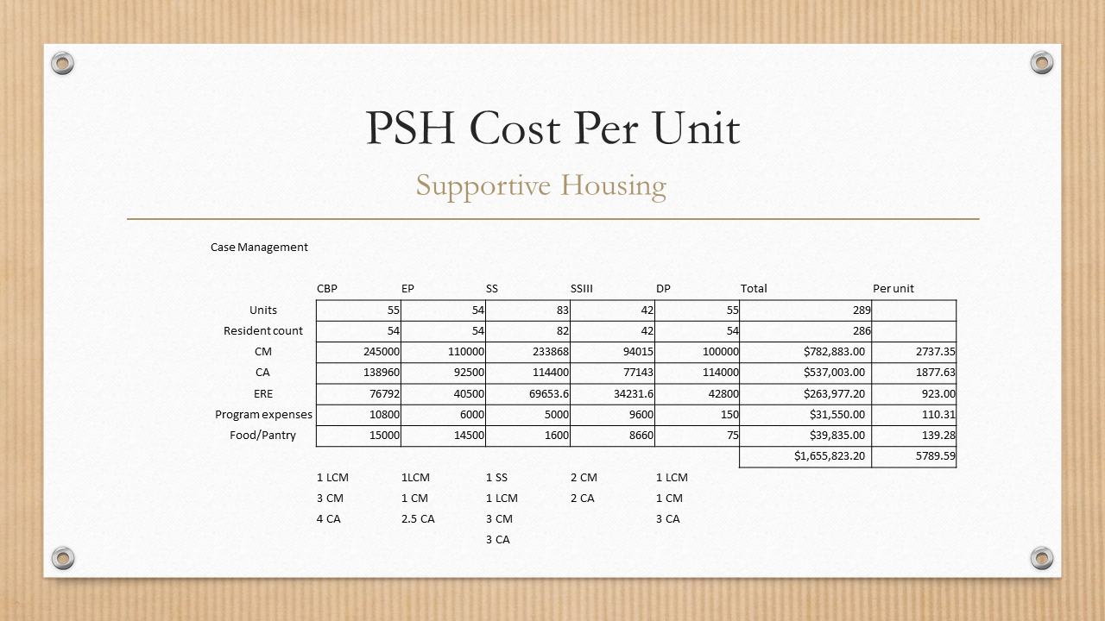

Slide 12
Employee Cost
Affordable Family
Supportive Housing
  Property Management salaries built into the financials at development as part of operations
  Operates normal business hours
  Provides resources and resident services but not housing case management
  Needs higher subsidy rents than affordable
  Heavy reliance on either grant or PBV’s to support operations
  Case Management is outside the operating budget
  Most operate 24/7

Slide 13
Affordable Family
Resident Services Costs per unit
Resident Services
 |  |  | .25 FTE |  | .50 FTE | .50 FTE | .25 FTE |  |  | .25 FTE | .25 FTE
 | Devine | Coral | Catherine | Cedar | Landmark | Carefree | Sunrise | UL2 | ULF | Whispering | SK | Total | Per unit
Units | 65 | 69 | 28 | 74 | 52 | 36 | 35 | 70 | 63 | 20 | 24 | 536.00
Resident count | 197 | 341 | 37 | 220 | 53 | 44 | 35 | 184 | 160 | 59 | 24 | 1354 | 2.53
Salary | $45,760.00 | $45,760.00 | $11,440.00 | $45,760.00 | $22,880.00 | $22,880.00 | $1,440.00 | $45,760.00 | $45,760.00 | $11,440.00 | $11,440.00 | $320,320.00 | $597.61
ERE | $9,152.00 | $9,152.00 | $2,288.00 | $9,152.00 | $4,576.00 | $4,576.00 | $2,288.00 | $9,152.00 | $9,152.00 | $2,288.00 | $2,288.00 | $64,064.00 | $119.52
Program expenses | $150.00 | $150.00 | $150.00 | $150.00 | $150.00 | $150.00 | $150.00 | $150.00 | $150.00 | $150.00 | $150.00 | $1,650.00 | $3.08
Food/Pantry | $ 75.00 | $75.00 | $75.00 | $75.00 | $75.00 | $75.00 | $75.00 | $75.00 | $75.00 | $75.00 | $75.00 | $825.00 | $1.54
 |  |  |  |  |  |  |  |  |  |  |  | $388,749.00 | $725.28

Slide 14
PSH Cost Per Unit
Supportive Housing

Slide 15
Working Together
Property Management
Case Management
  Attend weekly staffing
  Review notices with Case Management staff
  Compassion for our residents while enforcing rules
  Mutual Rescissions instead of eviction
  Holding units while in treatment
  Arizona Landlord Tenant Laws & Rights
  Must know the lease
  Learning Sessions for Staff and Residents
  Community Meetings
  Flex funding

Slide 16
Mission Driven Housing
We’re improving the lives of individuals and families through Native American culturally competent behavioral health, affordable housing, and community development services.

Slide 17
Thank you!
info@nativeconnections.org
602-254-3247
www.nativeconnections.org

