Slide 1

The Shared Housing Process
Amber Maiberger, ASU Action Nexus

Slide 2
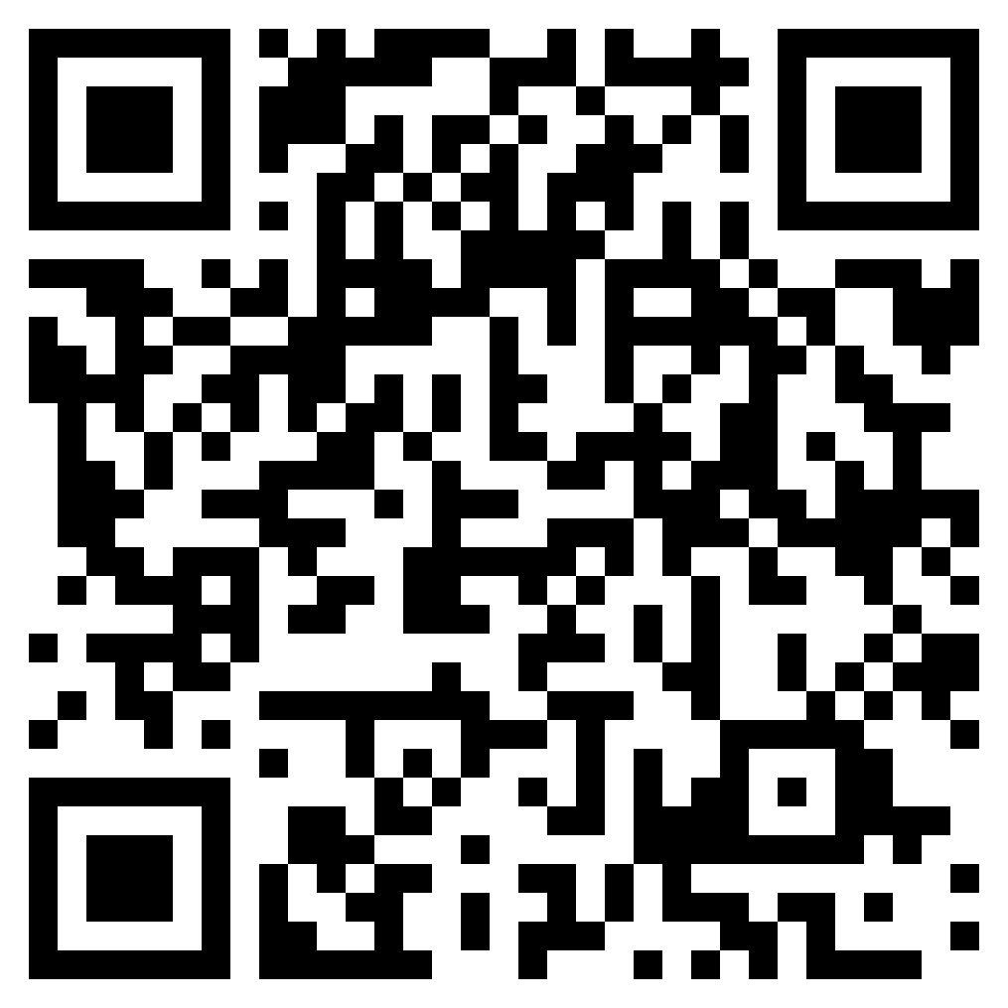
Please complete the pre-survey!
Notes:
5

Slide 3


What does Shared Housing do?
Maximizes access to existing 2-, 3-, and 4-bedroom housing options for ending homelessness
What does Shared Housing look like?
Two or more unrelated tenants who share common living space (most often have their own room)
Notes:
2

Slide 4
Why Shared Housing Now!
Decrease in affordable housing options
Increasing rents
Increased homelessness and length of time in homelessness
What we are facing:
What shared housing offers:
Between February 2022-February 2023, over 1800 individuals within Maricopa County identified at coordinated entry that they would participate in Shared Housing
Opens-up affordable housing options, split rent reduces individual rent burdens
More housing options reduces length of time to move-in
Opportunity to decrease isolation and increase self-determination
Shared housing is a norm – a common option - in the private housing market!
Notes:
Jake 3

Slide 5

Key Findings about Effective Shared Housing
All types of populations can be successfully served by shared housing when Housing First/Client Centered Principles are the foundation of all services
There is NO standardized/fidelity model of shared housing, instead an individualized approach should be taken with consideration for clients needs and shared housing best practices
https://www.sharedhousinginstitute.com/publications-1
Notes:
2.5

Slide 6
Shared Housing Impacts from other Communities:
Shared Housing Placements and Returns to Homelessness
(reported July 2020)
Organization | Communities | Shared Housing Funding Source | Shared Housing Target Population | Year for data – begin Shared Housing | Total # in shared housing since 2017 | Rate of Return to Homeless
MICAH | Fredericksburg, VA | PSH / RRH | Single Adults | 2018 | 225 | 7%
Palm Beach County | Palm Beach County, FL | RRH | Youth | 2017 | 258 | 9%
Illumination Foundation | Orange County, CA | PSH | Single Adults- Chronic Homeless | 2017 | 250 | 9%
Pacific House | Fairfield County, CT | PSH | Single Adults- Chronic Homeless | 2017 | 61 | 5%
PATH LA | Los Angeles County, CA | RRH | Single Adults | 2017 | 179 | 9%
BACS | Oakland, CA | RRH | Single Adults- Chronic Homeless | 2017 | 2000 | 10%
Notes:
2.5

Slide 7
Shared Housing Messaging

Slide 8
Shared Housing Client Messaging Process Points
Coordinated Entry Intake Question
Reality Testing
Housemate Pairing Questionnaire
Housemate Pairing Meet & Greet
Notes:
1

Slide 9
What is your role in shared housing client messaging?
Case workers can support client needs and have a positive impact on motivation for shared housing through client messaging
Identify if client has expressed interested in Shared Housing through their HMIS profile
  This question is being asked at Coordinated Entry:
    “Are you interested in living with another person as a means of reducing your rental costs and exiting homelessness quicker?”
It is never too late to ask a client if they are interested in having a roommate!!
Notes:
3

Slide 10

Shared Housing
Client Messaging
Your job is to offer a “menu” of housing options in ways that can be heard and understood
Framing Matters - we each have a particular view of where we want to live, many have had issues with house sharing in the past.
Frame the conversation using a problem-solving lens, listening deeply, motivating conversations that move towards informed decision-making and client choice.
Notes:
3

Slide 11
Client Benefits
move out of homelessness sooner
find better quality housing, more living space
can choose housemate/s
decrease isolation/increase personal support
shared housing can be temporary, stay for the life of the lease, or long term
Notes:
3

Slide 12
Motivational Interviewing Techniques (OARS)
OARS: Open Questions - Open questions invite others to “tell their story” in their own words without leading them in a specific direction.
OARS: Affirmations - Affirmations are statements and gestures that recognize client strengths and acknowledge behaviors that lead in the direction of positive change, no matter how big or small.
OARS: Reflective Listening (3 ways):
  1) Repeating or rephrasing: Listener repeats, rephrases what the speaker has said.
  2) Paraphrasing: Listener makes a restatement of speaker’s meaning.
  3) Reflection of feeling.
OARS: Summarizing – “Let me see if I understand so far.”.; “Here is what I’ve heard”. “Tell me if I’ve missed anything”.
Notes:
4

Slide 13
Reality Testing:
Notes:
10

Slide 14
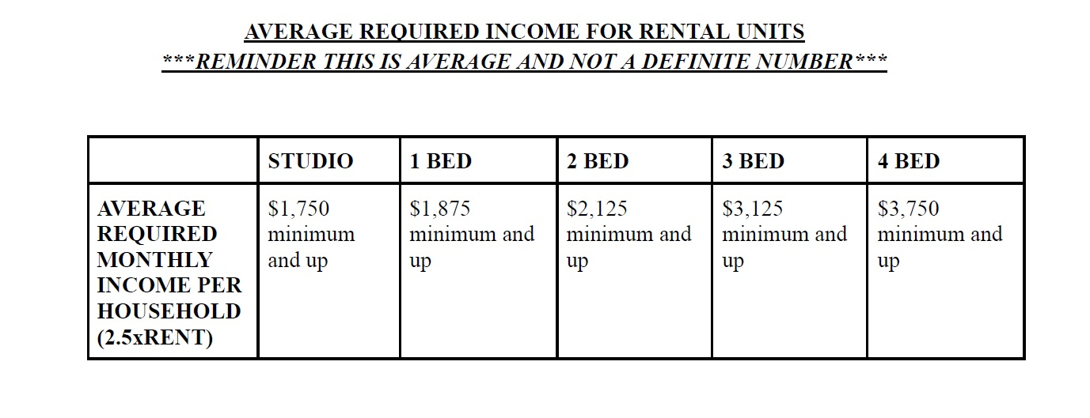
How to talk to clients about affordability?
Notes:
Jake 10

Slide 15
Now that they are interested…….

Slide 16
Housemate Pairing Process

Slide 17






Shared Housing Pairing Process
Requirements for Participating in Shared Housing Housemate Pairing Process:
Must have ability to afford rent(Employment, SSI, SSDI, Voucher)
  If income is too low, they may not be able to afford shared housing
Must actively be working with a Case Manager
  ASU does not work with clients directly
Must be move-in ready(Documents, Income, Fines Paid, Evictions Resolved, etc)
  If client is not ready, please wait to refer them until they are
Client says yes to SH
Ask if they know someone to live with
If no, complete Housemate Pairing Questionnaire
If yes, support clients in Deal Breaker Conversation to assess compatibility
Facilitate Housemate Meet and Greet(Deal Breaker Conversation)
Support Housing Navigation and Search
Support Housing Navigation and Search
Housing Found
Housing Found
Notes:
3

Slide 18
Case Manager Flow of Shared Housing
Case Manager introduces shared housing option with client during initial conversation
Case Manager completes Housemate Pairing Questionnaire
Amber sends introductory email between Case Managers with Potential Housemate Pairings
Once pair is finalized, Case Managers begin housing navigation and search
Clients sign lease, Case Managers help clients develop Housemate Agreement
Case Managers facilitate Meet and Greet Conversation with their clients
Notes:
3

Slide 19
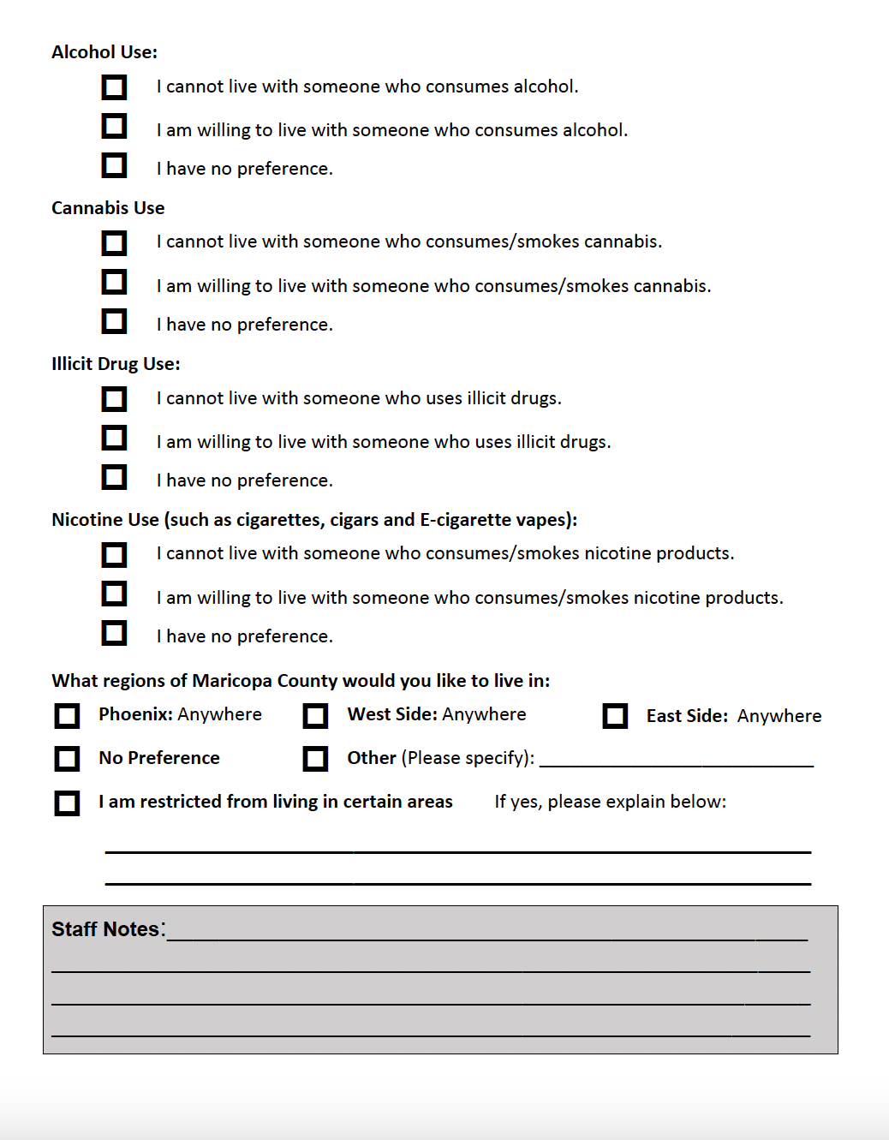
Housemate Pairing Process
Housemate Survey
Always First Ask: Do you know anyone you would want to live with?
Notes:
Jake 5
https://forms.gle/pzBYfRkzsDNdsikz7

Slide 20
Facilitating the Meet and Greet
Case Managers will collaborate together to schedule time for their clients to meet
  As the Case Manager, you will be the one communicating directly with your client to figure out their schedule and availability
  Clients can meet in-person, on zoom, or over the phone depending on preference
  You can provide clients with each other's contact information, with their permission, for them to meet independently
  Case Managers do not need to attend the Meet and Greet
Recap with your client after the meet and greet to provide space for them to process the meeting
Client will determine if they would like to continue with this pairing, email Amber if they are moving forward together or if they need a new pairing
Notes:
4

Slide 21
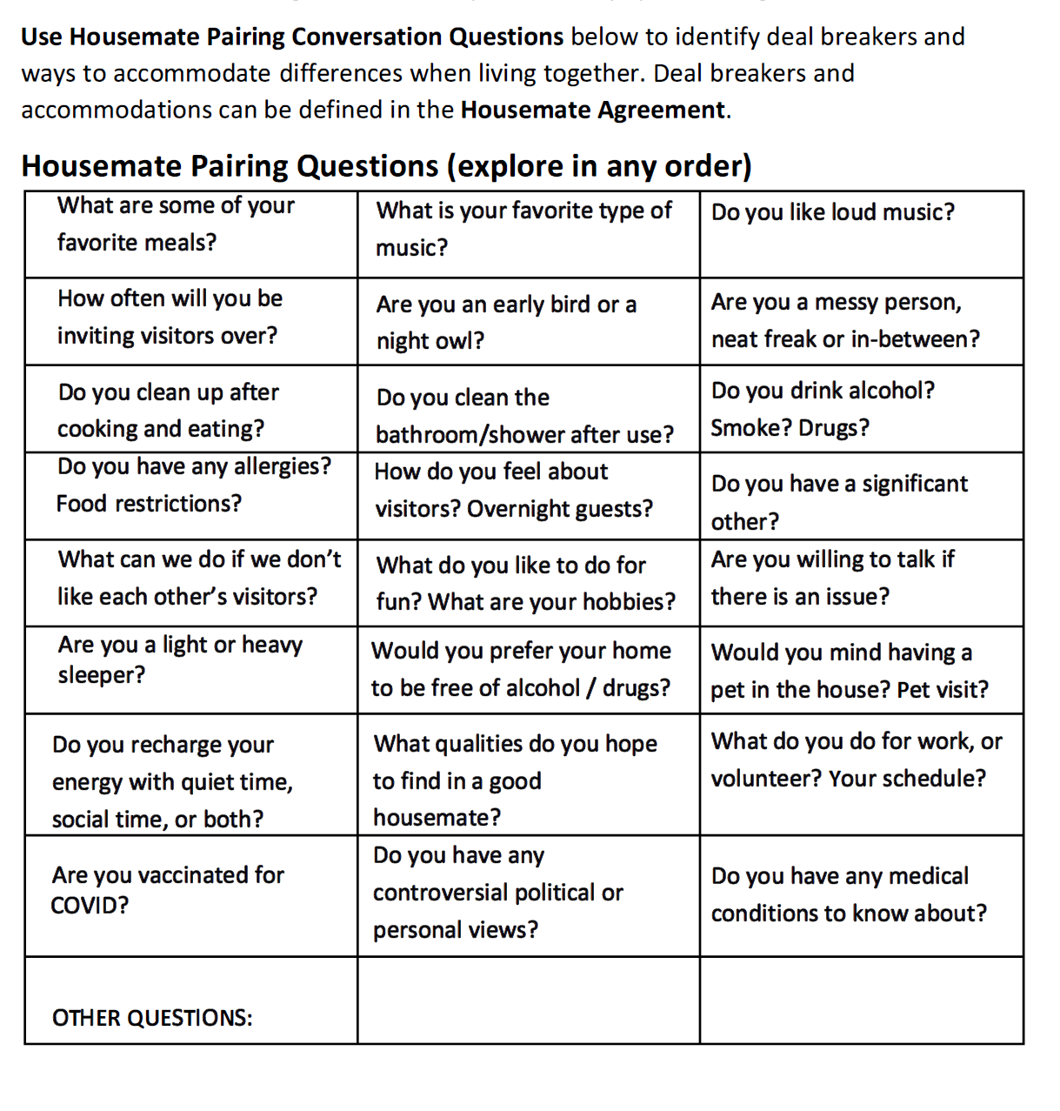
Deal Breaker Conversation Questions
Notes:
10

Slide 22
Best Practice for Landlord Engagement and Housing Navigation

Slide 23
The Landlord Engagement Process
If a client has a Housing Subsidy:
Hom, Inc will handle the landlord engagement process for individuals with a subsidy. The clients will use the Hom, Inc housing search process and units are available on Padmission.
If a client does not have a Housing Subsidy:
Case Managers will directly support their clients through the housing search and navigation.
Landlords needs ongoing commitment that vacancies will be filled if a roommate leaves the home
  Client can participate in housemate pairing process again if there is a vacancy
What is a lease bifurcation?
A BIFURCATED LEASE MEANS EACH INDIVIDUAL HAS THEIR OWN LEASE WITHIN THE HOME. THIS CAN ADD A SENSE OF SECURITY FOR THE INDIVIDUALS. LEASE BIFURCATION IS DEPENDENT ON THE LANDLORD NEGOTIATION.
Notes:
3

Slide 24
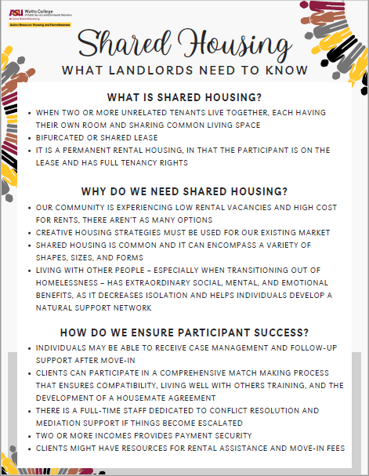
One-Pager Landlord Resource
Notes:
5

Slide 25
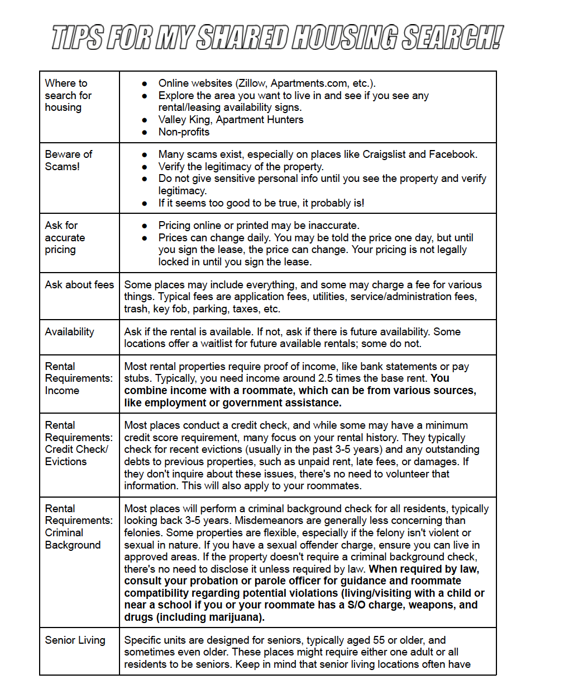
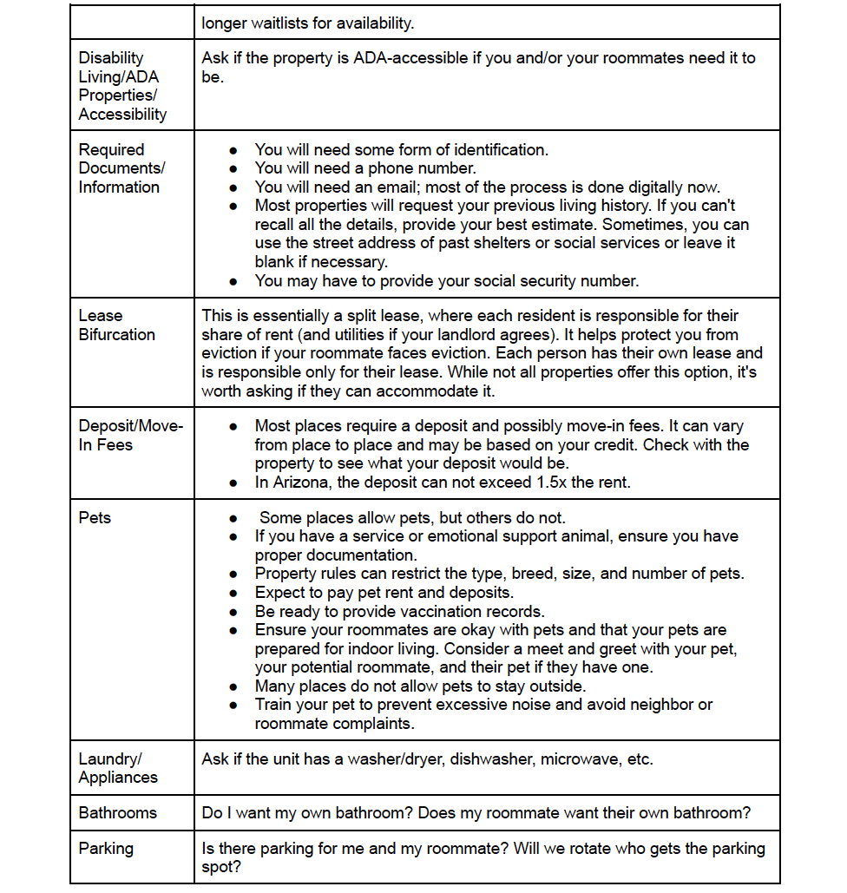
Notes:
Jake 5

Slide 26
Best Practice for Supporting Stable Housing

Slide 27

Shared Housing and Community Supports - Begin with the end in mind
Community-Care
Assess client supports:
What intensity of support is needed?
What is the duration needed?
What frequency of support is needed?
Be willing to change plan
Shared Housing is building Community within the home.
as each individual reveals more about what they need
Community Connections List currently in development.
Notes:
30,000 people in our community living in poverty; 200 are homeless. (mental health, addiction, credit, income issues) Difference is support system.
When relationship informs our approach we enter the work with our clients with a different understanding of what it means to build trust
Transactional Response: What services, resources and dollars can I set you up with?

Slide 28
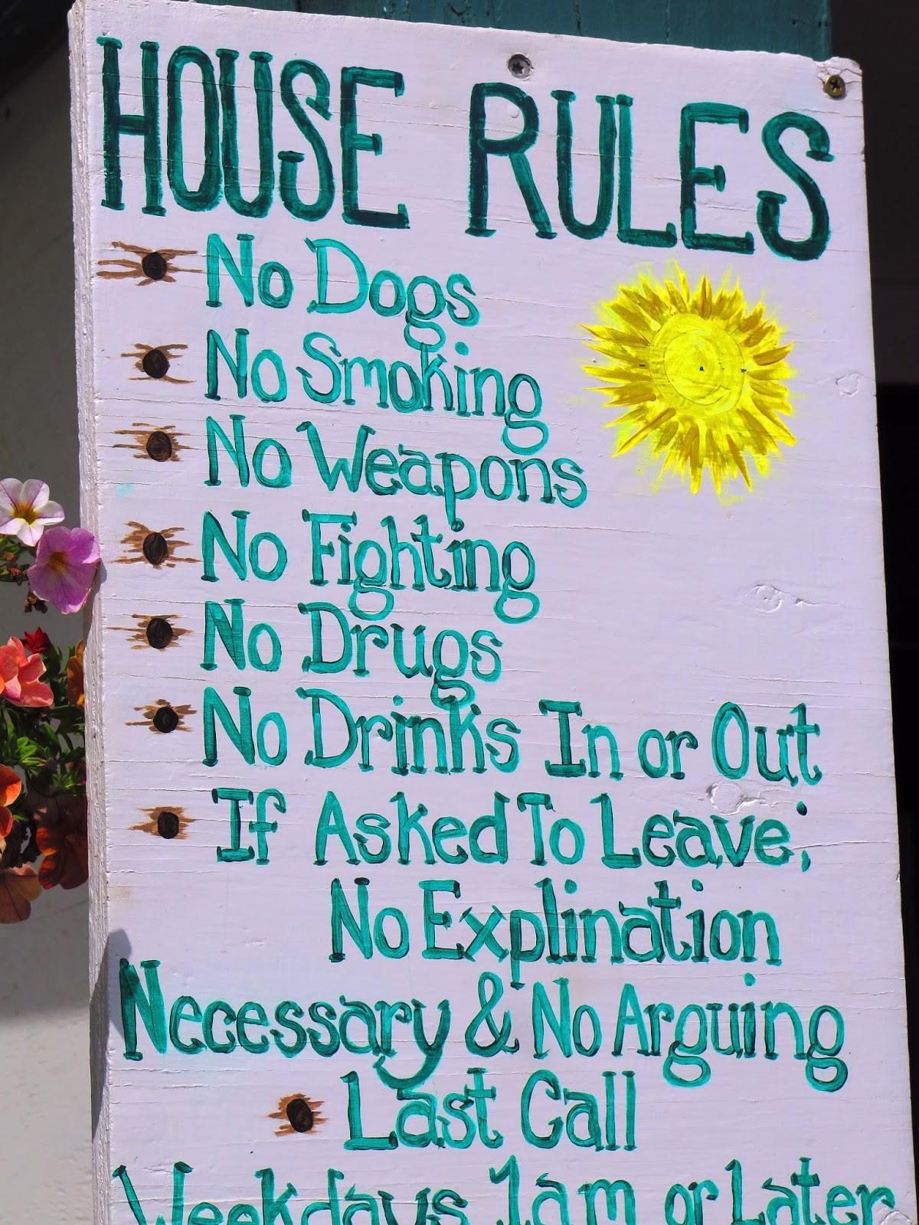
HOUSEMATE AGREEMENT: A Conflict Resolution Platform
The signed Agreement outlines household rules and personal boundaries all roommates agree to respect. If a conflict rises, consult the Agreement to identify, discuss, and re-agree to house rules or add new item to agreement.
SET HOUSE EXPECTATIONS:
Hold an initial Roommate meeting to write down important House Expectations and display in a prominent common area in the house. Re-do the House Expectations as a group activity every time a new roommate moves in.

Slide 29
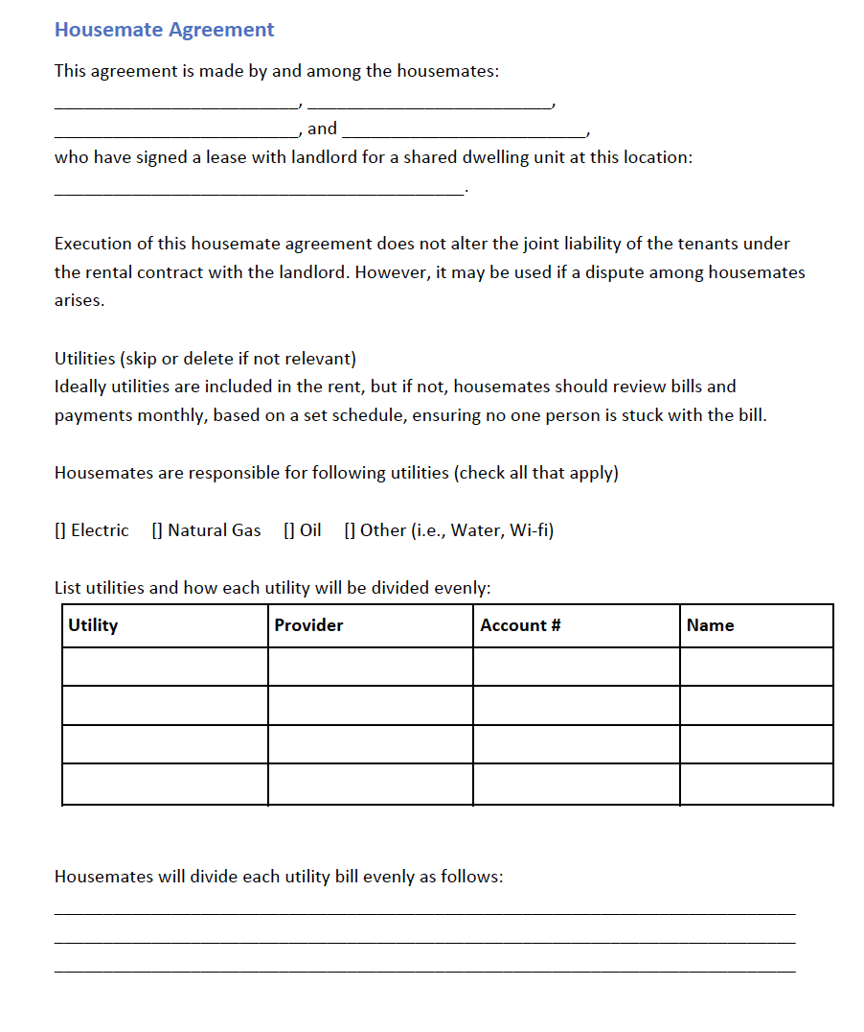
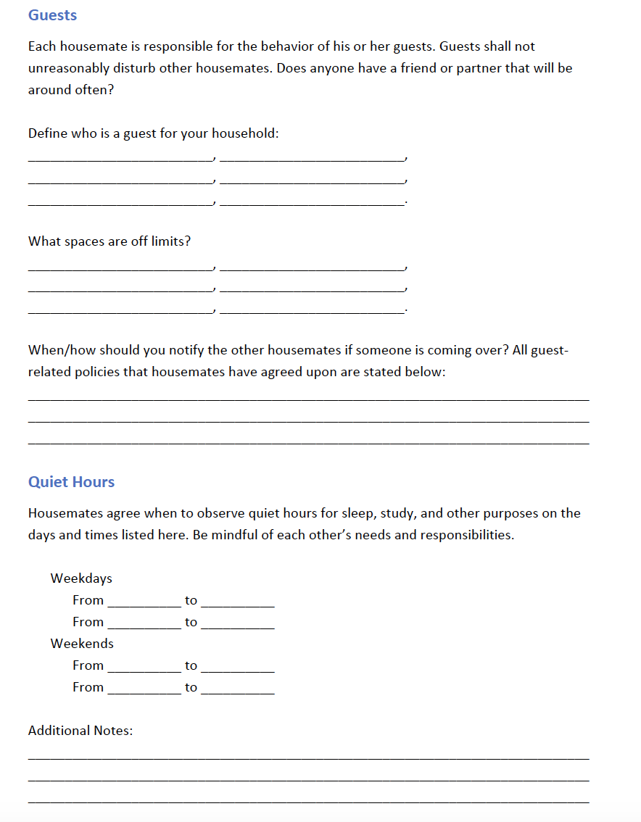

Slide 30
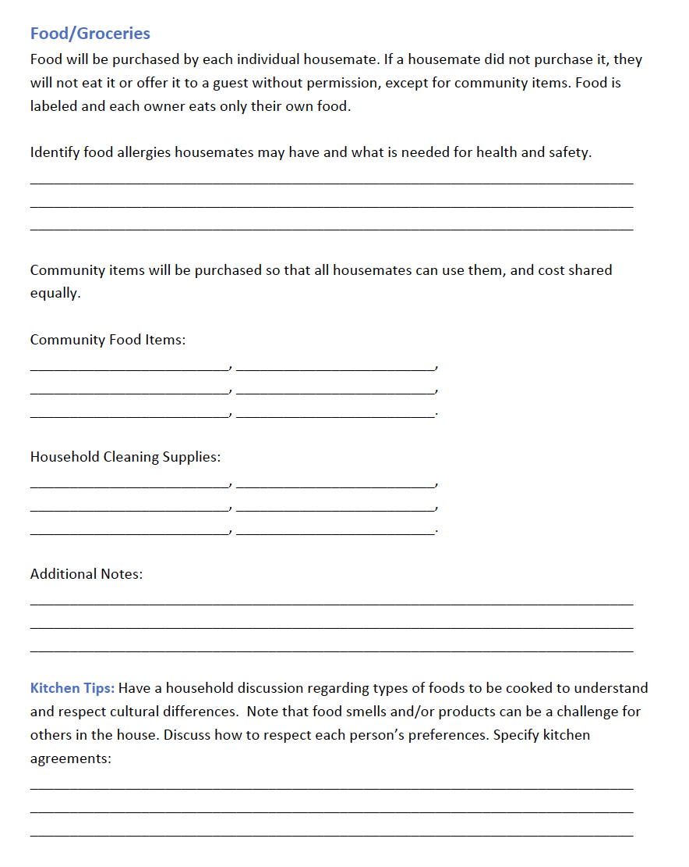
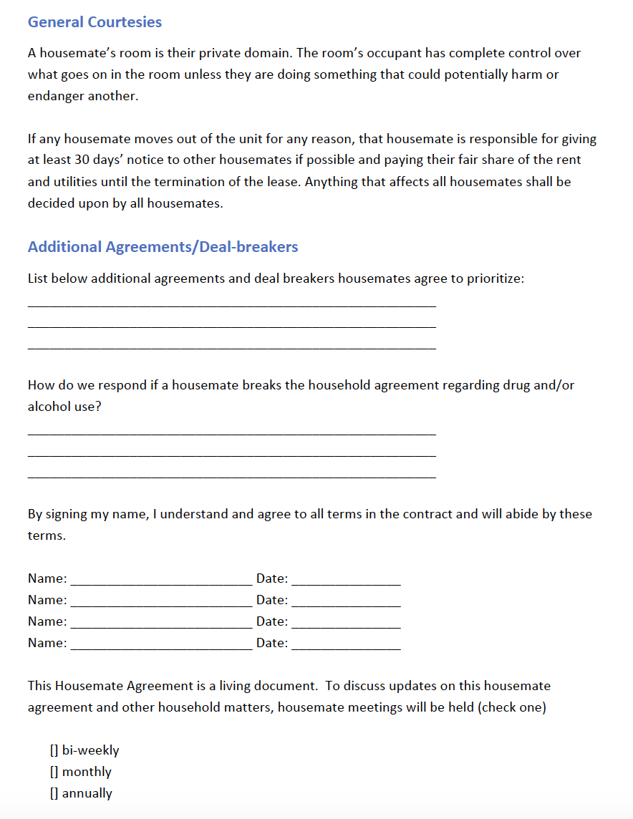

Slide 31
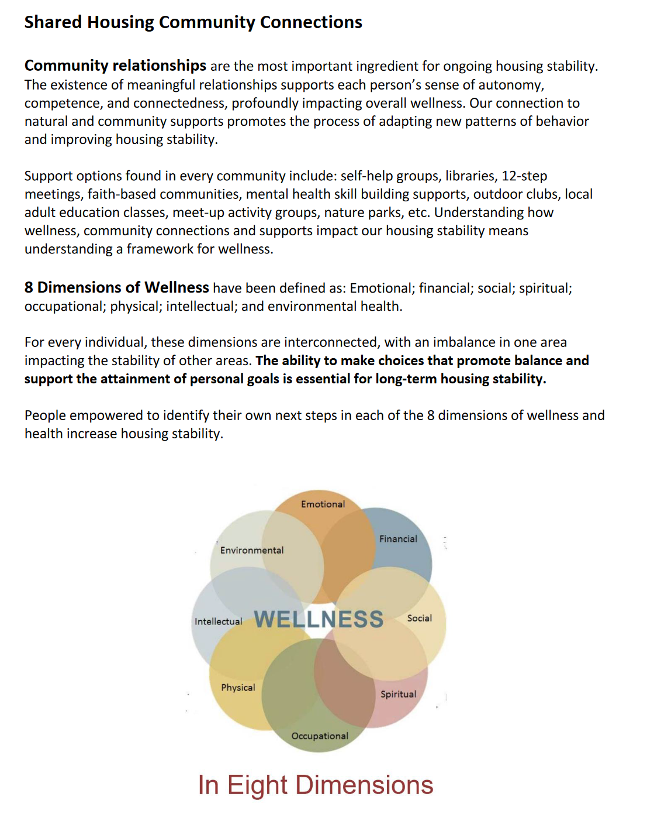
SH Community Connections Tool
Community Connections begin right away once in housing to:
empower clients to identify their own community connection goals
clients self-identify what motivates them to achieve their own goals and monitor progress

Slide 32
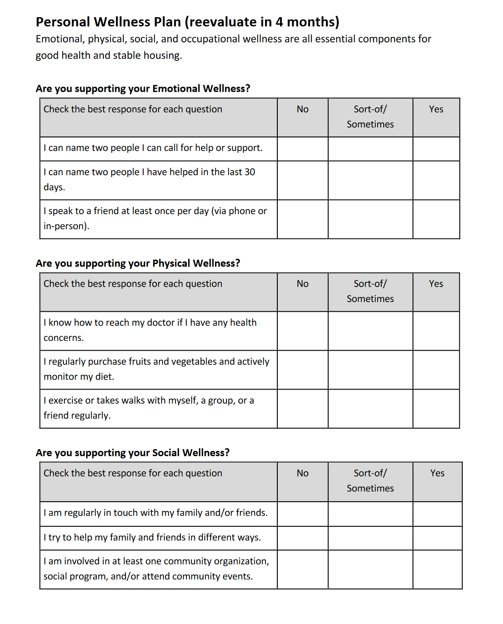
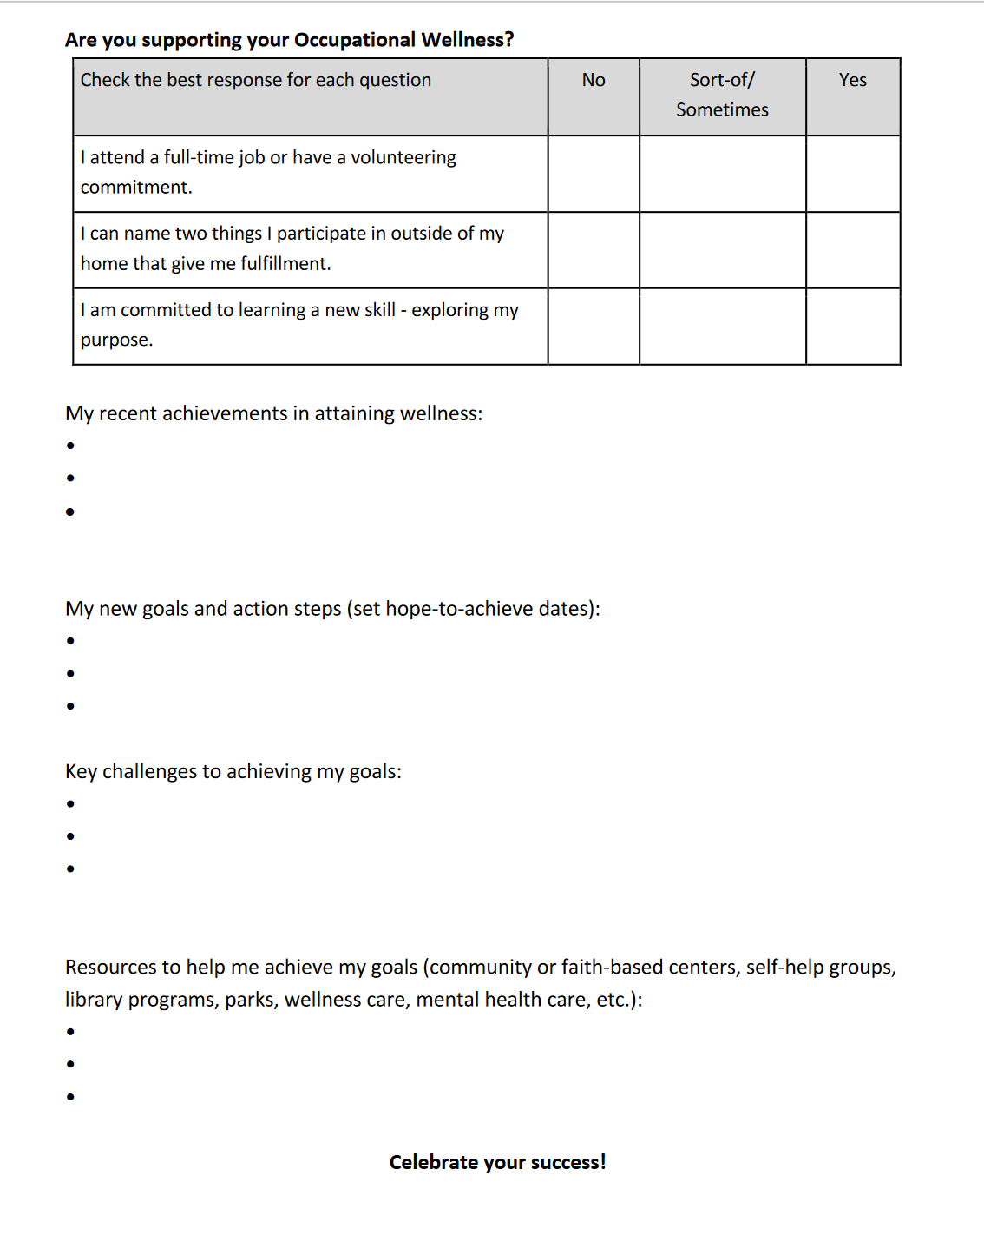

Slide 33
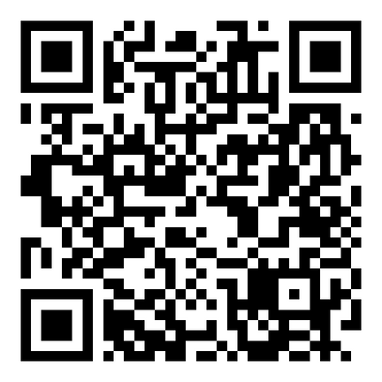
Please complete the post-survey!

Slide 34
Resources and Contact Information
For general Shared Housing Support:
Amber Maiberger
Program Coordinator Sr. ASU Action Nexus
amaiber1@asu.edu
602-543-4489
For Landlord Engagement Support:
Jake Bordelon
Graduate Assistant ASU Action Nexus
jake.bordelon@asu.edu
All resources available at:
https://publicservice.asu.edu/nexus/shared-housing
Join us for our Bi-weekly Case Conferencing on Tuesdays at 1pm!!

