Slide 1
CLIENT DATA
WHAT IS ON FIRE?
Notes:
Client Data - What is on fire?
Quantity vs quality - Pulse Check (narrative/bigger story)
Client feedback loop
Data and evaluation
Community partnership
New opportunities with data
HMIS 2015
Where we were -> where we are going
Unite Us/SharePoint
Mathematica/LEO
Closed feedback loop
Trauma informed
A call to action

Slide 2
Today’s Agenda
About Maggie’s Place
Mission and Vision
Client Data
Where we were
Where we are going
Key Partnerships
Key Projects
A Call to Action
Q&A

Slide 3
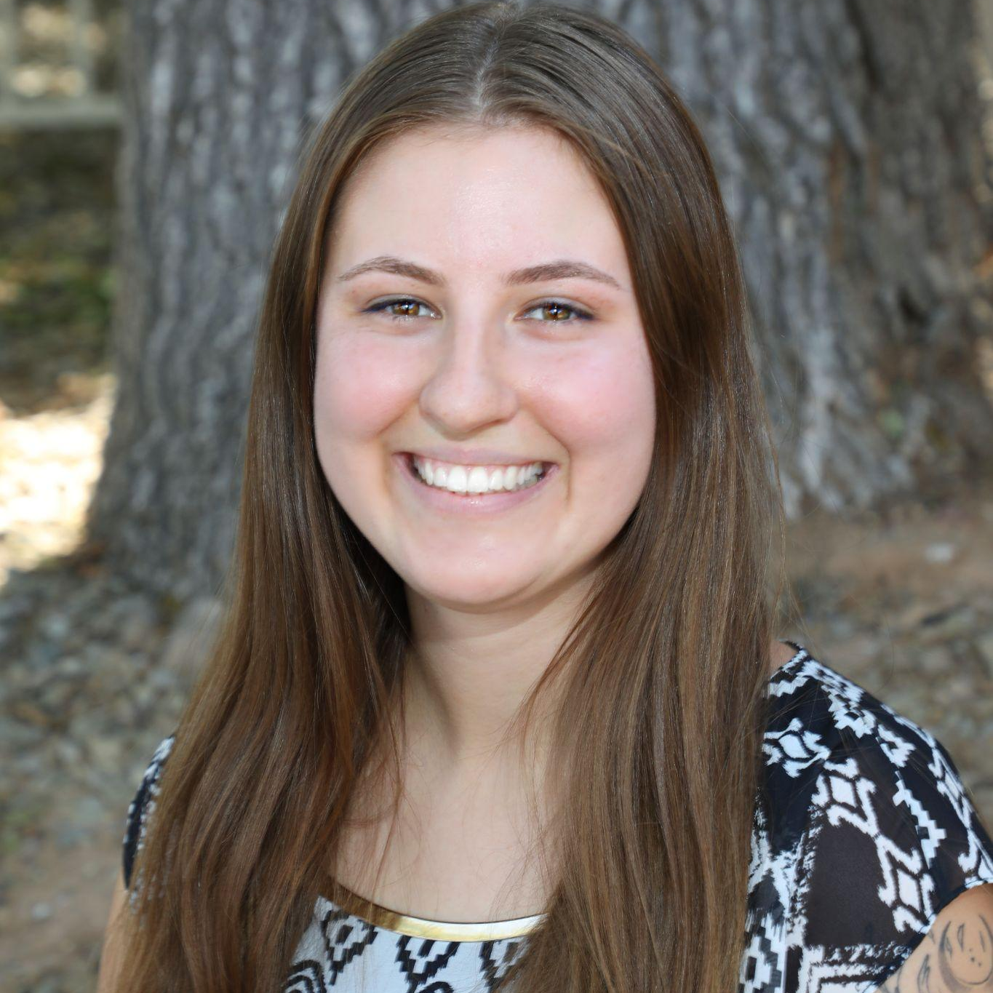
About Us
WHO WE ARE AND WHAT WE DO AT MAGGIE’S PLACE
Alicia Solano Martinez Grants & Program Data Manager
Diana Gioia Data & Evaluation Coordinator

Slide 4
Who we are…
Maggie’s Place was opened in 2000 by five young women in the spirit of Catholic Social Teaching. Our core values of love, hospitality, community, and excellence derive from these principles. Since then, we have served over 1,200 moms and 700 babies. As we have grown over the years, we have remained true to our core values and mission, while proactively seeking to be a community that welcomes and integrates moms, staff and AmeriCorps members from all faith traditions and walks of life around our common purpose.

Slide 5
Our Mission
Our Vision
Maggie’s Place provides safe housing and a nurturing community for homeless pregnant women, empowering them to thrive throughout their lifetime.
Maggie’s Place aspires to be the premier service provider in Maricopa County to our moms, babies and families, breaking the cycle of generational trauma to transform our community.
Notes:
I believe it is important to have balance between our mission and the way we view data to help improve the lives of those in need and future generations.

Slide 6
CLIENT DATA
WHERE WE WERE

Slide 7
Maggie’s Place Data Journey
Grassroots non-profit organization
Social Service Mission (did not want to feel clinical)
Growth over the last 3 years
2015 | Joined HMIS
Impact numbers were LOS, # of individuals served, households, & demographics
Point in Time focused
Emergency Shelter to Semi-long term housing and lifelong community
Exploring the WHY

Slide 8
Key Partnerships
Administration for Children & Families | FSSDD Grant
Supporting Evaluation Efforts for Demonstrations in Self-Sufficiency (SEEDS) project
Mathematica - Data analytic consultants
AmeriCorps | Recovery Coaching Life Cycle Evaluation (LCE) capacity building
University of Notre Dame's Wilson Sheehan Lab for Economic Opportunities (LEO) |
National study on the effectiveness of Maternity Homes and wraparound services
Notes:
FSSDD - Family Self-Sufficiency Demonstration Development

Slide 9
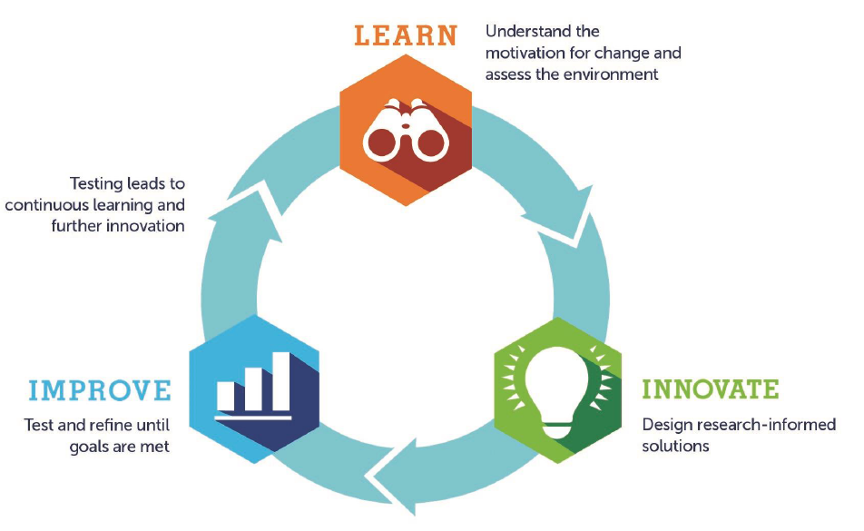
LI² | Learn, Innovate, Improve
Braindump
Road test
Define the solution

Slide 10
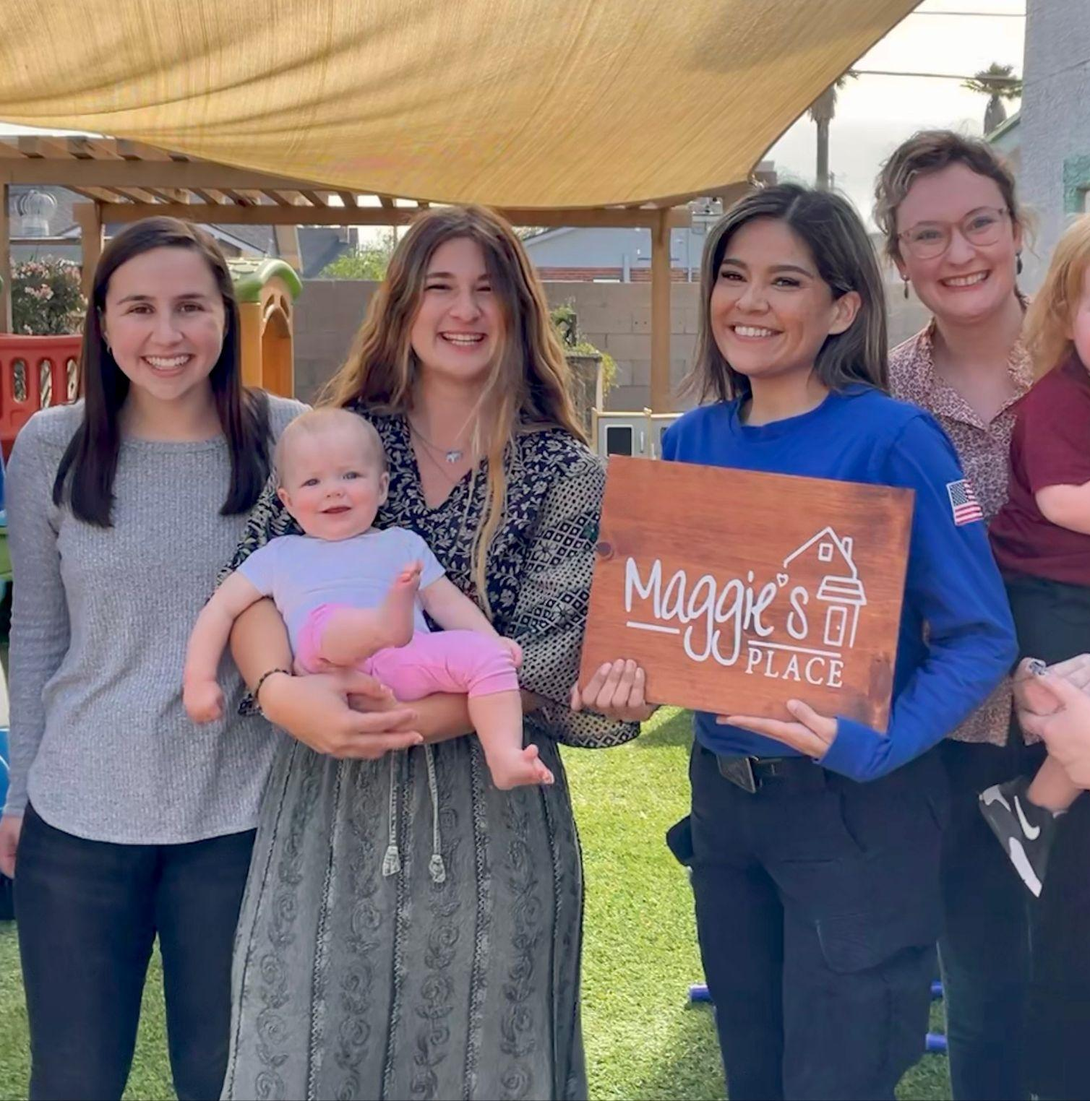
The more data the better, right?
Shift in views of data collection and analysis
Client approach
Quantity vs Quality
Quantitative | Is what we are collecting needed? What is the purpose?
Qualitative | Brainstorming and developing new systems
Data cleanup
Notes:
LOS increase example vs. total # served for the year

Slide 11
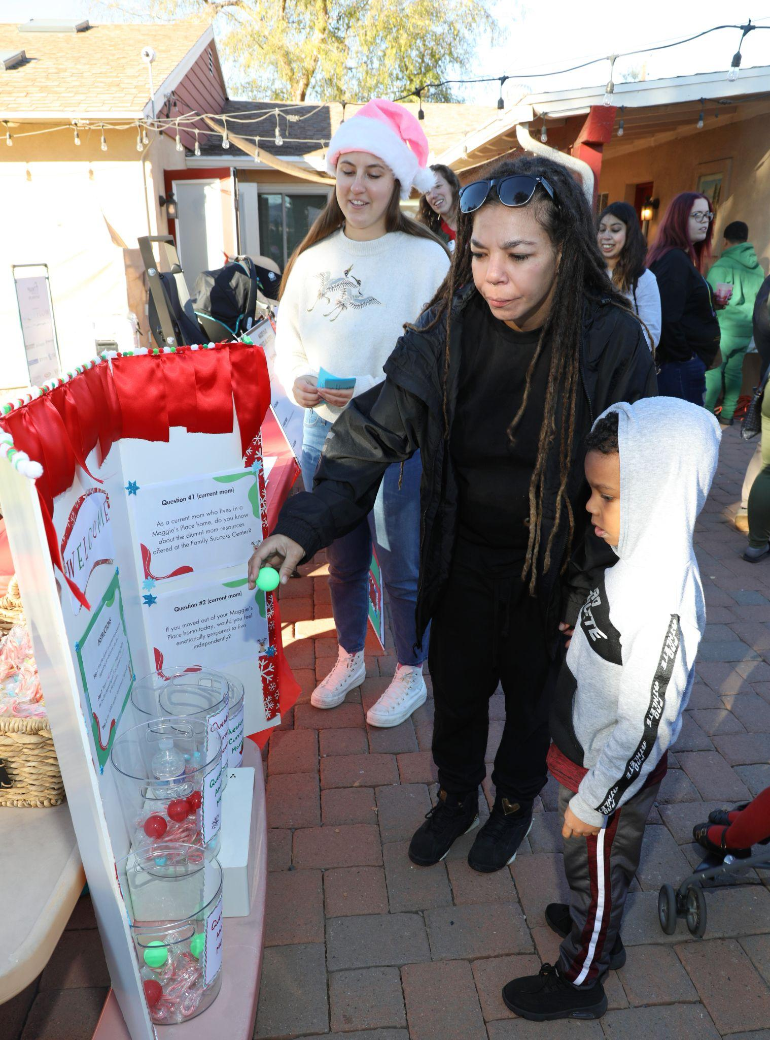
Client Feedback Loop
#1 | ASSESSING PARTICIPANTS NEEDS, PREFERENCES
Mathematica Partnership
Aftercare Logic Model
Pulse Check
Transition Roadmap
Maternity Home Logic Model
#2 | WHAT DO WE DO WITH OUR FINDINGS?
We have a responsibility to respond appropriately and in a timely manner
Make positive changes
Hold others accountable
#3 | BRIDGING THE SERVICE GAP
In the works:
Increase services for youth
Additional programming schedule options
Quality babysitters
Adequate spaces at the Family Success Center

Slide 12
CLIENT DATA
WHERE WE ARE GOING

Slide 13
Data moving forward
Trauma-Informed approach & surveying participants
Data collection intentionality, how we are collecting data matters to help improve outcomes and programs
Regular data analysis, not just a point in time reporting mindset, take a deeper look at year-end numbers and outcomes over time (in-depth/long-term data evaluation)
Research & Evaluation (Mathematica/LEO) work continued (2-5 years)
Additional funding needed to grow in this capacity
Ultimate goal - Improve the narrative of those served and why that matters

Slide 14
Unite Us & SharePoint
First organizational case management platform & referral system
Safe and structured participant data storage
Accountability & follow through for a higher level of care

Slide 15
A call to action!
Access to resources
Contribute to end homelessness by EMPOWERING individuals towards self-sufficiency
Challenge and encourage
We need advocates to continue believing in the mission of caring and serving those in need
Breaking the cycle of poverty
Holistic care approach

Slide 16
“People living in poverty deserve the dignity of evidence”
~Heather Reynolds, Managing Director | LEO

Slide 17
Q&A
What has worked for your organization in the past?
What is something you will take with you from today’s session?
What are some questions you have for us?

