Slide 1






Aﬀordable Housing for Older Adults
An Initiative of the Tucson Housing Foundation, AARP Arizona, the United Way of Tucson and Southern Arizona ELDER Alliance

Slide 2
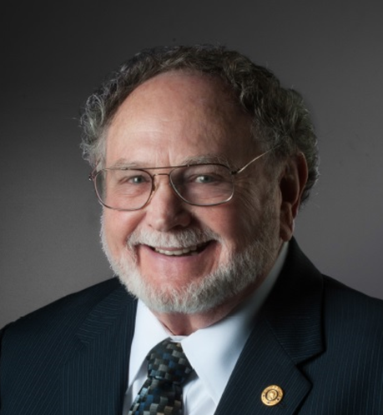
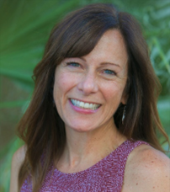
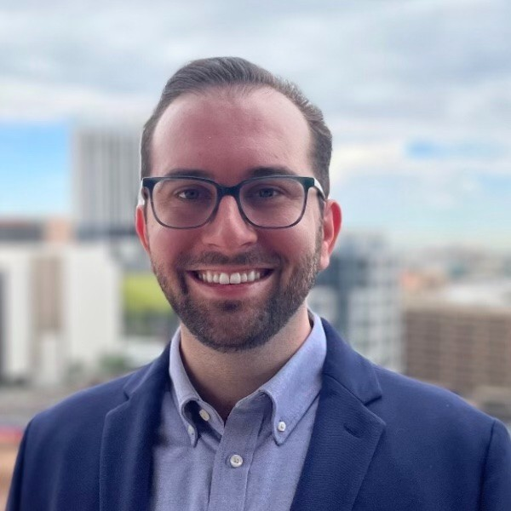

Jim Murphy
Board President
Tucson Housing Foundation
jmurphytsn@gmail.com
Elizabeth Cozzi
AVP Community Development
United Way Tucson
ecozzi@unitedwaytucson.org
Aaron Wodka
Associate State Director, Advocacy & Outreach
AARP Arizona
awodka@aarp.org
Notes:
Liz to introduce speakers

Slide 3
LACK OF HOUSING STOCK REMAINS OUR NUMBER ONE ISSUE
The 65 and older population is the fastest growing demographic since 2010, increasing 34.2% nationally and 48.4% in Arizona.
According to the U.S. Department of Housing and Urban Development’s 2021 Annual Homelessness Assessment Report (Part 2), the number of older adults experiencing unsheltered homelessness is on the rise, with a marked increase in those experiencing chronic homelessness over the past three years.
Adults 65 and older are the fastest-growing age group of people who experience homelessness
Creating housing for older adults that is attainable, accessible, strategically designed and located means that all groups – legislators, developers and advocates – need to prioritize this issue and collaborate.
Notes:
Liz

Slide 4
OUR LOCAL RESPONSE
The ELDER Alliance, housed at the United Way of Tucson and Southern Arizona, AARP Arizona, and the Tucson Housing Foundation, launched an initiative that brings together stakeholders to identify and implement solutions to our affordable housing crisis.
Notes:
Liz

Slide 5

Background/History
A Timeline of Action
Pima Council on Aging partners with the Junior League of Tucson to host Building
2008
A Community for All Ages, a national forum to align affordable housing for older adults with regional planning issues.
The City of Tucson Mayor’s Senior Taskforce hosts Blueprint for Action: Cultivating a Livable Community for Our Region – A Summit to Determine How Pima County’s Aging Population Will Impact Our Community. Resulting in the formation of action teams to address specific issues relevant to older adults…health care, socialization, transportation…and housing.
2013
A group, anchored by the United Way of Tucson and Southern Arizona ELDER ALLIANCE and the Pima Council on Aging, with support from the City of Tucson and AARP Arizona, begin work on creating an action plan that will provide a blueprint for developing age-friendly environments and resources for older adults in Tucson and Pima County.
2014
2019
City of Tucson Mayor and Council adopt Age-Friendly Tucson ACTION PLAN 2019-2024 as best-practice – the most significant recommendation being to create more affordable housing for very low to moderate income older adults through partnerships and collaborations with community organizations.
The Affordable Housing Summit was conceived to gather and share information and best-practices for the creation of affordable housing options in Pima County. This initiated momentum in creating community-led, data-informed approaches to address the multiple factors impacting housing security in the region. It was a success!
2021
As an outcome of the summit, The Affordable Housing Alliance of Older Adults was formed and launched the Affordable Housing for Older Adults Initiative.
The mission of the group is to develop an affordable housing initiative that prioritizes
the needs of the community’s most vulnerable members – lower-income older adults – and to create a model for community-wide collaboration.
The goal of the initiative is to serve as a resource for communities, nonprofits, public and private development entities, and local jurisdictions interested in creating or supporting efforts to develop affordable housing options that meet the specific needs of older adults.
2
Notes:
Jim

Slide 6

Q: Why do we need an initiative that focuses
Focus
on older adults?
_{A:} Older adults’ needs are more prevalent
than the general population.
Accessibility and Assistance
Older adults are more likely to have changes in mobility that limit their ability to climb stairs, bend down, reach up, etc. They may also be confined to a wheelchair, requiring wider entries and hallways.
These limitations require assistance with daily living activities while wanting to remain relatively independent.
Universal design features should be standard in all housing that older adults may occupy, with flexibility to accommodate in-home caregivers and medical technological assistance features.
Aging in Place
Older adults are less adaptive to change and can be adversely affected by the stress of moving. Surveys have shown that most older adults prefer to stay in their present residence as long as possible.
6
Notes:
Jim

Slide 7


Focus
Stagnant Income Sources
Older adults are often reliant on fixed income sources
that do not adjust significantly during inflationary periods.
Social Security is inadequate to accommodate
$
and slow to respond to local and national economic trends, including annual cost of living increases.
$
$
Fixed incomes cannot absorb significant
?
market-rate rent increases.
Safety and Security
Because of their physical limitations and sometimes declining cognitive abilities, older adults are highly vulnerable and need to live in a place where they can feel safe.
Social Interaction
As they age, older adults often lose friends and relatives, which can limit social contacts and adversely affect mental health. Housing for older adults should be designed to include access to a wide variety of activities that encourage social interaction.
7
Notes:
Jim

Slide 8


Transportation
Focus
Older adults often must give up driving several years before they die, requiring reliance on others to get to appointments, go shopping, visit friends, etc. Their homes should be located near public transportation if they live independently, and routes to stops should be easy to traverse.
Alternatively, on demand/dial-a-ride transit service should be available.
Health, Wellness and Medical Needs
Older adults require housing accessible to resources that support psychological and physical well-being, with particular proximity to resources that alleviate food insecurity.
Financial Vulnerability
Older adults are at risk of financial exploitation and predatory practices that contribute to housing instability.
8
Notes:
Jim

Slide 9

Action
The Affordable Housing Alliance for Older Adults Issue Teams and community advocates identified the following priority areas for alleviating barriers and creating pathways to the creation of diverse and sustainable affordable housing options for older adults.
Land Use and Zoning
Complete Streets
Priority Areas
Repurposing and Adaptive Reuse
Universal Design and
Visibility Code
Funding
Rental Increase Limits
Transit Oriented Development
Data Collection and Analysis
Q:
How do we address the barriers to affordable housing for older adults?
9
Notes:
Jim

Slide 10
STEERING COMMITTEE
Jim Murphy, Elder Alliance & Tucson Housing Foundation
Bill Mackey, University of Arizona
Liz Cozzi, United Way Tucson
Aaron Wodka, AARP Arizona
Micah Chetrit, United Way Tucson
Notes:
Aaron
Our approach was to form a committee to shepherd the work onward following publication of the initiative document.

Slide 11
MAJOR ACTION TO DATE BY THE
AFFORDABLE HOUSING ALLIANCE for OLDER ADULTS
Championed the Pima County central affordable housing dashboard
Advocated that City of Tucson amend its code to allow Accessory Dwelling Units (ADUs) in all single family residential zones
Advocated for a Pima County code amendment relaxing requirements for guest houses
Obtained an outside audit of City of Tucson Development Code resulting in recommended amendments. Presented suggested reforms to Tucson City Council Members
Hired Universal Design contractors to educate City and County Staff on modernizing Universal Design Standards
Hosted Housing Roundtable (Mayor of Tucson and other stakeholders), Priority Session (housing advocates), and the Affordable Housing Summit II (ELDER Alliance, community members)
Notes:
Aaron

Slide 12
MOVING THE NEEDLE -
ACCOMPLISHMENTS TO DATE
LAND USE AND ZONING
Expanded use of Individual Parking Plan (IPP) for affordable housing developments by city
Tucson Mayor and Council approved code amendments to allow for more development of attached single family houses
Tucson AARP challenge grant to create pre-approved accessory dwelling unit designs to encourage uptake
Code amendments that encouraging redevelopment of underused land in retail corridors with mixed uses including affordable housing under consideration
Several overlay districts are in effect in the City of Tucson that support higher density, mixed use, and diverse infrastructure including housing that is close to transportation and other amenities
Plan Tucson has invited broad, public participation and interested individuals can serve on committees include those related to affordable housing
Notes:
Aaron

Slide 13
MOVING THE NEEDLE -
ACCOMPLISHMENTS TO DATE
REPURPOSE & ADAPTIVE REUSE
City of Tucson and Pima County staff are inventorying city and county properties that could be made available for development of affordable housing
FUNDING
City of Tucson and Pima County have allocated supplemental federal dollars to selected Low Income Housing Tax Credit (LIHTC) projects
Pima County intends to make $5 million available annually for low-income projects
City of Tucson established El Pueblo Housing Development, a city run nonprofit, to facilitate the development of affordable housing
City of Tucson was awarded $50 million in federal funding from HUD to create three new affordable housing developments and rehabilitate the Tucson House which primarily serves those 55 and older
Notes:
Aaron

Slide 14
ACTION STEPS
The Alliance will continue to advocate for best practices and innovative housing options, centering the needs of older adults in our region.
Current efforts include:
Supporting an affordable housing bond initiative
Identifying sustainable financial streams for the city of Tucson Housing Trust Fund
Advocating for continued streamlining of zoning processes and building requirements
Championing code reforms
Hosting three upcoming stakeholder sessions on alternative housing options
Leading citizen engagement around zoning, planning, voting, etc.
PROVIDING INPUT INTO CONVERSATIONS ABOUT WHAT WILL BE BUILT ARE CRITICAL – SHOW UP AND SAY “BUILD IT!!”
Notes:
Liz

Slide 15
ALTERNATIVE HOUSING SEMINAR SERIES
Connect with like-minded advocates and learn about innovating housing options from national and local speakers!
Seminar #1: Cohousing
March 5, 2024
Registration information HERE:
https://events.aarp.org/event/63d21aaf-e142-4dd3-aa27-9abfe3e82dae/summary?locale=en
Seminar #2: Home Sharing
April 2, 2024
Seminar #3: Resident Owned Comunities
May 23, 2024
Notes:
Aaron
Our approach was to form a committee to shepherd the work onward following publication of the initiative document.

Slide 16
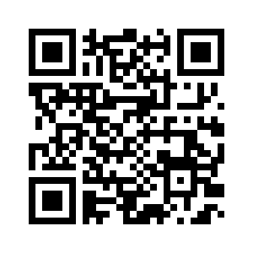
To read the initiative and access additional resources, please navigate to:
https://unitedwaytucson. org/affordable-housing/
QUESTIONS?
Notes:
Liz

Slide 17
Jim Murphy
Board President
Tucson Housing Foundation
jmurphytsn@gmail.com
Elizabeth Cozzi
AVP Community Development
United Way Tucson
ecozzi@unitedwaytucson.org
Aaron Wodka
Associate State Director, Advocacy & Outreach
AARP Arizona
awodka@aarp.org
Notes:
Liz to introduce speakers

