Slide 1
Re-Imagining Affordable Housing
Creating Housing That Breaks Boundaries and Changes Communities

Slide 2
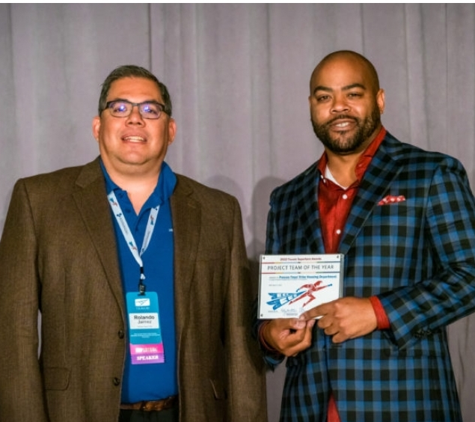
Who Are We?
Keith Gregory – Director of Housing, Pascua Yaqui Tribe
Rolando Jaimez – Deputy Director of Housing, Pascua Yaqui Tribe
Combined 34 years of affordable housing experience
Combined have 14 successful tax credit developments completed
Developers of the 2 largest tax credit project ever awarded to a Tribe in US history

Slide 3
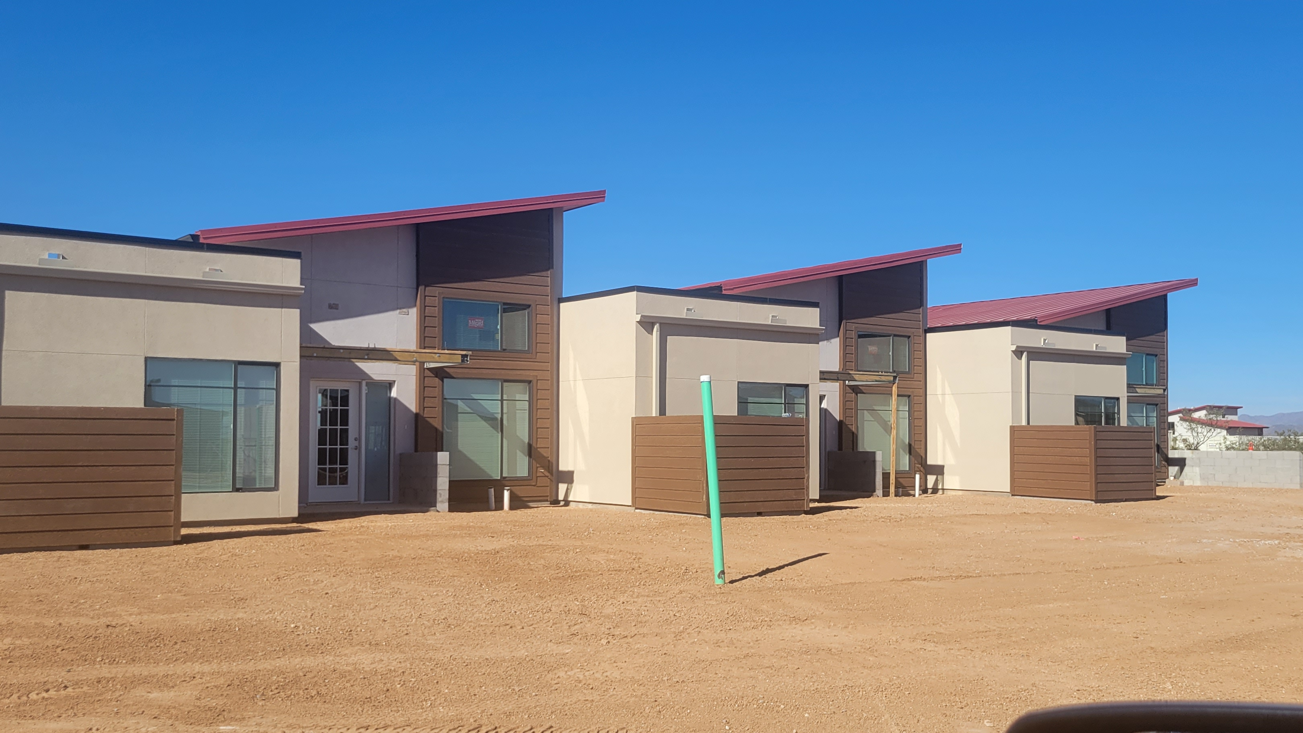
Re-Imagining Affordable Housing
Creative Solutions to Homelessness and Affordable Housing

Slide 4
Hopeworks Station North (Everett, WA) Beacon Group
65 studio & 1 bedroom units targeted to homeless youth and veterans earning 30% to 50% AMI
532 solar panels generate 198,000 kWh of electricity each year
Net Zero Energy

Slide 5
Warley Park (Sanford, FL) Wendover Housing Partners
Central Florida’s 1st permanent supportive housing community
81, one and two bedroom apartments for homeless individuals and families
Includes mental health care, job training programming, and after school care

Slide 6
PATH Metro Villas (Los Angeles, CA) PATH Ventures
186 Studios and 1 Bedroom Units
Includes veteran’s services, a teaching kitchen, and mental health clinics
Target population is veterans and homeless persons

Slide 7
Re-Imagining Affordable Housing
Creative Construction Methods/Materials

Slide 8
KIND Project
Mass Timber Project
148 Micro Units
Mass timber reduces carbon footprint, is healthier for occupants, and is a sustainable material.
Faster construction timelines due to lower weight of timber over steel/concrete.

Slide 9
Sparkbox Housing Project
Repurposed Shipping Containers
Focused on homeless housing
Environmentally friendly
Self-Powered (Rooftop Solar)

Slide 10
3D Printed Housing
Cuts labor costs
Printer can work 24/7
Printed materials are more sustainable

Slide 11
Re-Imagining Affordable Housing
Outstanding Design

Slide 12
Savonnerie Haymans (Belgium)

Slide 13
Torre Plaça Europa (Barcelona)

Slide 14
Housing Hatert (Netherlands)

Slide 15
Questions ($5 each)

